Slide 1
Telehealth to Reduce Overcrowding in the Emergency Department
Jerod S. Bell
Walden University
NURS 6231, HC Systems & Quality Outcomes
Dr. Gloria Beecher
July 5, 2023

Slide 2
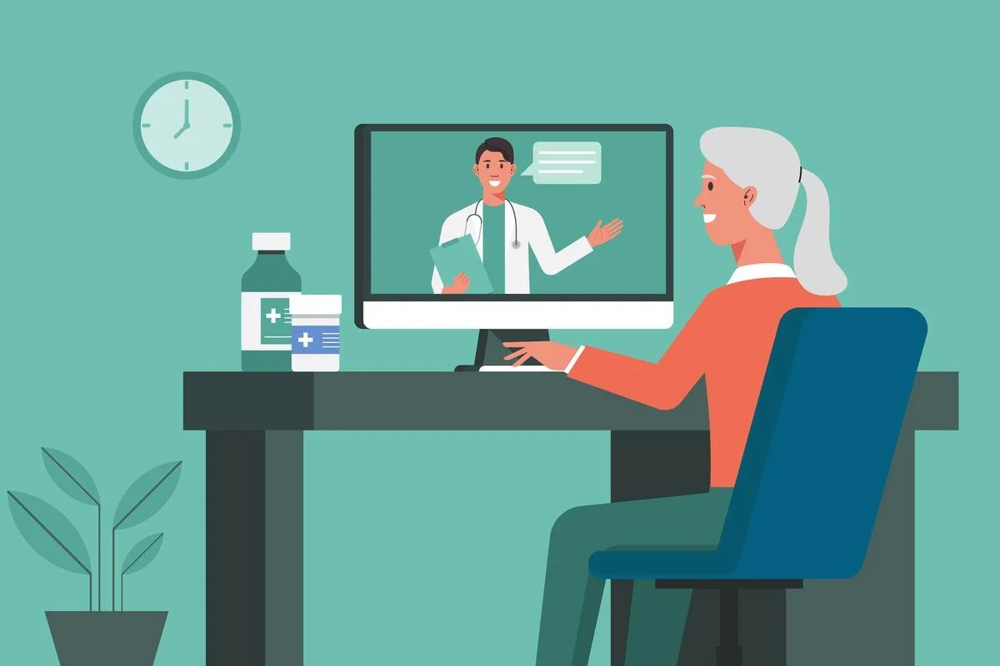

Telehealth to reduce overcrowding in the emergency department
The healthcare industry is experiencing significant changes in recent times.
Therefore, change is essential for the success of medical facilities (Nilsen et al., 2020).
Overcrowding in the emergency department has affected care provision, and significant changes must be made to ensure enhanced care provision.
Notes:
The healthcare industry is experiencing significant changes in recent times. There are many emerging processes due to the advancing technology aimed at meeting the changing demands of people. Therefore, change is essential for the success of medical facilities (Nilsen et al., 2020). As technology and other factors change, medical facilities must change to meet regulatory needs and keep pace with innovation. Thus, in my recent place of work, there are several problems that the facility needs to address to ensure it keeps pace with competitors. However, overcrowding in the emergency department has affected care provision, and significant changes must be made to ensure enhanced care provision.

Slide 3
Major problem and importance of addressing
Over time, the emergency department in my clinic has been overcrowding.
Many patients are in the wait line daily with non-urgent cases.
These congestions have resulted in increased complaints from the providers that they have difficulty addressing many clients daily.
Thus, there is necessary to address this issue to ensure that critically ill patients are not subjected to long wait times and that the staff has enough time to deal with patients.
Notes:
Over time, the emergency department in my clinic has been overcrowding. Many patients are in the wait line daily with non-urgent cases. These congestions have resulted in increased complaints from the providers that they have difficulty addressing many clients daily. Moreover, overcrowding has affected the ability to provide care to those in need in a timely way. Thus, there is necessary to address this issue to ensure that critically ill patients are not subjected to long wait times and that the staff has enough time to deal with patients. Also, addressing the issue will save less urgent patients wastage of time and money traveling to the facility.

Slide 4
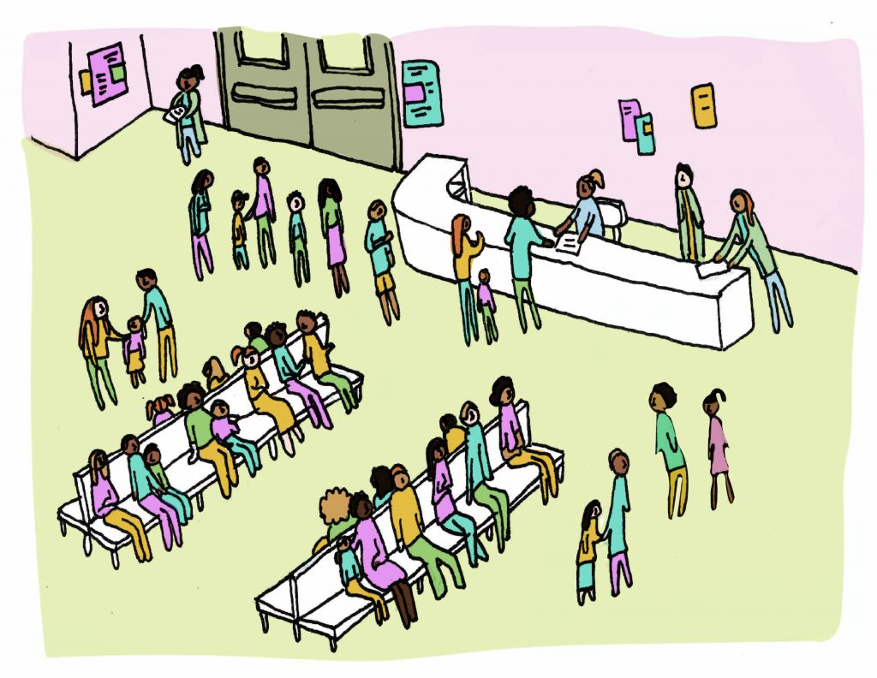
Research
As Alfaleh et al. (2022) explain, ED overcrowding is one of the major challenges many facilities experience.
Although the article explains that overcrowding may sometimes occur due to staff shortages, that is different in my facility.
The major problem that has caused overcrowding is the less-urgent patients visiting the ED.
That affects care provision and increases the risk to those in care need.
Notes:
As Alfaleh et al. (2022) explain, ED overcrowding is one of the major challenges many facilities experience. Majorly, the problem arises when medical providers cannot address many patient problems at the right time. Although the article explains that overcrowding may sometimes occur due to staff shortages, that is different in my facility. The major problem that has caused overcrowding is the less-urgent patients visiting the ED. A patient may visit the ED with a major problem, but after treatment, they return to the facility due to minor challenges. That affects care provision and increases the risk to those in care need.

Slide 5
Research
Sharifi Kia et al. (2022) did research to identify major solutions to the issue of overcrowding in ED.
According to the article, emergency departments are among the major departments in any medical facility.
Therefore, less urgent patient overcrowding in the department can affect care quality and increase fatality rates for people with urgent care needs.
Notes:
Sharifi Kia et al. (2022) did research to identify major solutions to the issue of overcrowding in ED. According to the article, emergency departments are among the major departments in any medical facility. Their performance has a significant impact on other departments in medical facilities. Many people need critical care annually in America, just like in our facility, and only emergency departments can provide care to these patients. Therefore, less urgent patient overcrowding in the department can affect care quality and increase fatality rates for people with urgent care needs.

Slide 6

Research
According to research by Sartini et al. (2022), overcrowding in EDs is a global challenge that poses major challenges to medical facilities.
According to the authors, the main purpose of emergency departments is to address urgent medical problems that require quick diagnosis.
Many factors contribute to overcrowding, such as poor services and delayed transfers.
However, less urgent patients have been major contributors to overcrowding.
Notes:
According to research by Sartini et al. (2022), overcrowding in EDs is a global challenge that poses major challenges to medical facilities. According to the authors, the main purpose of emergency departments is to address urgent medical problems that require quick diagnosis. Therefore, overcrowding in the department has proven to affect care provision and the timely management of these urgent cases. Many factors contribute to overcrowding, such as poor services and delayed transfers. However, less urgent patients have been major contributors to overcrowding.

Slide 7
Telehealth to address overcrowding
Based on the research above, telemedicine is the proposed innovation to address the issue of overcrowding in the emergency department.
Telemedicine is a low-cost means of ensuring that patients with non-urgent illnesses get treatment from a physician as soon as feasible.
Instead of spending time in the emergency department, these patients may get treatment remotely
As Alfaleh et al. (2022), integrating telehealth in the ED has reduced overcrowding and unnecessary visits.
Notes:
Based on the research above, telemedicine is the proposed innovation to address the issue of overcrowding in the emergency department. Telemedicine is a low-cost means of ensuring that patients with non-urgent illnesses get treatment from a physician as soon as feasible. Furthermore, it is ideal since it increases convenience for individuals with non-urgent diseases. Instead of spending time in the emergency department, these patients may get treatment remotely, reducing the time it takes to see a clinician and the length of stay. As Alfaleh et al. (2022), integrating telehealth in the ED has reduced overcrowding and unnecessary visits. For instance, a patient with back pains would not need to visit the department, but a video call with the physician would help evaluate the situation and find a solution.

Slide 8

The potential impact of telehealth on patient experience
The major impact of the innovation is that it can significantly reduce the time a patient wastes waiting to see a clinician.
For instance, a patient nursing a leg fracture will not need to visit the ED for a checkup.
In video communication, the provider will ensure timely and regular follow-ups.
That will increase patient-doctor interaction which creates a positive patient experience.
Notes:
The major impact of the innovation is that it can significantly reduce the time a patient wastes waiting to see a clinician. More individuals will be able to get treatment faster, reducing the number of individuals in the ED daily. Fewer patients in the ED will improve the facility's safety, and faster care will improve patient contentment. Moreover, patients with less urgent needs will have a humble time interacting with the physician since the professional will not be quick to address a long line. For instance, a patient nursing a leg fracture will not need to visit the ED for a checkup. In video communication, the provider will ensure timely and regular follow-ups. That will increase patient-doctor interaction which creates a positive patient experience.

Slide 9
The potential impact of telehealth on outcomes
One of the ways that the innovation will improve outcomes is through disease management.
Telehealth will help less-urgent patients communicate with their providers and follow care plans effectively without needing in-person visits.
Moreover, many in-person visits happen when patients experience adverse effects from medication.
However, with telehealth, it will be easy to communicate with the provider and change medication on time.
Notes:
One of the ways that the innovation will improve outcomes is through disease management. Having a condition does not necessarily require visiting medical facilities to receive care. Telehealth will help less-urgent patients communicate with their providers and follow care plans effectively without needing in-person visits. Moreover, many in-person visits happen when patients experience adverse effects from medication. However, with telehealth, it will be easy to communicate with the provider and change medication on time. Such ways will improve outcomes since care guidance is done promptly.

Slide 10
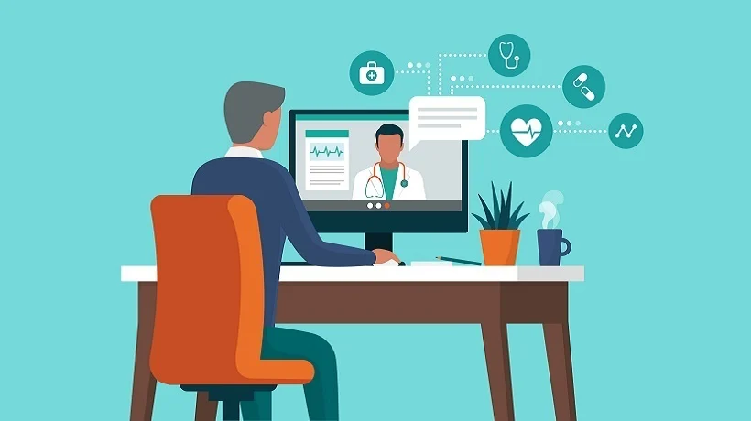
Applying telehealth in the clinic
To integrate innovation in the facility, there needs several considerations.
The facility must categorize the already available patients as urgent or less urgent.
The next thing would be integrating the telehealth network in the facility.
The other step would be educating staff members in the facility about using the technology and allocating them to various roles.
Next would be educating all patients to be enrolled in the system about its use, best practices, and benefits.
They would then create profiles and start using the system.
Notes:
Based on research, as Mechanic etal. (2022) explain, telehealth uses virtual-based platforms to deliver care. Therefore, to integrate innovation in the facility, there needs several considerations. The facility must categorize the already available patients as urgent or less urgent. The next thing would be integrating the telehealth network in the facility. The network should ensure adherence to patient data privacy and security. The other step would be educating staff members in the facility about using the technology and allocating them to various roles. Next would be educating all patients to be enrolled in the system about its use, best practices, and benefits. They would then create profiles and start using the system.

Slide 11
Conclusion
Overcrowding is one of the major problems medical facilities experience.
My facility has been experiencing the same challenge, especially in the emergency department.
The main cause of the overcrowding is the lack of any alternative where less urgent patients would access care without the need to visit the department.
However, based on research, integrating telehealth in the facility would help address the challenge.
Patients with less demanding needs can easily consult the provider at home, improving their experience and outcomes.
Notes:
Overcrowding is one of the major problems medical facilities experience. My facility has been experiencing the same challenge, especially in the emergency department. The main cause of the overcrowding is the lack of any alternative where less urgent patients would access care without the need to visit the department. However, based on research, integrating telehealth in the facility would help address the challenge. Patients with less demanding needs can easily consult the provider at home, improving their experience and outcomes.

Slide 12
References
Alfaleh, A., Alkattan, A., Alageel, A., Salah, M., Almutairi, M., Sagor, K., & Alabdulkareem, K. (2022). The role of telemedicine services in changing users’ intentions for presenting to the emergency departments in Saudi Arabia. Digital Health, 8, 20552076221091358. https://journals.sagepub.com/doi/full/10.1177/20552076221091358
Mechanic, O. J., Persaud, Y., & Kimball, A. B. (2022). Telehealth Systems. FL. https://www.ncbi.nlm.nih.gov/books/NBK459384/
Nilsen, P., Seing, I., Ericsson, C., Birken, S. A., & Schildmeijer, K. (2020). Characteristics of successful changes in health care organizations: an interview study with physicians, registered nurses and assistant nurses. BMC health services research, 20, 1-8. https://bmchealthservres.biomedcentral.com/articles/10.1186/s12913-020-4999-8
Sartini, M., Carbone, A., Demartini, A., Giribone, L., Oliva, M., Spagnolo, A. M., ... & Cristina, M. L. (2022, August). Overcrowding in emergency department: causes, consequences, and solutions—a narrative review. In Healthcare (Vol. 10, No. 9, p. 1625). MDPI. https://www.mdpi.com/2227-9032/10/9/1625
Sharifi Kia, A., Rafizadeh, M., & Shahmoradi, L. (2022). Telemedicine in the emergency department: an overview of systematic reviews. Journal of Public Health, 1-15. https://www.ncbi.nlm.nih.gov/pmc/articles/PMC8791673/

