Slide 1
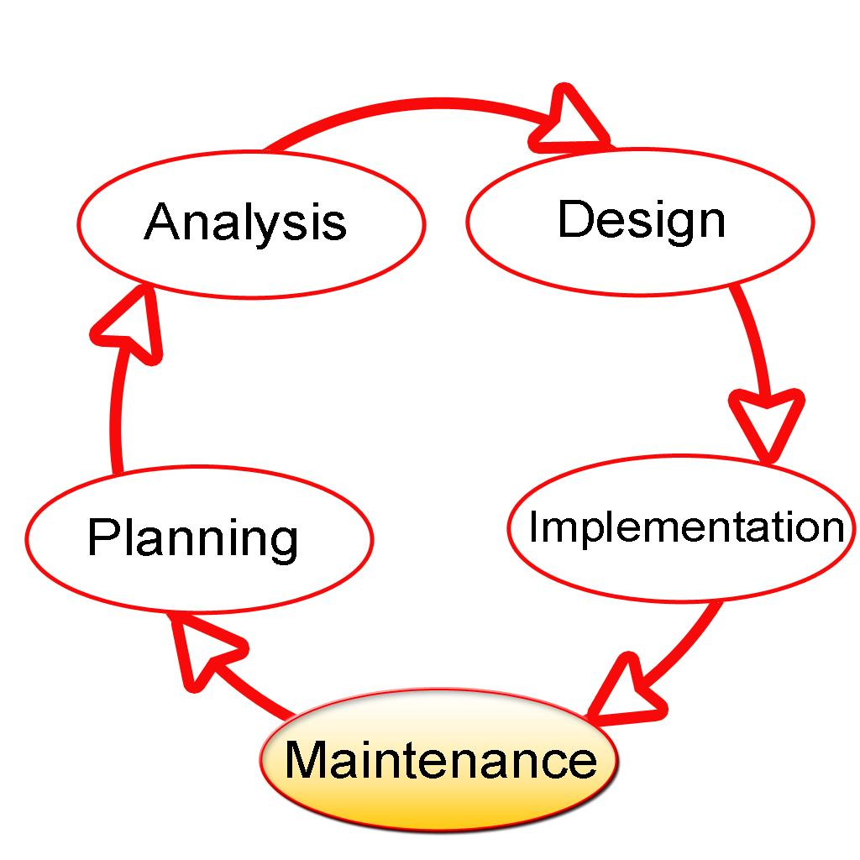
Systems Development Life Cycle
Gloria Ibe, Neville Ibit, Latisha Lobban, Brian Pizzaro, Adrianna Ruger, Satya Tadepalli

Slide 2
Contents
Overview
History and details
Importance in healthcare IT
Systems analysis and design
Step by Step Importance
Life cycle

Slide 3
Overview
Brian

Slide 4
History and details
Fallon

Slide 5
Importance in Healthcare IT
Gloria
Notes:
Consider talking about:
System investigation
Analysis
Design
Environments
Testing
Training and transition
Operations and maintenance
Evaluation

Slide 6
Systems analysis and design
Latisha

Slide 7
Step by Step Importance
Neville

Slide 8
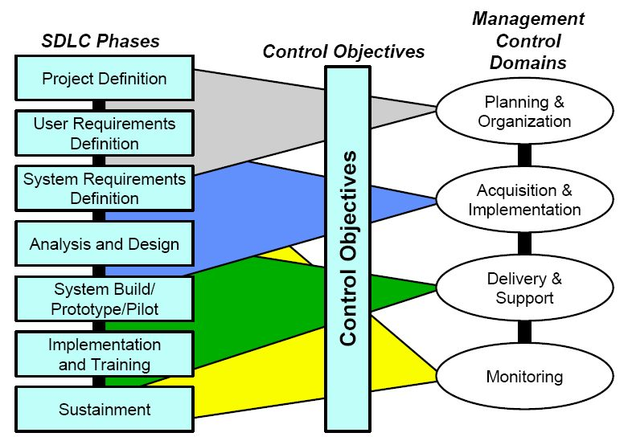
Life cycle
Satya
Notes:
Consider talking about:
Management and control
Work breakdown structured organization
Baselines
Complementary methodologies

Slide 9
Works cited

