Slide 1
Qualitative Data Analysis
Tutorial

Slide 2
What is a Code?
“the most basic segment, or element, of the raw data that can be assess in a meaningful way regarding the phenomenon” (Boyatzis, 1998: 63)
Codes are a way of condensing a sentence (or group of sentences) into a meaningful synopsis of its direct or indirect meaning
Summative Code – a code that ‘sums up’ what the sentence/group of sentences is about, e.g. a minute summary, poor leadership, known about, not talked about, turned a blind eye.
Evocative Code – a code that highlights what meaning(s) the sentence evokes, but doesn’t necessarily say directly eg emotive, angry, helplessness, worthless, victimised

Slide 3
From Codes to Categories
Over time and during repeated coding, you will end up with many, many codes
These codes can then be grouped into categories (also called ‘2nd order codes or axial codes)
Categories are like a label that describes the codes within the category, are therefore by necessity broader than the codes, which are quite specific
E.g. if your codes were
‘Anger about X’,
‘Fear over the consequences of X’
Surprise that X happened’
Then these could all be grouped in the category ‘Emotions concerning X’

Slide 4
Levels of Analysis
Codes = Micro level
Category = Meso level
Themes/concepts = Macro Level

Slide 5
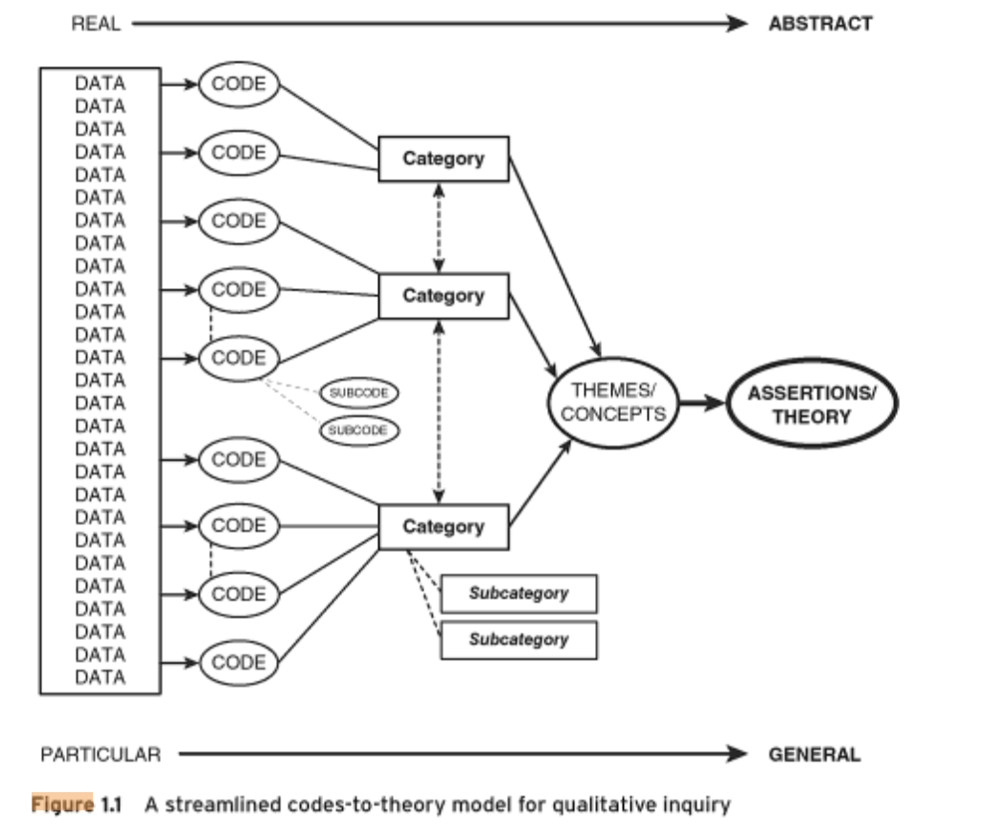

Slide 6
Coding is ‘Messy’!
There will be many times where you feel that you have too many codes, not enough categories, and that your analysis is becoming very messy
KEEP GOING – this is common for many qualitative analyses; take a break, you will start to see patterns emerging eventually

