Slide 1
POLS 422
HoFSTEDE CULTURAL DIMENSIONS and communication skills – part 1
Lecture 9

Slide 2
Cultures around the world are getting more and more interconnected and the business world is becoming increasingly global. For managers this means that they should be able to work with a large variety of people from different countries and cultural backgrounds. However, since most people are so strongly immersed in their own culture, they often fail to see how it affects their patterns of thinking or their behavior. To overcome this, researchers suggest some kind of tools or mechanisms with which to compare countries on cultural similarities and differences. A number of attempts have been made to combine these cultural differences across borders (e.g. the GLOBE study, Trompenaars’ cultural dimensions and Hall’s cultural dimensions).

Slide 3
However, the most-used and best-known framework for cultural differences is Geert Hofstede’s Cultural Dimensions. Over the years, his study led to six cultural dimensions on which countries can be ranked: Power Distance, Individualism/Collectivism, Masculinity/Femininity, Uncertainty Avoidance, Long-term/Short-term Orientation and Restraint/Indulgence.

Slide 4
Hofstede’s Cultural Dimensions Theory, developed by Geert Hofstede, is a framework used to understand the differences in culture across countries and to discern the ways that business is done across different cultures. In other words, the framework is used to distinguish between different national cultures, the dimensions of culture, and assess their impact on a business setting.
Hofstede’s Cultural Dimensions Theory was created in 1980 by Dutch management researcher, Geert Hofstede. The aim of the study was to determine the dimensions in which cultures vary.

Slide 5
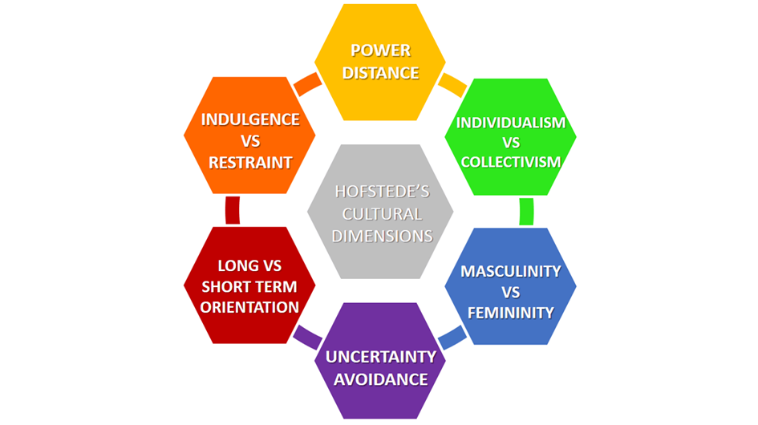

Slide 6
1. Power Distance
This dimension expresses the degree to which the less powerful members of a society accept and expect that power is distributed unequally: beliefs about the appropriate distribution of power in society. The fundamental issue here is how a society handles inequalities among people. People in societies exhibiting a large degree of Power Distance accept a hierarchical order in which everybody has a place and which needs no further justification. In societies with low Power Distance, people strive to equalise the distribution of power and demand justification for inequalities of power. China and Saudi Arabia are countries with a high Power Distance index.

Slide 7
Power distance stands for inequality that is defined not from above, but from below. It is, in fact, the extent to which organizations and societies accept power differentials.
Societies with large power distance are characterized by the following features:
- Autocracy in leadership;
- Authority that is centralized;
- Paternalistic ways of management;
- A number of hierarchy levels;
- The acceptance of the privileges that come with power;
- A lot of supervisory staff;
- An expectation of power differences and inequality.

Slide 8
2. Uncertainty Avoidance
Uncertainty avoidance is the extent to which the members belonging to a society are capable of coping with future uncertainty without going through stress.
Weak uncertainty avoidance comes with the following features:
- Undertaking risk;
- Flexibility;
- Tolerance toward differing opinions and behaviors.

Slide 9
Strong uncertainty avoidance is represented by the following aspects:
- Tendency to avoid risk;
- Organizations that have a number of standardized procedures, written rules, and clearly delineated structures;
- Strong requirement for consensus;
- Respect for authority;
- Requirement for predictability highlighting the significance of planning;
- Minimal or no tolerance for deviants;
- Promotions depending upon age or seniority.

