Slide 1
AMERICAN CORRECTIONS
Twelfth Edition
Chapter 16
Making It: Supervision in the Community
© 2019 Cengage. All rights reserved.

Slide 2
Learning Objectives (1 of 2)
Describe the major characteristics of the postrelease function of the corrections system.
Define community supervision and revocation of community supervision.
Explain how community supervision is structured.
Analyze the constraints on community supervision.

Slide 3
Learning Objectives (2 of 2)
Describe residential programs and how they help people on parole.
Identify the major problems that people on parole confront.
Understand why some people on parole are viewed as dangerous and how society handles this problem.
Describe the effectiveness of postrelease supervision.

Slide 4
Overview of the Postrelease Function (1 of 5)
Conditions of Release:
Restrictions on conduct that people on parole must obey as a legally binding requirement of being released.
Parole boards only release about one-fourth of people from prison (down from 65 percent in 1976).
80 percent of those released now under parole supervision (compared to 60 percent in 1960).
No truly “clean” start is possible.
Important to remember that the experience of a “former convict” is almost as stigmatizing as that of a “convict,” and can be more frustrating.
Notes:
Learning Objective 1: Describe the major characteristics of the postrelease function of the corrections system.

Slide 5
Overview of the Postrelease Function (2 of 5)
Community Supervision:
Restrictions on people on parole:
Personal and material problems are staggering
Most are unskilled or semiskilled, and have trouble finding any type of reasonable employment.
Nearly one-fourth of people on parole fail within six months.
With little preparation, people move from the structured environment of the prison into a complex/temptation-filled free world.
Notes:
Learning Objective 2: Define community supervision and revocation of community supervision.

Slide 6
Overview of the Postrelease Function (3 of 5)
Revocation:
Parole revoked for two reasons:
Committing a new crime
Violating conditions of parole (technical violation):
Revocation usually involves noncriminal conduct (e.g., failure to change address)
Most occur when person on parole is arrested on a serious charge or cannot be located.
Parole is a privilege.
The Supreme Court requires a two-step process involving probable cause and potentially returning the individual to prison.

Slide 7
Overview of the Postrelease Function (4 of 5)
Two-stage Revocation Proceeding:
Parole board determines whether there is probable cause that a violation has occurred. The person on parole has the right to:
Be notified of charges
Be informed of witnesses
Be heard
Present witnesses
Confront parole board witnesses (safety)

Slide 8
Overview of the Postrelease Function (5 of 5)
Parole board decides if the violation is severe enough to warrant return to prison.
Parole agency has several options:
Return person on parole to prison
Note violation but strengthen supervision
Note violation but take no action
Highest rate of failure in first year
Number of revocations is hard to determine. Within three years, nearly 68 percent of parolees are arrested for a new violation, and 43 percent are arrested during the first year after their release.

Slide 9
Discussion Question 1
Do you think depriving a released individual of a “clean start” is a good deterrent or the result of a flawed system? Why?

Slide 10
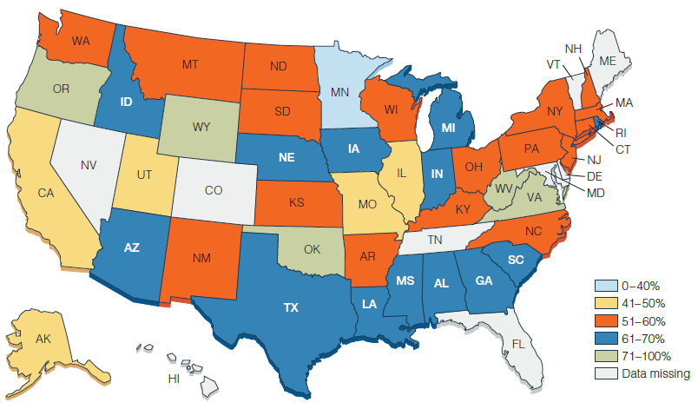
Figure 16.5 Percentage of Success After Release from State Prison to Parole Supervision
Notes:
Why do some states seem to do a better job at helping people make it after prison?

Slide 11
Discussion Question 2
If technical violations were no longer sufficient cause for revocation of parole, how do you think recidivism rates would change? Do you think these violations are necessary to supervise the behavior of the person on parole?

Slide 12
The Structure of Community Supervision (1 of 3)
Three forces influence released individual’s adjustment to free society:
Parole officer
Play two roles, cop and social worker
Parole bureaucracy
Workload of parole officers is extremely high
Experiences of individual
Always important to consider
Complex web of attitudes, situations, policies, and random events determines the outcome of the supervision process.
Notes:
Learning Objective 3: Explain how community supervision is structured.

Slide 13
The Structure of Community Supervision (2 of 3)
Agents of Community Supervision:
Cop and social worker
Two hidden conditions:
Parole officer’s style. Officers have certain expectations about how clients will behave and how to treat them:
Parental approach
Welfare approach
Punitive officers
Passive agents
Supervision plan. This plan states what the parole officer is going to do about his or her client’s problems and how they are going to supervise them.

Slide 14
The Structure of Community Supervision (3 of 3)
The Community Supervision Bureaucracy:
Workload:
Active versus reduced surveillance
Parole officers spend as much as 80 percent of their time at nonsupervisory work
Philosophy and Policy
Constraints on Officers’ Authority:
Go along with the system
Unwritten rules
Notes:
Learning Objective 4: Analyze the constraints on community supervision.

Slide 15
Residential Programs (1 of 2)
Community Correctional Centers:
A small-group living facility, especially those who have been recently released from prison:
Typically house between 10 and 25 people at a time.
Usually provide counseling and drug treatment
Impose strict curfews
Residents can gradually earn a reduction in restrictions
Idea is to provide treatment while promoting step-by-step adjustment to community life
Notes:
Learning Objective 5: Describe residential programs and how they help people on parole.

Slide 16
Residential Programs (2 of 2)
Work Release Center:
A facility that allows residents to work in the community during the day while residing in the center during nonworking hours
Originated in Wisconsin with the 1913 Huber Law
Two types:
People in prison work during day and return at night
People work and live at home during week; return to center on weekends

Slide 17
The Experience of Postrelease Life (1 of 2)
The Strangeness of Reentry
Supervision and Surveillance
The Problem of Unmet Personal Needs
Barriers to Success:
Civil Disabilities:
Right to vote
Public assistance and food stamps
Public housing
Driver’s licenses
Adoptions and foster care
Student loans
Notes:
Learning Objective 6: Identify the major problems that people on parole confront.

Slide 18
The Experience of Postrelease Life (2 of 2)
Many restrictions are statutory stemming from common law traditions of “civil death.”
Securing housing, food stamps, and childcare are some of the many issues this population faces.
Expungement and Pardon:
Expungement:
A legal process that results in the removal of a conviction from official records.
Pardon:
An action of the executive branch of the state or federal government excusing an offense and absolving a person of the consequences of his or her crime.

Slide 19
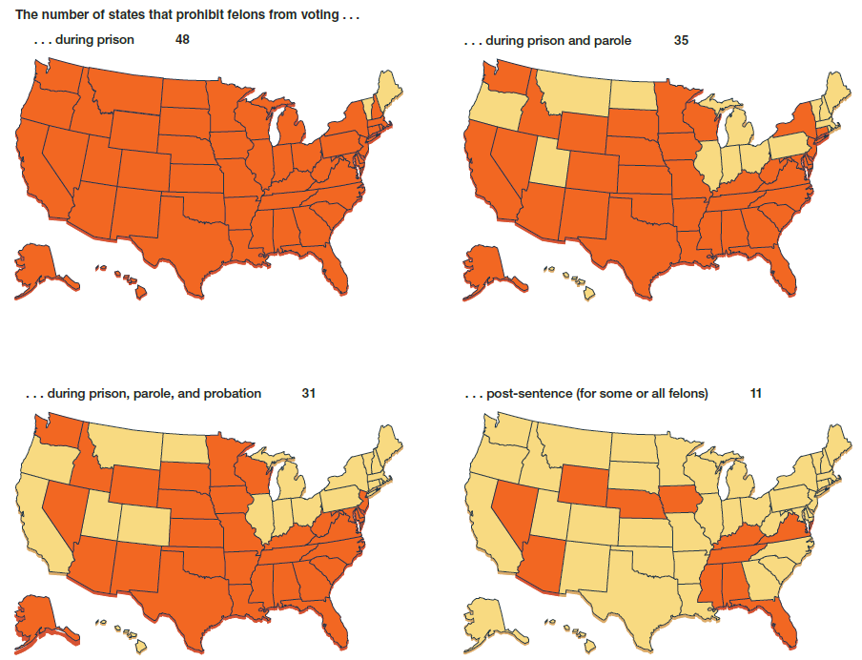
Figure 16.7 Voting Rights for People Convicted of Felonies
Notes:
Florida is the largest of 11 states that can permanently strip some or all felony-convicted people of their right to vote. States have clemency processes to restore voting rights in some cases.

Slide 20
The Person on Parole as “Dangerous”
More than two-third of states have passed sex offender notification laws:
Notification laws seem to have heightened public discomfort
Isolated tragedies can exaggerate the actual danger
No correlation between numbers of people on parole and crime rate
Statutes such as Megan’s Law come out of parole violations
Notes:
Learning Objective 7: Explain why some people on parole are viewed as dangerous and how society handles this problem.

Slide 21
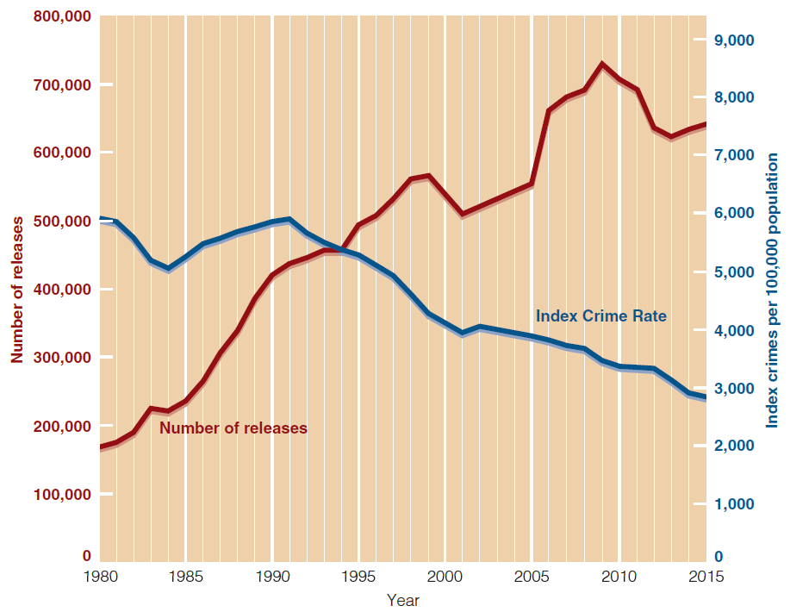
Figure 16.9 Crime Rate and Releases from State and Federal Prisons, 1980–2015
Notes:
Even though the number of people released into the community has increased steadily for almost three decades, crime has not increased during that time.

Slide 22
The Elements of Successful Reentry
Most important adjustments for successful reentry
Getting substance abuse under control
Getting a job
Getting a community support system
Getting a new sense of “who I am”

Slide 23
Postrelease Supervision (1 of 2)
How Effective Is Postrelease Supervision?
Measured in terms of rates of recidivism
Less than half of those released from prison remain arrest-free after three years
Mandatory release only seems to work for those who committed property offenses
Case management
Overall, success of parole supervision is mixed
Notes:
Learning Objective 8: Describe the effectiveness of postrelease supervision.

Slide 24
Postrelease Supervision (2 of 2)
Evidence-based priorities for policy changes to help the parole process include:
Develop and use of valid risk assessments
Target supervision strategies to deal with critical needs of high-risk cases
Creation of incentives for people who want to succeed
Support and help those who do reenter comply with the restrictions
Be sensible about revoking parole

Slide 25
Discussion Question 3
How do you see parole evolving in the future and how do you see these changes affecting the corrections system?

