Slide 1
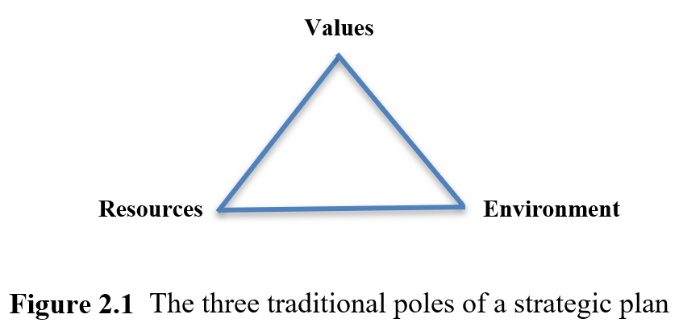
Strategic management

Slide 2
Strategic management
Environment operates at macro (external to an organization, i.e. industry level, economic) and micro level (specific environment, i.e. processes within the organization). Elements in the macro environment constantly penetrate into the micro environment, and affect an individual organization.
Conventional Strategic Management Process:
Mission and Goals
Organization’s direction and outcomes to be accomplish
Environmental Analysis
Macro – STEEPLE
Micro – SWOT or PRIMO-F

Slide 3
Strategic management
Strategic Formulation
Evaluation of factors and choices made to meet goals
Strategy Implementation
Leadership – adaptation and development of a strategy, and gaining support and commitment of those who are expected to carry it out
Strategy Evaluation
Activity that determines whether the actual change and performance matches what has been planned to what extent

Slide 4
Strategic management
However, this process only shows how strategic management should be done rather than describing what is actually done by senior managers.
Again, strategy is a political process undertaken by people with power and who are influenced by ideology.

Slide 5
A framework for studying strategy and leadership
Macro environment
Socio-cultural, Technology, Economic, Ecology, Politics, Legal, Ethical
Micro environment
People, Resources, Innovation, Marketing, Operations - Finance & Strengths, Weaknesses, Opportunities, Threats

Slide 6
A framework for studying strategy and leadership
A hierarchy of strategy
Corporate-level strategy
Business-level strategy
Functional-level strategy
Team-level strategy
Levels of leadership
Organizational performance

Slide 7
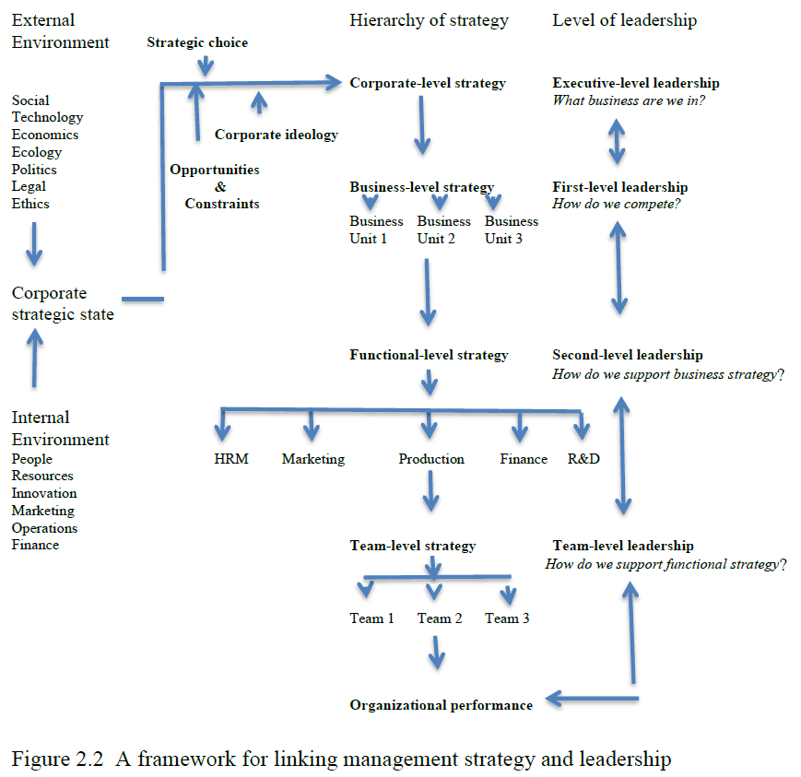
A framework for studying strategy and leadership

Slide 8
The nature of innovation
Innovation can be defined as the process of coming up with good, new ideas and making them work technically and commercially (Tidd and Bessant, 2018). Innovation therefore only counts as innovation, if it produces something that ultimately will be sold to customers, or, in the public sector, that will result in ‘more for less’ (Parker, 2018, p. 30).
Incremental innovations enable organizations to ‘do things better’. Over time, and in cumulative form, incremental innovations can produce significant changes. Breakthrough innovations enable organizations to ‘do things different’ (Bessant, 2003).

Slide 9
The nature of innovation
Product innovation
Process innovation
Disruptive innovation is a common pattern of innovation (Christensen, 2016).

Slide 10
The external and internal contexts driving or disables innovation
External
Globalization
Market opportunities
Competitive pressures
Changes in laws and regulations
Changes in available technologies
Internal
Available knowledge and resources
Positive innovation strategies
Organizational cultures and practices

Slide 11
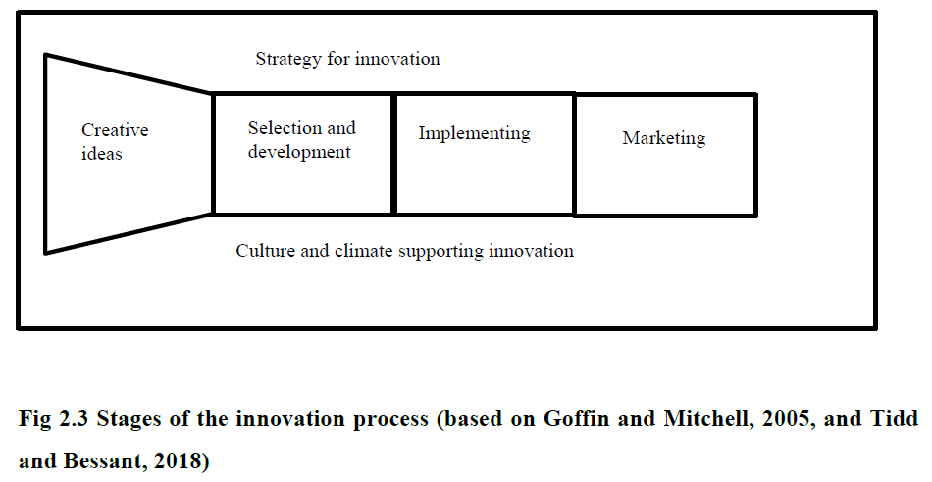
The leaders’ roles in innovation processes

Slide 12
The leaders’ roles in innovation processes
Individuals in leadership roles therefore need to be able to work well together in order to exercise shared leadership (Bolden and O’Regan, 2016).
Leadership of different types is thought to be needed at different stages of the innovation process.
There need to be a balance of exploration (search for new knowledge and ideas) and exploitation (of what is already known), also known as ambidexterity to realize an innovation process.
E.g. Transformation and transactional leadership

Slide 13
Evaluation and criticism
Neoliberalism has been criticised as not just as something that has created the atomization of labour through strict regulation and strengthen management’s ‘right to manage’; it is also emphasized to be more than just the economic system – it has a political and ideological agenda.
This leads to corporate ideology where the major beliefs and values provided by leaders form the frame of reference for decision-making and action (lets us to understand how the employment relationship is managed).

Slide 14
Evaluation and criticism
This idea continues to be aided by other organizations such as business schools, ‘think tanks’ and the media as “apparatus of justification” to continue spreading and formulation of these neoliberal ideas, such as shareholder value – illustrating that this is the way to do things and how the world is viewed.
Power blind becomes an important matter in discussion of the strategy literature.
Charismatic leaders also are romanticized as innovation enablers, while other key variables such as employees with creativity or the state is being ignored or downplayed.

