Slide 1
Art Gallery
Name
School
Date

Slide 2
High Renaissance Art Introduction
Religion in this case interests me as it allows me to create a personal relationship between the paintings and our reality.
I hope to learn more about religion in relation to Leonardo Da Vinci’s works.
I also hope to create a connection with the different forms of art which existed at his time and how they used the theme for their development.

Slide 3
High Renaissance Art Introduction
Religion was one of the most famous themes in the renaissance period.
It allowed a painters such as Leonardo Da Vinci to express their feelings and emotions towards different aspects of religion through their paintings.
It was motivated by the accurate portrayal of classical monuments in a lifelike manner through naturalism, Leonardo Da Vinci portrayed different aspects of religion.
Therefore, religion promoted both Leonardo Da Vinci’s artwork and his faith as a strong Catholic Christian.

Slide 4
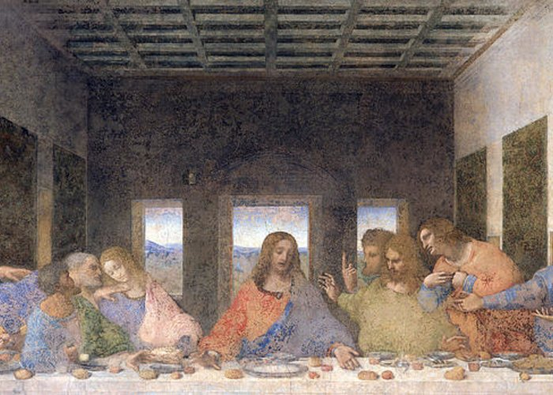
The Last Supper Leonardo Da Vinci 1498 Mural Painting
“The Last Supper” is Leonardo Da Vinci’s artwork drawn in 1498.
Leonardo made the image of the last supper lifelike portraying a more human inspired drama.
He focused on showing people on the idea of Jesus getting betrayed by one of his disciples.

Slide 5
The Last Supper
Visual Elements:
Line: Vertical lines. The windows, doors, and interior wall paintings are vertical, hence leading the eye into an expression and arousal of inquietude and exaltation emotions.
Shape: There are rectangular windows, walls, and doors. The disciples’ heads also form depict spherical shapes.
Light: There is a single source of light; outside sky that penetrates the room. The light is contrasting.
Color: Red-orange, blue, orange, and yellow-green. The colors are muted. Yes, a combination of primary hue and tertiary hues?
Texture: Lacy on the gowns of the disciples.
Mass: The art is heavier at the back where dark colors have been used immensely.
Time: Daytime because the sky is still bright.
Motion: Disciples coalescing towards each other hence forming two groups leaving Jesus at the center.

Slide 6
The Last Supper
Design Principles:
Unity: Visual unity is portrayed by the seeming consultative mood of the disciples.
Variety: Different colors of the robes worn by the disciples issues multiplicity.
Balance: Elements are distributed uniformly in the paint hence a bilateral symmetry.
Emphasis: Jesus’ lone figure at the center of the table is the center of interest.
Directional forces: Random visual flow.
Contrast: Bright light from the distant hills attempts to brighten in between the dark walls.
Repetition & rhythm: The rectangular dark paintings in the room and windows and the door creates contrasting rhythms.
Scale & proportion: Scale of the disciples matches the room they occupy.

Slide 7
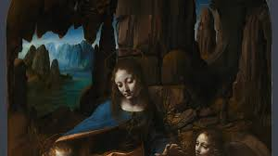
The Virgin of the Rocks Leonardo Da Vinci 1483-1486 Oil Painting
The painting was drawn in 1483-1486.
It was an oil to panel painting which described angel Uriel, John the Baptist, Madonna and baby Jesus in a setting filled with rocks, which gives the painting its name.
It largely portrays Leonardo’s understanding of the religion together with the significant bodies associated with it.

Slide 8
The Virgin of the Rocks
Visual Elements:
Line: Curved lines as depicted on the hips and rock pinnacles. The application of paint shows compassion and humility of Mary by choosing to sit on the ground despite being regarded as a queen.
Shape: Shapeless rocks towering above Mary and the infants.
Light: The figures are illuminated by light falling from the top-left of the picture.
Color: Vegetation-based dark green. Tertiary hues.
Texture: Opaque vegetation colors provided earthy rock tones.
Mass: Evenly distributed throughout.
Time: Seems to be night-time because there is an unnatural source of light.
Motion: No motion depicted. General calmness.

Slide 9
The Virgin of the Rocks
Design Principles:
Unity: Head positions for John the Baptist, Madonna and baby Jesus are all focused on something not captured in the paint. It presents a conceptual unity.
Variety: The rocks and distant hills create some invigoration .
Balance: Objects concentrated in the middle hence a formal symmetry.
Emphasis: The laid-back facial expression of Madonna provides the necessary interest.
Directional forces: Vertical orientation.
Contrast: The bright blue distant rocks contrast the dominant color of the rocks immediately behind Madonna.
Repetition & rhythm:The dominant color and shapes of the rocks creates rhythmical visual sense.
Scale & proportion: Madonna matches the scale of rocks behind her but diminishes that of the two boys.

Slide 10
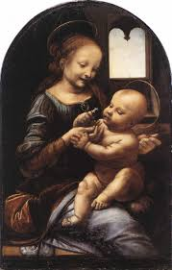
Madonna of the Carnation Leonardo Da Vinci 1478-1480 Oil Painting
It was Leonardo’s oil on panel painting which he worked on in 1478-1480.
It includes the Virgin Mary siting with Baby Jesus, depicting different symbols.
The images of Virgin Mary and Baby Jesus are put into more light compared to the other objects in the painting to emphasize their existence and different poses.

Slide 11
Madonna of the Carnation
Visual Elements:
Line: Diagonal line depicting two objects in action between the mother and the child.
Shape: Dominant shape from the painting rectangular window with circular edges.
Light: The painting at its center is illuminated by light positioned from a horizontal elevation. The window also lets in some natural light.
Color: Dominantly black with tertiary hues.
Texture: Visually smooth with no impasto.
Mass: The artwork is heavier on the left side where there is immense darkness.
Time: It is daytime because the window also brings in some bright light in addition to the luminous inside light source.
Motion: There is motion as evidenced by the girlish Virgin mother as she smiles and fondles her child.

Slide 12
Madonna of the Carnation
Design Principles:
Unity: The style of shinning light presents the common axis.
Variety: What creates diversity?
Balance: Objects concentrated in the middle hence a formal symmetry
Emphasis: Center of focus is the tiny object that Mary and Jesus seems to be ‘fighting’ over.
Directional forces: Diagonal visual movement.
Contrast: The bright light from the window behind Mary attempts to contrast the light source shining upon the room.
Repetition & rhythm: Is an element repeated?
Scale & proportion: Are the objects in proportion to each other?

Slide 13
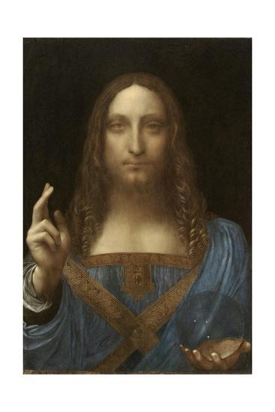
Salvator Mundi Leonardo Da Vinci 1513 Oil Painting
As a renaissance artist, Leonardo used oil and walnut for this painting in 1513.
It shows Jesus Christ, making a cross sign with his other hand holding a transparent round object, representing his role as savior of the world.
It familiarizes people with the scripture,
relating them to Christ and his actions
to the world.

Slide 14
Salvator Mundi
Visual Elements:
Line: Diagonal line that indicates gesturing and more actions such as talking .
Shape: Circular transparent object held by the left hand of the painted figure, presumably ‘Jesus’ (The National Gallery, 2020).
Light: One source of light illuminating the figure from front way.
Color: Blue-pink, muted of tertiary hue.
Texture: Visually rough with traceable impasto.
Mass: The artwork is heavier on the back of the figure where there is immense darkness.
Time: Time setting is at night since the painting is illuminated from one unnatural source of light.
Motion: There is motion since the figure makes a cross sign with his other hand holding a transparent round object.

Slide 15
Salvator Mundi
Design Principles:
Unity: Jesus’ facial expression plus the transparent object he is holding and the gesture displayed by the other hand demonstrates consistency of style.
Variety: The window behind Mary acts as another source of light in addition to the primary source inside the room hence creating multiplicity.
Balance: Objects concentrated in the middle hence a formal symmetry.
Emphasis: The transparent object held by Jesus.
Directional forces: Vertical movement.
Contrast: Darkness behind Jesus produces a sharp contrast of the light shining on Jesus’ face.
Repetition & rhythm: No element of repetition.
Scale & proportion: Jesus is out of scale compared to other objects in the paint.

Slide 16
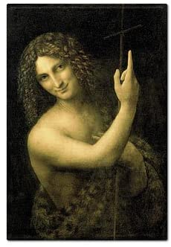
Saint John the Baptist Leonardo Da Vinci 1513-1516 Oil Painting
The painting is believed to be Leonardo’s final painting which he worked on in 1513 to 1516.
He used oil and walnut wood type to portray the image of John the Baptist.
The painting was an example of Leonardo’s High Renaissance oil painting.

Slide 17
Saint John the Baptist
Visual Elements:
Line: Diagonal line demonstrating an actions where the figure seems to be issuing offering explanation over a cross he is holding.
Shape: No shape.
Light: One source of light illuminating the figure from the front.
Color: Black, tinted and simulating hue.
Texture: Visually rough with traceable impasto.
Mass: The artwork heavier on the back of the figure where there is immense darkness.
Time: Time setting is at night since the painting is illuminated from one unnatural source of light.
Motion: There is motion since the figure holds a cross with both hands while gesturing.

Slide 18
Saint John the Baptist
Design Principles:
Unity: The dark background provides an accord to the paint.
Variety: The cross held by John the Baptist acts as an extra pivot hence creating diversity.
Balance: John the Baptist, the main object tends to be leaning towards the left corner of the image hence presenting asymmetrical balance.
Emphasis: The smiling face of John the Baptist.
Directional forces: Diagonal visual flow.
Contrast: Light in front of John the Baptist contrasts the heavy darkness behind him.
Repetition & rhythm: The long hair and the robe creates resonance.
Scale & proportion: Over-scaled for the paint frame.

Slide 19
Formal Art Criticism Theories
Describe the theory
Tell why you feel this artwork is best categorized and understood using this theory
Tell how the theory explains one of your gallery artworks

Slide 20
Contextual Art Criticism Theory
Describe the theory
Tell why you feel this artwork is best categorized and understood using this theory
Tell how the theory explains one of your gallery artworks

Slide 21
Expressive Art Criticism Theories
Describe the theory
Tell why you feel this artwork is best categorized and understood using this theory
Tell how the theory explains one of your gallery artworks

Slide 22
Conclusion
Religion is a huge part of Leonardo Da Vinci’s work.
It reflects not only his faith, but also his belief on different events relating to his religion.
His real portrayal of different events are largely contribute to the popularity of his work.
His work was both authentic and relatable.

Slide 23
References
Amazon Prime. (2020). St. John the Baptist by Leonardo da Vinci Fridge Magnet. Retrieved from https://www.amazon.com/Baptist-Leonardo-Vinci-Fridge-Magnet/dp/B00BT7VBZ6
Art.com. (2020). Salvator Mundi by Leonardo da Vinci. Retrieved from https://www.art.com/ products/p25844441736-sa-i8036275/salvator-mundi-attributed-to-leonardo-da-vinci.htm
Emeritus, D. P. Prebles’ Artforms. [VitalSource Bookshelf] Retrieved from https://online.vitalsource.com/#/books/97802059722...
Fine Art America. (2020). The Last Supper by Leonardo da Vinci. Retrieved from https:// fineartamerica.com/featured/18-the-last-supper-leonardo-da-vinci.html?product=greeting- card
Leonardo da Vinci. (2020). Benois Madonna. Retrieved from https://www.leonardodavinci.net/ benois-madonna.jsp
The National Gallery. (2020). The Virgin Rocks by Leonardo da Vinci. Retrieved from https:// www.nationalgallery.org.uk/paintings/leonardo-da-vinci-the-virgin-of-the-rocks

