Slide 1
Unit 5: Leading Teams
(Knowledgecast)

Slide 2
Today’s Knowledgecast
As a result of today’s Knowledgecast, you should be able to:
Examine the difference between groups and teams in a work context
Appraise a range of approaches managers can use to create high performance teams
Assess the interventions managers can implement to address poor performance within teams

Slide 3
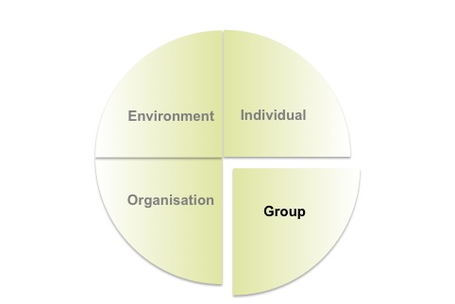
Understanding Groups and Teams
Employee behaviour is influenced by
a combination of 4 factors
Understanding Groups and Teams requires
an appreciation of differences in:
Groups vs. Teams
Team Formation
Team Performance
Team Dynamics
Team Communication
Changing Team Formats
Individual behaviour
is influenced by a
range of factors
The majority
of workers are dependent on the skills and talents of others.

Slide 4
Teams – 4 Problems for Leaders and
Managers
How do I create the perfect team?
Purpose: Mullins (2016)
Skills: Belbin (2000)
How do I get my team to work together effectively?
Tuckman and Jensen (1977)
What role do I need to take to manage the team effectively?
CIPD (2010)
Mullins (2016)
What do I do when the team is not working well together?
JoHari Window (cited in Mullins 2016)

Slide 5
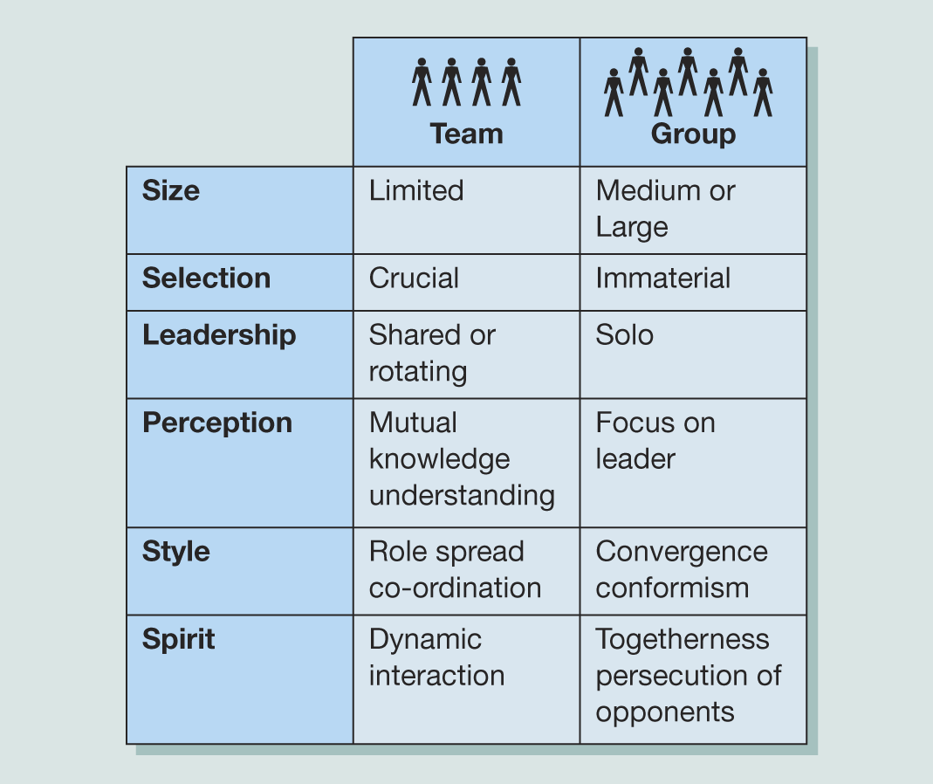
Defining Groups vs Teams
GROUPS
Schein
interact psychologically aware of each other & perceive
Adair
Conscious
Shared purpose
Interdependence
interaction
TEAMS
Mullins:
Shared goals
Contribute own skills, dependency on success of others
Gestalt Theory – whole is greater than sum of its parts
Source:
Belbin (2000)
One size DOES NOT fit all. The majority of workers are dependent on the skills and talents of others.
Leaders must be aware of their own behaviour within the Group or Team context

Slide 6
Q1. What makes the perfect team?
The answer could be found in defining its characteristics:
A belief in shared aims and objectives
A sense of belonging to the group
Acceptance of group values and norms
A feeling of mutual trust and dependency
Full participation and consensus in decisions
A free flow of information and communication
Open expression of feelings and disagreements
Conflict resolved within the group
Low levels of staff turnover and absenteeism
Source:
Mullins (2016)

Slide 7
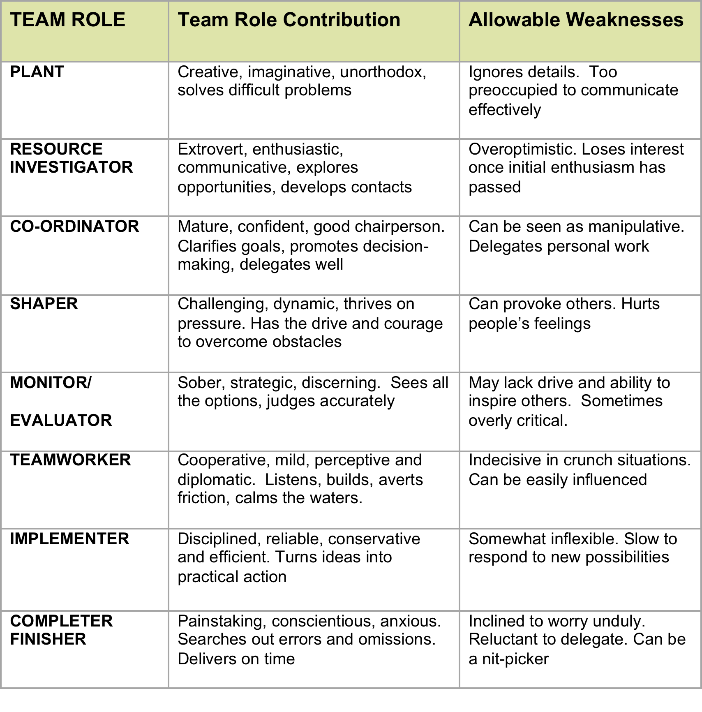
Source:
Belbin 2000 (cited in Mullins, 2016)
Q1. What makes the perfect team?
To function effectively an organisations requires
Collaboratin
Cooperation
Amongst its members

Slide 8
Q2. How do I get my team to work
together effectively?
FORMING
STORMING
NORMING
PERFORMING
Polite
Impersonal
Guarded
Watchful
Confronting people
Dealing with conflict
Opting out ‘not for me’
Lose team members
Getting organised
Developing skills
Establishing systems and procedures
Tackling challenges
Getting Feedback
Closeness/friendship
Flexible
Supportive and trusting
Sharing ideas
Tolerant of members
Based on
Tuckman and Jensen (1977)
ADJOURNING

Slide 9
Q2. How do I get my team to work
together effectively?
Ground Rules – an example
We all turn up for every meeting on time
We are honest with our opinions and feelings all the time
We keep to deadlines
It is OK to ask for help when we are struggling with work
We deal with problems as a team as soon as they appear
We review our ground rules in every meeting
We challenge each other to come up with the best ideas possible
We give each other constructive feedback to help improve our skills
We have fun together

Slide 10
Q3. What role do I need to take
to lead the team effectively?
In a CIPD (2010) Employee Outlook survey:
49% of respondents felt that they were well/fairly well informed about their organisation
53% of respondents felt that they were consulted on matters of importance to themselves by their line manager
Source:
CIPD (July 2010)
1. Have a shared purpose
2. Convince your leaders
3. Engage your people
4. Consider your channels
5. Keep the personal touch
7. Measure your results
6. Work collaboratively

Slide 11
Q3. What role do I need to take to
lead the team effectively?
Clear and shared goals
Agreed ways of working
Effective communication
Support and cooperation
Regular review of progress
We agree what we are setting out to achieve
We agree a set of Ground Rules
We agree the methods to use when we communicate with each other
We agree to help each other with team tasks
We meet regularly to review our action plan
We agree what success looks like
We take everyone’s needs into account
We deal with poor cooperation as a team
We review our Ground Rules to make sure the team is working effectively

Slide 12
Q4. What do I do when the team
is not working well together?
Development of leadership and management ability by:
Diagnosing the relationships between people
Understanding how others react to you
Identifying hidden behaviour that needs to be shared
Identifying behaviours unknown to you
Adapting your behaviour to meet the needs of the situation
Source:
Mullins (2016)

Slide 13
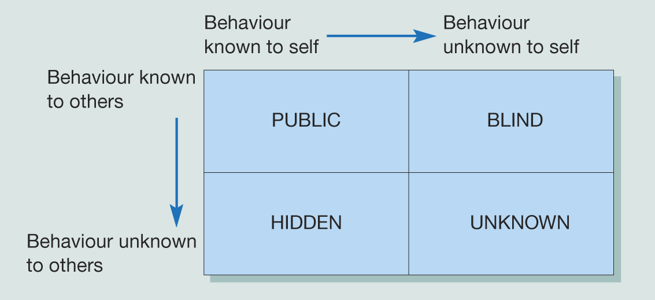
Q4. What do I do when the team
is not working well together?
Using ‘Johari Window’ to develop self-insight in order to:
Reduce the ‘Hidden’ area through self-disclosure
Reduce the ‘Blind’ area through feedback from others

Slide 14
What makes a Successful Virtual Team?
The Culture | The Team Members
High level of trust and collaboration across the team | Use technology to build relationships and team development
Clear individual and team standards | Flexible and dynamic with the variety of tasks, roles, and time zones
Tools for communication and collaboration | Commitment to deliver promised results
Common processes and procedures | Rapid accepting of new team members
Communication prioritised by the sender | Rapid accepting of change in the team
Reward and recognition policies in place
Leaders role model the use of communication and technology
A Geographically separated, non face to face, self managed team in different time zones
makes for some key challenges for a Virtual Team

Slide 15
Knowledgecast Summary
Reflect critically on and apply conceptual and practical approaches to leadership in a range of different organisational settings
Critically evaluate techniques to address and overcome resistance to change
Critically reflect upon personal experiences and aspirations around leadership enabling them to develop originality in their own leadership capabilities
Explore the ethical relationships between leaders and followers

