Slide 1
Project quality management

Slide 2
Introduction
Project Quality Management includes the processes & activities that determine quality polices, objectives & responsibilities to ensure that the project satisfies the needs for which it is undertaken.

Slide 3
PQM
Plan Quality :
identify quality requirements and standards
Document how to demonstrate compliance
Perform Quality Assurance ( QA ) :
Auditing the quality requirements
Ensure appropriate quality standards and operational definitions are used
Perform Quality Control :
Monitor and record results
Assess performance
Recommend necessary change

Slide 4
Implementation of PQM
These processes interact with each other as well as with the processes of other knowledge areas
Each process involves an effort of one or more individual or group of individuals based on the need of the project.
Each process occurs at least once in every project phase during the project life cycle.

Slide 5
Definitions of Quality (External)
Transcendent definition: Excellence
Product-based definition: Quantities of product attributes
User-based definition: Fitness for intended use
Value-based definition: Quality vs. Price
Manufacturing-based definition: Conformance to specifications

Slide 6
Quality versus Grade
Quality & Grade are not the same..
Quality : Degree to which a set of characteristics fulfill requirements
Grade : Category assigned to products or services having the same functional use but different technical characteristics
While a quality level that fails to meet quality requirements is always a problem, low grade may not be

Slide 7
Precision versus Accuracy
Precision and Accuracy are not equivalent..
Precision : repeated measurements are clustered and have little scatter
Accuracy : measured value is very close to the true value
Precise measurements are not necessarily accurate

Slide 8
PQM Approach compatibility
Compatible with ISO 9000 and 1000 series of standard guidelines
Proprietary approaches to quality as recommended by Deming, Juran, and Crosby, and others.
Nonproprietary approaches such as TQM, Continuous improvement approaches and others.

Slide 9
Nature of PQM
Project quality management must address both the management of the project and the product of the project.
Failure to meet quality requirements in either dimension can have serious and negative consequences for any or all of the project stakeholders

Slide 10
Examples of Negative Consequences
Meeting the customer requirement by over working the project team may lead to negative consequence in employee turnover
Meeting project schedules by rushing planned quality inspections may produce negative consequences when errors go undetected.

Slide 11
Common understanding
Customer Satisfaction :
Conformance to requirements
Fitness for use
Prevention over inspection : cost of preventing mistakes is generally less than the cost of correcting
Continuous improvement
(plan – do – check – act )
TQM & Six Sigma
Management responsibility

Slide 12
QUALITY PLANNING

Slide 13
Quality planning
Quality Planning involves identifying with quality standards
It is a key facilitating process during the Project planning Process
In modern quality management quality is planned in and not inspected in
Prior to the development of ISO 9000 series, quality planning concepts were widely discussed as part of quality assurance.

Slide 14
Quality Planning Inputs
Scope Baseline
Scope statement: contain details of technical issues and other concerns
WBS: identifies deliverables, work packages and control accounts used to measure project performance
WBS Dictionary: defines technical information for WBS elements

Slide 15
Quality Planning Inputs
2) Stakeholder Register
Identifies stakeholders with a particular interest in, or impact on, quality
3) Cost performance Baseline
Documents the accepted time phase used to measure cost performance
4) Schedule Baseline
Documents the accepted schedule performance measures including start and finish dates

Slide 16
Quality Planning Inputs
5) Risk register
Threats and opportunities
6) Enterprise Environmental Factors
Governmental agency regulations
Rules, standards & guidelines
working / operating conditions

Slide 17
Quality Planning Inputs
7) Organizational process assets
Organizational quality polices, procedures & guidelines
Historical databases
Lessons learned from previous projects
Quality policy

Slide 18
Tools and Techniques for Quality Planning
1) Cost / Benefit analysis
The planning process must consider benefit/cost tradeoffs
The Primary Cost: Is the expanses associated with PQM activities
The Primary Benefit: Is less work, higher productivity, lower costs, and increased stakeholder satisfaction
Note: it is elementary that the benefit should outweigh the cost

Slide 19
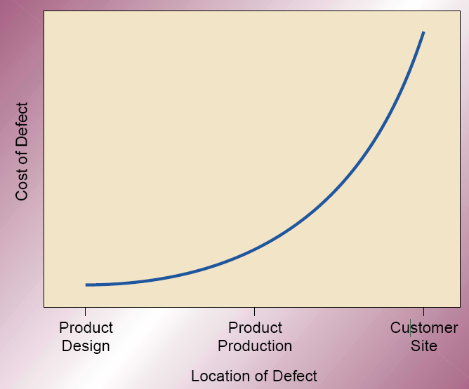
Tools and Techniques for Quality Planning
2) Cost of Quality ( COQ )

Slide 20
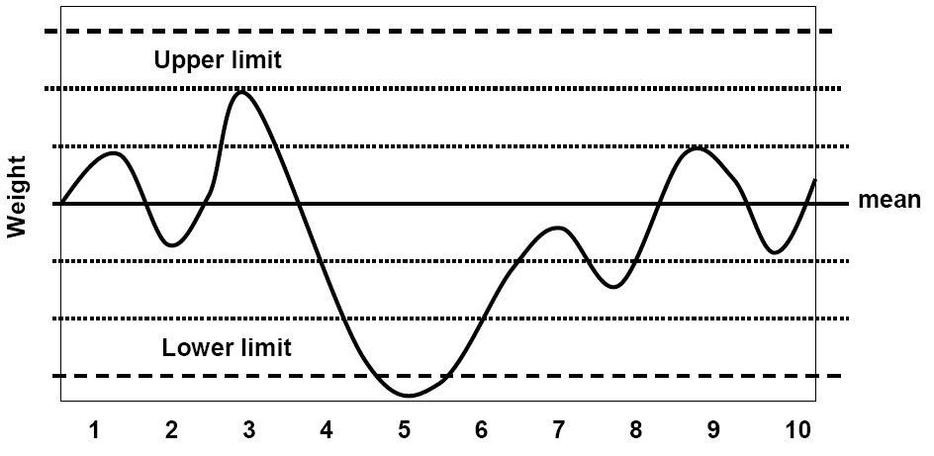
Tools and Techniques for Quality Planning
3) Control charts
To determine whether or not a process is stable or has predictable performance.

Slide 21
Tools and Techniques for Quality Planning
4) Benchmarking
Benchmarking involves comparing actual or planned project practices to those of other projects to generate ideas to:
1- Generate ideas for improvement
2- provide a standard for measurement of performance
Note: other projects compared may be within the same organization or out side and may be within the same application area or in another

Slide 22
Tools and Techniques for Quality Planning
5) Design of Experiments DOE
Aims to define variables that have most influence on the overall outcome
Commonly applicable to the product of the project issues.
Used in project management issues such as cost and schedule tradeoffs to allow for optima solutions.

Slide 23
Tools and Techniques for Quality Planning
6) Statistical Sampling
Choosing part of a population of interest for inspection
Sample frequency and sizes should be determined during the plan quality process

Slide 24
Tools and Techniques for Quality Planning
7) Flowcharting
The flowcharting techniques in quality management generally include
cause and effect diagram
System or process flow charts
Flowcharting can help in anticipating probable quality problems and thus helps to develop approaches for dealing with them

Slide 25
Tools and Techniques for Quality Planning
8) Quality Management Methodologies
Six Sigma, Lean Six Sigma, Quality Function Deployment, CMMI, etc

Slide 26
Tools and Techniques for Quality Planning
9) Additional Quality Planning Tools
Brainstorming
Affinity diagrams
Nominal group techniques
Matrix diagrams
Prioritization matrices
Force field analysis

Slide 27
Outputs from Quality Planning
1) Quality Management Plan
The Quality Plan should address:
Quality Control of the project
Quality Assurance
Quality Improvement of the project
Note: the project quality plan can be highly detailed or broadly framed based on the needs of the project

Slide 28
Outputs from Quality Planning
2) Quality Metrics
On-time performance, budget control, defect frequency, failure rate, availability, reliability and test coverage
3) Quality checklists
A structured tool used to verify that a set of required steps or requirements have been performed

Slide 29
Outputs from Quality Planning
4) Process Improvement Plan
Process boundaries
Process configurations
Process metrics
Targets for improved performance
5) Project Document Updates
Stakeholder register
Responsibility Assignment Matrix

Slide 30
QUALITY ASSURANCE

Slide 31
Quality Assurance
Process of auditing the quality requirements and the results from quality control measurements to ensure appropriate quality standards and operational definitions are used
Continuous process improvement reduces waste and eliminates activities that do not add value.

Slide 32
Inputs To Quality Assurance
1) Project management plan
Quality management plan : how quality assurance will be performed
Process improvement plan : steps for analyzing processes to identify activities which enhance their value
2) Quality Metrics

Slide 33
Inputs To Quality Assurance
3) Work Performance Information
Technical performance measures
Project deliverables status
Schedule progress
Costs incurred
4) Quality Control Measurements
To analyze the quality standards and processes of the performing organizations

Slide 34
Tools and Techniques For Quality Assurance
Plan quality and Perform Quality Control Tools & Techniques
2) Quality Audits
Identify all the good/best practices being implemented
Identify all the gaps/shortcomings
Share the good practices introduced or implemented
Proactively offer assistance in a positive manner
Highlight contributions of each audit in the lessons learned

Slide 35
Tools and Techniques For Quality Assurance
3) Process analysis
Examines problems experienced, constraints experienced and non-value-added activities
Includes root cause analysis to develop the required preventive actions

Slide 36
Outputs From Quality Assurance
1) Organizational Process Assets Updates
2) Change requests
To increase effectiveness and/or efficiency of the policies, processes and procedures
3) Project Management Plan Updates
Quality management plan
Schedule management plan
Cost management plan
4) Project Document Updates
Quality audits reports
Training plans
Process documentation

Slide 37
QUALITY CONTROL

Slide 38
Quality Control
The process of monitoring and recording results of executing the quality activities to assess performance and recommend necessary change
Quality control is often performed by a quality control department
The project management team should have a working knowledge of statistical quality control especially sampling and probability to help evaluate and control outputs.

Slide 39
Quality Control
The project management should be aware of the following among other subjects:
Prevention ( keeping errors out of the process)
Inspection (keeping errors out of the customers hand )
Attribute sampling (for conformity of results)
Variable sampling (where the results are rated on a continuous scale that measures the degree of conformity or non conformity
Tolerances ( specified range of acceptable results )
Control limits ( thresholds, which can indicate whether the process is out of control )

Slide 40
Inputs To Quality Control
1) Project Management Plan
2) Quality Metrics
3) Quality Checklists
4) Work performance measurements
Planned vs. actual technical performance
Planned vs. actual schedule performance
Planned vs. actual cost performance

Slide 41
Inputs To Quality Control
5) Approved change requests
6) Deliverables
7) Organizational process assets
Quality standards & polices
Standards & work guidelines
Issue and defect reporting procedures and communication polices

Slide 42
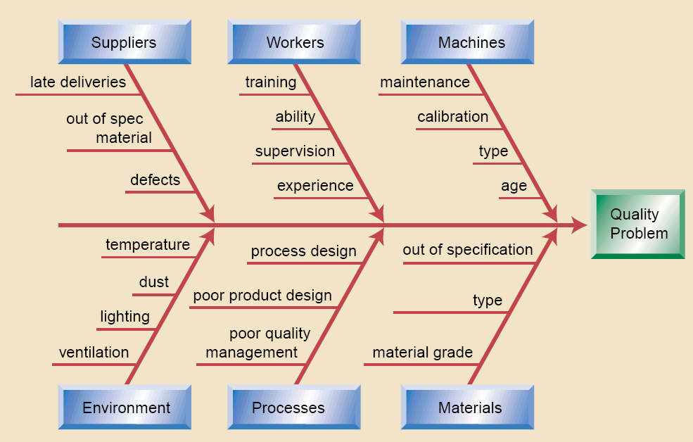
Tools and Techniques for Quality Control
1) Cause & Effect Diagram* ( Fishbone Diagram )

Slide 43
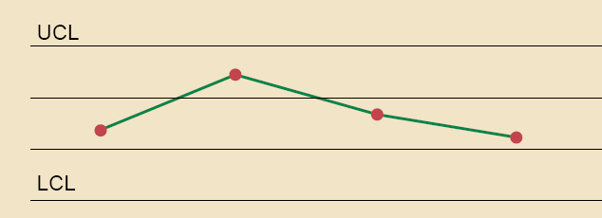
Tools and Techniques for Quality Control
2) Control Charts
Illustrates how a process behaves over time and when a process is subject to special cause variation, resulting in out-of-control condition
Control charts are most often used to monitor repetitive activity in production but can also be used to monitor cost and schedule variances

Slide 44
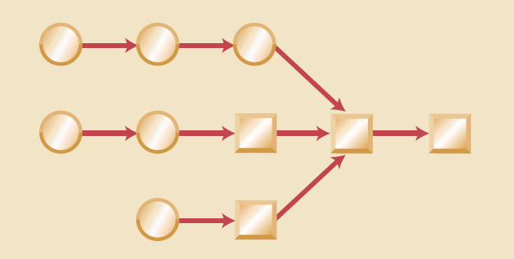
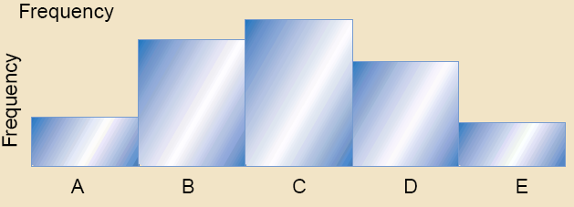
3) Flowcharting
4) Histogram

Slide 45
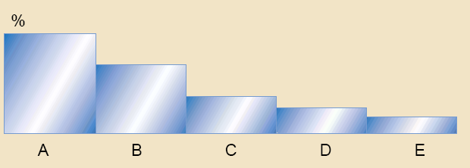
Tools and Techniques for Quality Control
5) Pareto Diagram
A Pareto diagram is a histogram ordered by frequency of occurrence which shows how many results were generated by what category or identified cause

Slide 46
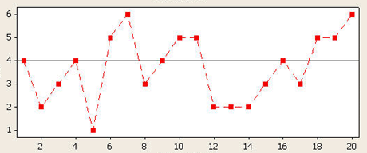
Tools and Techniques for Quality Control
6) Run Chart
Shows trends in a process over time, variation over time, or declines or improvements in a process over time
Trend analysis is often used to monitor:
Technical performance
Cost & schedule performance

Slide 47
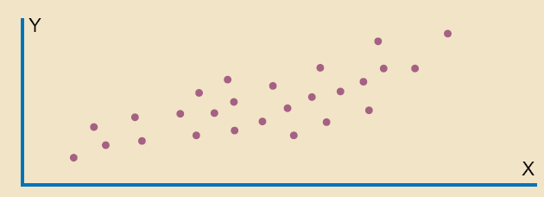
Tools and Techniques for Quality Control
7) Scatter diagram
8) Statistical Sampling

Slide 48
Tools and Techniques for Quality Control
9) Inspection
Examination of a work product to determine whether it confirms to documented standards
10) Approved change requests review

Slide 49
Outputs for Quality Control
Quality Control Measurements
Documented results of quality control activities in the format specified during quality planning.
Validated changes , where the inspected items will either be accepted or rejected and those rejected may be reworked
Validated deliverables

Slide 50
Outputs for Quality Control
Organizational Process Assets Updates
Completed checklists
Lessons learned
Change requests
A change request should initiated in accordance with the defined perform integrated change control

Slide 51
Outputs for Quality Control
Project Management Plan Updates
Quality management plan updates
Process improvement plan updates
Project document updates

Slide 52
Outputs for Quality Control
Completed Checklists, which become a part of a project record when they are used
Process Adjustments, which involves immediate corrective or preventive action as a result of quality control measurements. In some cases the adjustment may need to be handled according to procedures for overall change control.

Slide 53
Questions on Quality
1. In today’s view of quality, who defines quality?
a. Senior management
b. Project management
c. Project Team
d. Customers

Slide 54
2. Which of the following is true about quality costs when quality management principles are applied?
a. Prevention costs and failure costs (internal and external) are not related
b. Prevention costs and failure costs (internal and external) are inversely related
c. Prevention costs and failure costs (internal and external) are directly related
d. Prevention costs should guarantee no failure costs

Slide 55
3. What is the order of the four steps in Deming’s Cycle for Improvement?
a. Plan, do, check, and act
b. Do, plan, act, and check
c. Check, do, act, and plan
d. Plan, act, check, and do

Slide 56
4. A control chart helps the project manager to:
a. Focus on the most critical issues to improve quality
b. Focus on stimulating thinking
c. Explore a desired future outcome
d. Determine if a process is out of control

Slide 57
5. Which of the following is true?
a. ISO 9000 is a European standard
b. ISO 9000 is a paperwork nightmare
c. ISO 9000 certification ensures that your company produces quality products
d. ISO 9000 is an international standard for quality management systems

Slide 58
6. When a process is set up optimally, the upper and lower specification limits typically are:
a. Set equal to the upper and lower control limits
b. Set outside the upper and lower control limits
c. Set inside the upper and lower control limits
d. Set an equal distance from the median value

Slide 59
7. Which of the following is considered a cost of prevention?
a. In-process testing
b. Rework costs
c. Collecting data for use in process improvement efforts
d. Mass inspection

Slide 60
8. Quality assurance includes:
a. Collecting data for quality control
b. Completing tic charts
c. Planning for collection of data
d. Preparing a Pareto diagram

Slide 61
9. Quality Assurance should be performed:
a. during creation of the project proposal
b. during project design
c. during project testing
d. throughout the project

Slide 62
10. Another name for Inspection is:
a. Review
b. Audit
c. Walkthrough
d. All of the above

Slide 63
Thank You!

