Slide 1
Chapter 7
Social Networking,
Engagement, and
Social Metrics

Slide 2
Social Networking Services and Communities
Engaging Consumers with Blogs and Microblogs
Mashups, Social Metrics, and Monitoring Tools
Knowledge Sharing in the Social Workplace
Web 2.0—The Social Web

Slide 3
Web 2.0—The Social Web
Chapter 7
The Constantly Changing Web
Web 2.0 (the social web): a term used to describe a phase of World Wide Web evolution characterized by dynamic webpages, social media, mashup applications, broadband connectivity and user-generated content.
Social media: a collection of Web applications, based on Web 2.0 technology and culture that allows people to connect and collaborate with others by creating and sharing digital content.

Slide 4
Web 2.0—The Social Web
Chapter 7
The Constantly Changing Web
World Wide Web (the Internet): a network of documents on the Internet, called webpages, constructed with HTML markup language that supports links to other documents and media (e.g. graphics, video, audio, etc.).
Broadband: refers to wide bandwidth technologies that create fast, high volume connections to the Internet and World Wide Web.

Slide 5
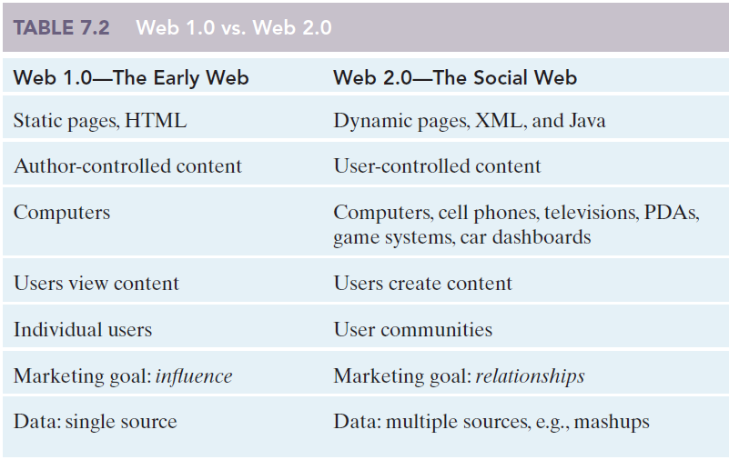
Web 2.0—The Social Web
Chapter 7

Slide 6
Web 2.0—The Social Web
Chapter 7
Setting the Stage for Web 2.0
Broad bandwidth (broadband)
Sustainable business models
New Web programming technologies
Application programming interface (API)
Plug-Ins

Slide 7
Web 2.0—The Social Web
Chapter 7
Setting the Stage for Web 2.0
AJAX technologies, or asynchronous JavaScript and XML, is a term referring to a group of technologies and programming languages that make it possible for webpages to respond to users’ actions without requiring the entire page to reload.
JavaScript
Extendable Markup Language (XML)
Document Object Model (DOM)
HyperText Markup Language (HTML)
XMLHttpRequest
Cascading Style Sheets (CSS)

Slide 8
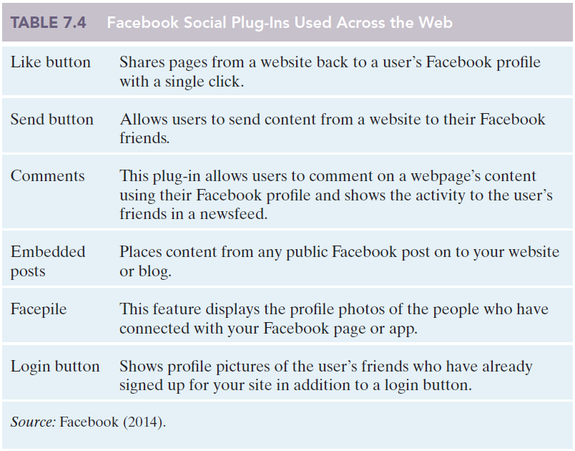
Web 2.0—The Social Web
Chapter 7

Slide 9
Web 2.0—The Social Web
Chapter 7
Social Media Applications and Services
Social Networking Service (SNS): an online platform or website that allows subscribers to interact and form communities or networks based on real-life relationships, shared interests, activities and so on.
Both YouTube and Facebook started as SNSs, but now span multiple application categories.

Slide 10
Web 2.0—The Social Web
Chapter 7
More than Facebook, YouTube, & Twitter
Collaboration
Communication and Engagement with Customers (Marketing)
Image and Reputation Management (Public Relations)
Communication and Engagement with Employees and Partners (Management)
Talent Acquisition and Recruiting (Human Resources)
Research and Knowledge Management
Productivity and Information Utilities
Fund Raising

Slide 11
Web 2.0—The Social Web
Chapter 7
Elements of Social Media: What Makes it Different?
User-generated content (UGC).
Content control.
Conversation.
Community (common values, culture).
Categorization by users (tagging).

Slide 12
Web 2.0—The Social Web
Chapter 7
Elements of Social Media: What Makes it Different?
Real people (profiles, usernames, and the human voice vs. the corporate “we”).
Connections (followers, friends, members, etc.).
Constant updating (real-time, dynamic).
Content separated from form.
Equipment independence.

Slide 13
Web 2.0—The Social Web
Chapter 7
Cluetrain Manifesto
Understanding not only how people behave, but also the way they think about things.
Transforms Markets to conversations where successful companies will learn to engage customers instead of traditional unidirectional or broadcast communications.

Slide 14
Web 2.0—The Social Web
Chapter 7
Leverage the Groundswell
Listening
Talking
Energizing
Supporting
Embracing

Slide 15
Web 2.0—The Social Web
Chapter 7
How has Web 2.0 changed the behavior of Internet users?
What are the basic tools or applications that characterize Web 2.0?
Why is Web 2.0 referred to as the social Web?
What are some of the benefits or advantages that Web developers gain from using AJAX technologies?
What are some of the most important messages for business organizations in the Cluetrain Manifesto?
What is feature convergence? Give some examples of this trend with regard to social media apps.
Notes:
Suggested Answers
1. The new technologies dramatically increase the ability of people to interact with businesses and each other, sharing and finding information, and forming relationships.
2. Web 2.0 is a term used to describe a phase of World Wide Web evolution characterized by dynamic webpages; use of XML and Java; social media; data from multiple sources, as in mashup applications; broadband connectivity; user communities; and user-generated and user-controlled content.
3. The new technologies dramatically increase the ability of people to interact with businesses and each other, sharing and finding information, and forming relationships. This perspective explains why Web 2.0 is often called the social Web.
4. AJAX technologies, or asynchronous JavaScript and XML, is a term referring to a group of technologies and programming languages that make it possible for webpages to respond to users’ actions without requiring the entire page to reload. AJAX makes it possible for Web developers to create small apps that run on a page instead of a server.
This capability makes programs run much faster, eliminating a key source of frustration with the early Web.
With AJAX and APIs, website programmers can import data from other sources to create new functions and features that we have come to associate with social media applications.
5. “Markets are conversations.”
These conversations enable powerful forms of social organization and knowledge exchange.
People have figured out they obtain better information and support from one another than from vendors. So much for corporate rhetoric about adding value to commoditized products.
Companies should realize their markets are often laughing. At them.
6. Feature convergence is the trend for applications to take on additional features of other applications, such that few applications fit neatly into categories anymore. For instance, Facebook started as a social networking service, but now has features that span almost all of the categories of Web 2.0 applications. YouTube started as a sharing site, making it easy for people to share video clips with others. However, YouTube now contains many features that make it difficult to distinguish from a social networking service. The same is true of Flickr, a photo-sharing site that has really become a community platform for people interested in photography.

Slide 16
Social Networking Services and Communities
Engaging Consumers with Blogs and Microblogs
Mashups, Social Metrics, and Monitoring Tools
Knowledge Sharing in the Social Workplace
Web 2.0—The Social Web

Slide 17
Social Networking Services and Communities
Chapter 7
Old Web versus New Web
Online or virtual communities parallel physical communities, but were primarily user-to-user interactions.
Usenet and Newsgroups provided a static means of communicating messages.
Online communities have transformed to include:
Selling goods and services
Promoting products to prospective customers; for example, advertising
Prospecting for customers
Building relationships with customers and prospective customers
Identifying customer perceptions by “listening” to conversations

Slide 18
Social Networking Services and Communities
Chapter 7
Semantic Web
Selling goods and services
Customer Prospecting
Soliciting ideas
Advertising
Building Customer Relationships
“listening” to Customers
Interactive Support
Encourage Customers
News-
groups
Old Web
Usenet

Slide 19
Social Networking Services and Communities
Chapter 7
Social network analysis (SNA)
The mapping and measuring of relationships and flows between people, groups, organizations, computers, or other information or knowledge-processing entities.
Social graph: to the global social network reflecting how we are all connected to one another through relationships.
Giant global graph: illustrates the connections between people and/or documents and pages online.

Slide 20
Social Networking Services and Communities
Chapter 7
Leveraging the Power of the Crowd
Crowdsourcing: a model of problem solving and idea generation that marshals the collective talents of a large group of people.
Crowdfunding: turning to a crowdsourcing model to raise money for business start-ups or projects such as Kickstarter, GoFundMe, and Indiegogo.
Donations
Rewards
Credit
Equity
Royalties

Slide 21
Social Networking Services and Communities
Chapter 7
Facebook Dominates Social Networking
Users can develop their own apps.
Created Newsfeed: constant stream of status updates.
Timeline: shows progression chronologically.
Wants to curate all user content, causing a rise in privacy concerns.

Slide 22
Social Networking Services and Communities
Chapter 7
Facebook
Open Graph
Personal
News
History
Business

Slide 23
Social Networking Services and Communities
Chapter 7
Facebook
Google+ (G+)

Slide 24
Social Networking Services and Communities
Chapter 7
Virtual Reality
Second Life is a social network that uses avatars to represent their residents (users). Users can develop their own apps.
Avatars are an icon, figure, or visual representation of a person in a digital environment.

Slide 25
Social Networking Services and Communities
Chapter 7
Private Social Networking Services
Social communities with restricted membership used by many colleges and universities.
Easier to monitor activities and track conversations.
Requires considerably more time, attention, and resources than using general SNS.

Slide 26
Social Networking Services and Communities
Chapter 7
What are the major differences between social networking services and older online communities?
What is the basic difference between the social graph and Berners-Lee’s concept of the Giant Global Graph?
Explain Facebook’s Open Graph initiative and how it plans to expand its influence across the World Wide Web.
What are some potential ways that business organizations can take advantage of Second Life’s unique virtual world interface?
Why would a business want to create a private SNS? What are some of the challenges associated with doing this?
Notes:
Suggested Answers:
1. Older online communities were often like public bulletin boards where all members of the community could read the messages that others posted. Websites were static, essentially online billboards for the businesses that created them. E-mail was the primary mechanism for social interaction.
A Social Networking Service (SNS) is an online platform or website that allows subscribers to interact and form communities or networks based on real-life relationships, shared interests, activities and so on.
We use a variety of tools and services for sharing interests with others. In addition to consuming content, we add comments or reviews and signal our appreciation for the content by clicking a “Like” or “11” button.
2. Facebook has begun using the term social graph to refer to the global social network reflecting how we are all connected to one another through relationships. Facebook users can access a social graph application that visually represents the connections among all the people in their network.
Berners-Lee (2007) extends this concept even further when he coined the term giant global graph. This concept is intended to illustrate the connections between people and/or documents and pages online.
3. In April 2010 Zuckerberg announced Facebook’s new initiative called Open Graph. The goal was to connect all the different relationships that exist on the Internet by linking websites to Facebook. Programmers at external websites were encouraged to include a Facebook “Like” button on their websites. That way, when a Facebook member visits the website, they can click “Like” and their relationship with that website will be reflected back on their Facebook page for friends to see.
Facebook also encourages other websites to allow people to use their Facebook username and password to sign in or create accounts. For instance, if you are a Facebook member and you visit Pandora.com (a music service) or Yelp.com (a local directory service), you can sign into the sites using your Facebook username and password. Facebook will then share your profile information with those sites.
4. IBM used it as a location for meetings, training, and recruitment. American Apparel was the first major retailer to set up shop in Second Life. Starwood Hotels used Second Life as a relatively low-cost market research experiment in which avatars visit Starwood’s virtual Aloft hotel. Fashion and clothing manufacturers like Reebok, American Apparel, Adidas, and others used Second Life as a place to feature new clothing designs, setting up virtual stores where Second Life citizens could purchase digital clothing for their avatars. The hope was that awareness of fashion products on Second Life would spur interest and eventual purchase of real-world products.
5. Private SNSs allow a greater degree of control over the network. Companies can easily monitor activity on their own SNS platforms and track conversations taking place about their brands and products.
Managing a private SNS requires considerably more time, attention, and resources than maintaining a presence on a general SNS. Organizations need to understand up-front that they are making a substantial commitment with this strategy.

Slide 27
Social Networking Services and Communities
Engaging Consumers with Blogs and Microblogs
Mashups, Social Metrics, and Monitoring Tools
Knowledge Sharing in the Social Workplace
Web 2.0—The Social Web

Slide 28
Engaging Consumers with Blogs and Microblogs
Chapter 7
Blogs
Websites were people regularly post a variety of content in various digital formats.
Blogs can establish reputations and promote business interests and/or share viewpoints.
Blogospheres are connected blogs.
Microblogs are frequent, but brief posts such as Twitter.

Slide 29
Engaging Consumers with Blogs and Microblogs
Chapter 7
Blogs
Blogging Platforms are software used to create and edit content with features that make blogging relatively easy.
Wordpress (51%) and Blogger (21%) are the most popular blogging platforms.

Slide 30
Engaging Consumers with Blogs and Microblogs
Chapter 7
Twitter
A valuable tool for activists engaged in organizing protests, debating political viewpoints, and broadcasting real-time information through Tweets.
Uses content tags called Hashtags (#) to allow users to follow conversations and/or trends.

Slide 31
Engaging Consumers with Blogs and Microblogs
Chapter 7
Growing Use of Twitter
Twitterspheres are third-party apps to enhance functionality and experience.
TweetDeck, Twitpie, Twitterfeed, and Twitterholic are essential Twitter tools.

Slide 32
Engaging Consumers with Blogs and Microblogs
Chapter 7
Growing Use of Twitter
Celebrities, companies, products, and services.
Coupons and specials.
News and political platforms.
Friendly status updates.

Slide 33
Engaging Consumers with Blogs and Microblogs
Chapter 7
Tumblr
Another update services providing microblogging with emphasis on photographs and video.
Allows just as much text as a regular blog, but Tumblr is mostly used for fashion, entertainment, and the arts.

Slide 34
Engaging Consumers with Blogs and Microblogs
Chapter 7
What is the difference between a blog and a microblog?
What is a blogging platform?
Why do marketers use blogs and microblogs?
What makes Twitter a more attractive communication channel than traditional media for many individuals and organizations?
How is Tumblr different from other types of blogging platforms?
Notes:
Suggested Answers:
1. In their simplest form, blogs are websites where people regularly post content. Some personal blogs are simply online diaries or journals where people share their thoughts, reflections, or an account of their life. Other blogs are more sophisticated and professional in format, resembling online newspapers or magazines. Because blogging technology has become so common place, you may not always realize you are reading a blog when accessing online content.
A microblog is a blog that consists of frequent, but very brief posts containing text, pictures, or videos. Twitter is perhaps the most well-known example of a microblog.
2. A blogging Platform is a software application used to create, edit, and add features to a blog. WordPress and Blogger are two of the most popular blogging platforms.
3. Corporate bloggers use the medium to tell stories about their brands and connect with customers. Blogs can also be an effective tool for interactive dialogue. Many blogs utilize comment features, allowing readers to respond to blog posts, interacting with the blogger and other readers.
4. With traditional media, content is tightly controlled and brand messages are “pushed” out to users, often in the form of an ad interruption. With social media, users are frequently attracted or “pulled” to content that is interesting to them and they have greater freedom to decide if, when, and how they want to interact with such content.
5. Most microblog content consists of text-based messages, although there appears to be an increase in people who are microblogging photos and video on Twitter and Tumblr. Tumblr has increased in popularity recently among younger Internet users because of its multimedia capabilities and ease of use.
Tumblr is often described as a microblogging service because it makes the posting of multimedia content easy for users, and allows them to update their blogs frequently. However, Tumblr blogs can include just as much text as a regular blog, although most who use the service emphasize photographs and video as the primary content. This emphasis on multimedia makes the Tumblr blogs more visually compelling. Tumblr is particularly popular among those who are blogging about things like fashion, entertainment, and the arts.

Slide 35
Social Networking Services and Communities
Engaging Consumers with Blogs and Microblogs
Mashups, Social Metrics, and Monitoring Tools
Knowledge Sharing in the Social Workplace
Web 2.0—The Social Web

Slide 36
Mashups, Social Metrics, and Monitoring Tools
Chapter 7
Mashup
Web applications that combine information from two or more sources.
Present information in a way that creates some new benefit or service.
http://www.programmableweb.com/mashups/directory

Slide 37
Mashups, Social Metrics, and Monitoring Tools
Chapter 7
Mashup
Popular APIs are from social media sites (user-generated social information).
Provide the power to separate content from form – Web developers have greater control over information display and use.

Slide 38
Mashups, Social Metrics, and Monitoring Tools
Chapter 7
RSS (really simple syndication)
Allows real-time consumption and personalized organization and display of news information.
Mostly free service (Feedly.com, Digg.com)

Slide 39
Mashups, Social Metrics, and Monitoring Tools
Chapter 7
RSS (really simple syndication)
Allows real-time consumption and personalized organization and display of news information.
Mostly free service (Feedly.com, Digg.com)

Slide 40
Mashups, Social Metrics, and Monitoring Tools
Chapter 7
Monitoring Service
Conversation tracking on social media sites
Paid services: Radian 6, Alterian SM2, Hubspot.
Free services: Twitter Search, Social Mention
Provides organizations a better understanding of brand, product, and even executive perception from consumers.
Brand advocates positively portray a brand or company online.

Slide 41
Mashups, Social Metrics, and Monitoring Tools
Chapter 7
Why are mashups considered part of social media?
Describe a typical consumer mashup.
What is an RSS reader?
Describe the ways in which businesses can benefit from using social media monitoring tools?
Notes:
Suggested Answers:
1. To begin with, many of the most popular APIs used in mashup apps are from social media sites. That means the data involved in the mashup are likely to be user-generated social information. The other reason mashups are considered social media is that they represent the power to separate content from form—allowing Web developers (and sometimes users) greater control over how information is displayed and used on the Web.
2. One of the most common examples of a consumer mashup that you are likely to encounter involves the integration of map data (from companies such as Google or Mapquest) with information like store names, locations, phone numbers, and consumer reviews from other websites.
3. RSS technology allows users to subscribe to multiple sources (e.g., blogs, news headlines, video) and have the content displayed in a single application, called an RSS reader or RSS aggregator. Depending on the features of the aggregator, users can personalize how they want information from their news sources organized and displayed.
4. Monitoring applications allow users to track conversations taking place on social media sites. The initial impetus for the growth of monitoring tools was the need for business organizations to better understand what people were saying about their brands, products, and executives (the “listening” part of the groundswell strategy model). Monitoring services can be used to identify industry experts, commentators, and opinion leaders who post regularly to social media sites. Once identified, public relations professionals can build relationships with these individuals and encourage them to become brand advocates who regularly portray the brand or company positively in their online writing and social media posts.

Slide 42
Social Networking Services and Communities
Engaging Consumers with Blogs and Microblogs
Mashups, Social Metrics, and Monitoring Tools
Knowledge Sharing in the Social Workplace
Web 2.0—The Social Web

Slide 43
Knowledge Sharing in the Social Workplace
Chapter 7
Synchronous Communication
Dialogue or conversation taking place in real-time (Skype, ooVoo).
VenueGen allows meetings in virtual worlds with avatars.

Slide 44
Knowledge Sharing in the Social Workplace
Chapter 7
Research and Knowledge Sharing Tools
Search Engines: identify and share information relevant to a project topic (Yahoo, Bing, Google).
Discussion Groups: provide a forum for asking questions to groups of people (AMA, LinkedIn).
Blogs, tweets, and page status can provide valuable information.

Slide 45
Knowledge Sharing in the Social Workplace
Chapter 7
Social Bookmarks
Diigo and Delicious
Diigo provides approval buttons and highlight features for member collaboration.
Delicious uses folksonomy to provide content search results based on human tags or interests.

Slide 46
Knowledge Sharing in the Social Workplace
Chapter 7
Content Creation and Sharing
Cloud storage services: uses the Internet for storage and retrieval of information.
Dropbox allows the storage and sharing of files and folders with others.
Box.net places greater emphasis on social tools and features for collaboration.
Wikis provide encyclopedia-like webpages, driven by collaborative open-edit content.

Slide 47
Knowledge Sharing in the Social Workplace
Chapter 7
How can working teams use social media as an alternative to face-to-face meetings?
Why are social bookmarking services superior to the traditional method of saving “favorites” or “bookmarks” in a browser?
What are some ways you can use social media to solicit knowledge, information, and advice from experts on the Web?
What advantages do sites like Dropbox and box.net have over e-mail as a way of sharing and collaborating on creating documents?
Notes:
Suggested Answers:
1. Services like Skype and ooVoo now make it possible to conduct video calls among small groups, making it easier to hold meetings.
2. Most Web browsers allow users to store links to online content by saving them to a list of favorites or bookmarks. This approach becomes cumbersome as more information is saved because lists grow long and difficult to use. Organizing bookmarks into folders helps a bit, but the folders tend to hide information and users can forget what folder they have stored information in.
Social bookmarking services provide tools which allow users to tag Web content with keywords of their choosing. Users can retrieve links by searching on these keywords. In addition to retrieving links tagged with keywords, users can search for Web content tagged by others. This is what makes the bookmarking system “social.”
3. Social media monitoring tools can be used to search the Web for blog posts, tweets and other social activity by industry experts and commentators that might prove to be sources of valuable information. It is often possible to engage these experts on social media by commenting on blog posts, interacting on social networks or services like Twitter.
4. The e-mail approach has several drawbacks, perhaps the most obvious being the challenge of keeping different versions of the work organized.
There are two features of Dropbox that make it a great tool. First, saving files to Dropbox is just as easy as saving a file to your hard drive. Other services require you to manually upload and download files. Dropbox also maintains a version history for documents, making it easy to see changes made to a document and undo them if necessary. This is a great feature for teams working on collaborative writing projects.
Like Dropbox, box.net is a cloud storage service but places greater emphasis on social tools and features, which make it a great choice for collaborating teams. Users can edit files stored on box.net without downloading to their hard drives. Like many other social companies, box.net has created an open source API, allowing third-party developers to write applications for box.net users that offer additional sharing and collaboration features. Over 60 such apps have been developed so far.

