Slide 1
Sira I
IWS 192 Islamic World Studies: Foundational Sources
Spring 2020
Dr. Mbengue

Slide 2
Questions on Lings (pp. 1-41)
The story about which particular figure(s) does Lings choose to start his book with?
Which sources does Lings use to narrate the story?
Why, in your view, did Lings start his book with such a story?
Ultimately, which particular form of Islamic rite does Lings’ narrative connect with the story?
Which city do you recognize as the center of Lings’ narrative?
How does Lings story make sense of the later rise of polytheistic practices in what first appeared as a foundational place for monotheism?

Slide 3
Questions on Lings (pp. 1-41)
Overall, what type of society is Lings describing in his narratives?

Slide 4
Muhammad
Born in 570 AD in the City of Mecca (Hijāz), from the Quraish tribe and the Banū Hashim clan;
Born to ‘Abdullah and Amīna, who respectively died before his birth and shortly thereafter;
Taken over by his grandfather ‘Abdul Mutallib who died two years later and finally by his uncle Abū Tālib while he was 8;
At 25, married Khadijah, his widow employer. They got four daughters and two sons.

Slide 5
MUHAMMAD AND THE EARLY MUSLIM COMMUNITY
At the age of forty, Muhammad received first revelations during while meditating in the cave of Hira, outskirts of Mecca in 610 AD;
Period of temporary cessation of revelation;
Second wave of revelations with injunction to preach;
Small number among Meccans followed Muhammad, including wife Khadija, adopted son Zayd ibn Hārith, Abū Bakr, cousin ‘Alī etc..., about 40 people within the first 3 years.

Slide 6
MUHAMMAD AND THE EARLY MUSLIM COMMUNITY
First met with ridicule and disdain, Muhammad’s message increasingly opposed with violence by Meccan establishment;
Persecution of small community intensified;
615 AD, about a dozen among Muhammad followers went to seek refuge in Abyssinia, under the Christian king, the Negus, followed the next year by another wave of refugees (about 100);
The Meccan establishment increased their pressure on Muhammad’s clan (Banū Hāshim).

Slide 7
MUHAMMAD AND THE EARLY MUSLIM COMMUNITY
619 AD Muhammad lost his uncle and his wife;
620 AD Muhammad turned to the neighboring city of Tā`if in hope for a more receptive audience, but was harshly rejected;
During their visit to Mecca, Muhammad spoke to people from the Khazraj tribe inYathrib who in greater number swore allegiance to him the next year in ‘Aqaba;
622 AD Muhammad and his followers migrated to Yathrib.

Slide 8
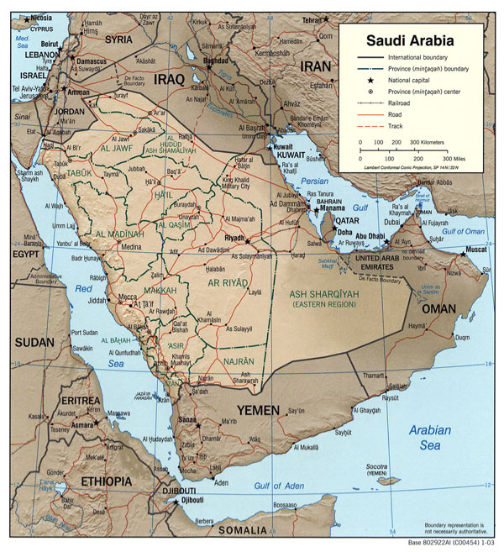

Slide 9
THE NEW ISLAMIC STATE
Hijra (Emigration) in 622, marked the beginning of a new era for Muslims;
Once in Yathrib, henceforth called Medina, Muhammad established an alliance uniting the indigenous warring tribes of Aws and Khazraj as well as the three main local Jewish tribes (Banū Qurayza, Banū Qaynuqā’ and Banū Nadīr);
The Muslim community in Medina divided into two main groups: The indigenous Muslims (Ansār and the Meccan immigrants Muhājirūn);
Hostility with Meccan establishment however did not die down :Series of battles between the two sides from 624 to 628 AD;
628 AD, treaty with the Meccans: The Treaty of Hudaibiyyah;
630 AD, Muhammad and his companions performed pilgrimage in Mecca: Mecca became part of the Islamic community;
632 AD, Muhammad passes away.

