Slide 1
Overview of History of Muslim World to 1500
HST 143 Muslim World 1500 – 1920
Spring 2020
Dr. Mbengue

Slide 2
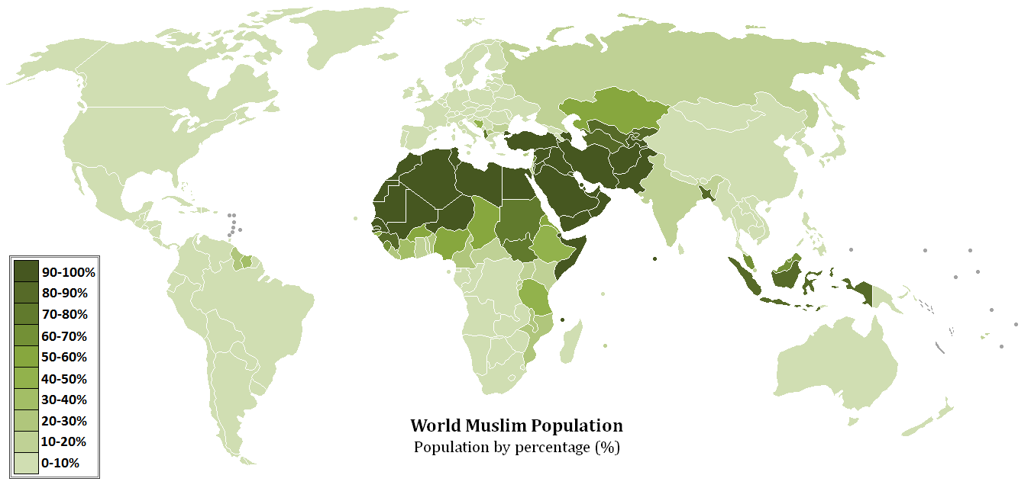
14
11
13
18
15
10
12
17
36
34
7
16
6
8
9
35
33
32
1
5
37
4
19
3
20
38
39
41
42
31
40
29
46
2
43
44
45
28
30
27
22
23
24
47
26
21
25
48
49

Slide 3
Chronology
570 Birth of Muhammad in Mecca;
610 First revelation;
622 Hijra to Medina (former Yathrib);
630 Conquest of Mecca;
632 Death of Muhammad;
632 Abu Bakr becomes Caliph;
632-633 Ridda wars;
634 Umar becomes Caliph;
637, 638, 642, 651: Islam expands to Syria, Iraq, Egypt, and Iran;

Slide 4
Chronology
644 Uthman becomes Caliph;
656 Ali becomes Caliph;
656 First civil war;
661 Mu’awiya becomes Caliph, beginning of Umayyad dynasty;
680 Karbala;
705-715 Islam expands to Central Asia and Sind;
711-720 Islam arrives in the Iberian peninsula;
750 Fall of Umayyad state rise of Abbasid state;
756 Umayyad emirate in Cordoba (Iberian peninsula);

Slide 5
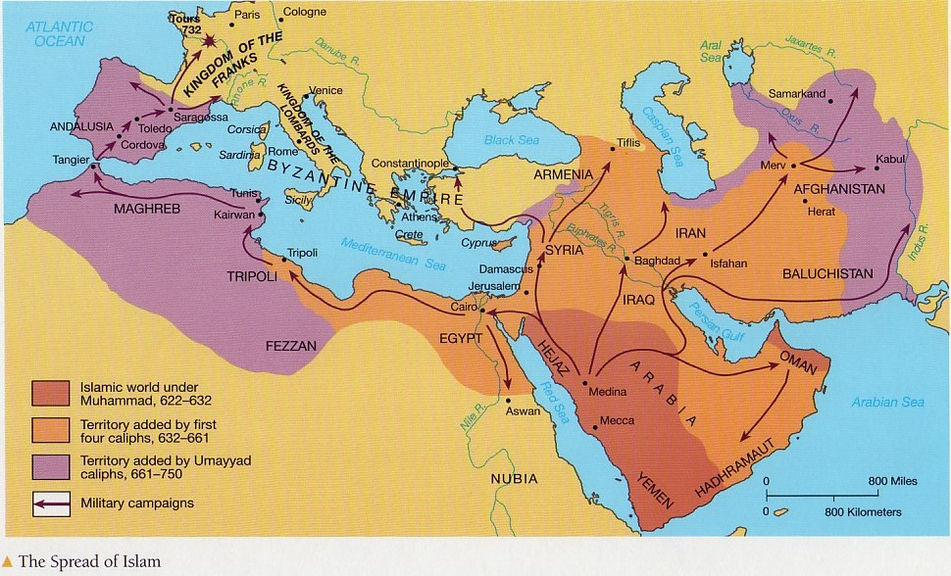

Slide 6
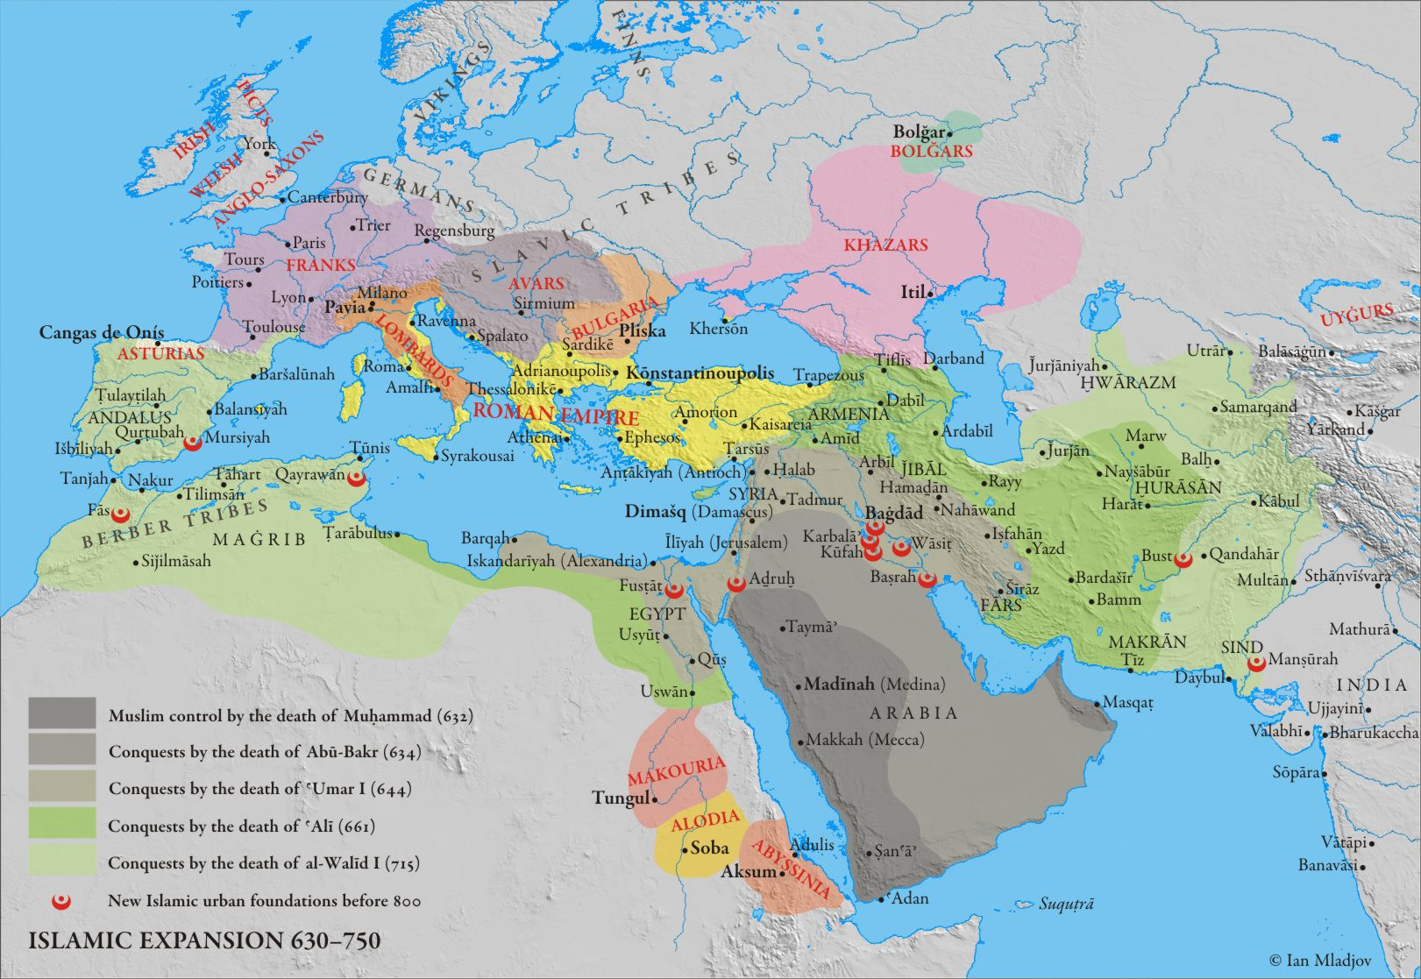

Slide 7
Chronology
762 Foundation of Baghdad;
909 Fatimid state in Ifriqiya;
945 Buyids seize power in Baghdad;
969 Fatimids conquer Egypt;
Saljuqs control Baghdad;
1050s-1147 Almoravid Empire;
1085 Toledo falls to Reconquista;
1099 First Crusade conquers Jerusalem;

Slide 8
Chronology
1147-1269 Almohad Empire;
1219-1222 Chinggis Khan’s campaigns in Muslim world;
1236-1266 All of Andalus except Granada falls to Reconquista;
1250 Mamluk state;
1258 Hulagu destroys Baghdad;
1260 Mamluks defeat Hulagu’s army;
1280-1334 Career of Osman, founder of Ottoman dynasty;
1347 First wave of plague;
1370 Timur’s career begins in Transoxiana;

Slide 9
Periodization in Muslim World History

Slide 10
Alternative Periodization
S.D. Goitein for example:
1- Arabism and Arabic Islam 500-850 C.E.;
2- The Intermediate Civilization 850-1250 C.E.;
3- Institutional Islam,Territorial, mostly non-Arab civilizations 1250-1800 C.E.;
Transition to National Cultures 1800-

