Slide 1
ITS 835 enterprise risk management
Chapter 5
ERM in Practice at the University of California Health System

Slide 2
introduction
University of California’s ERM
Technology
Premium rebate program
  Professional Liability Prescription Program (PLPP)
  ERM and the Center for Health Quality and Innovation
Protected health information value estimator
  PHIve

Slide 3
University of California’s erm
University of California (UC) Health System
  Clinics, medical centers, schools
  Over 3 million patient visits annually
UC Office of the President’s Office of Risk Services
  Responsible for ERM
UC formally adopted COSO Integrated Framework in 1995
  Committee of Sponsoring Organizations Internal Control
Newly hired Chief Risk Officer (CRO)
  Experienced in ERM from industry
Key Performance Indicator (KPI)
  Critical to ERM foundation

Slide 4
TECHNOLOGY
UC’s approach incorporates technology
  ERM information system (ERMIS)
Initial phases
  Simple risk assessment tools
  Dashboards
  Control, mitigation, monitoring, survey
Dashboard system
  Based on KPIs
  Visual indicators

Slide 5
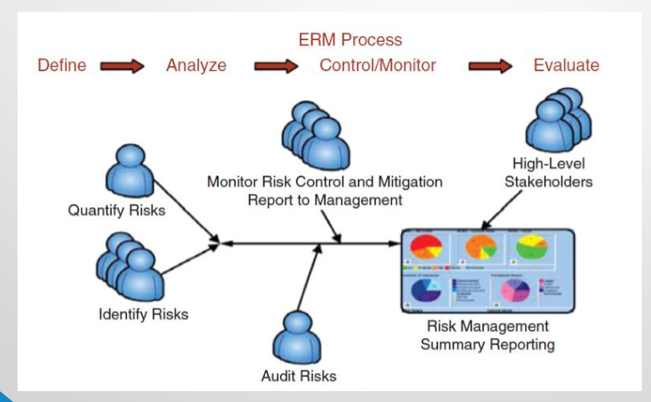
ERM PROCESS

Slide 6
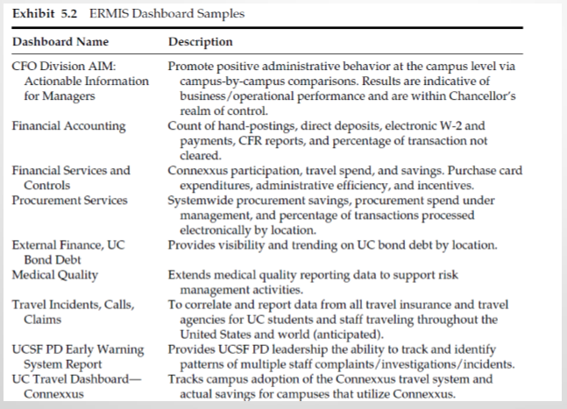
ERMIS DASHBOARD

Slide 7
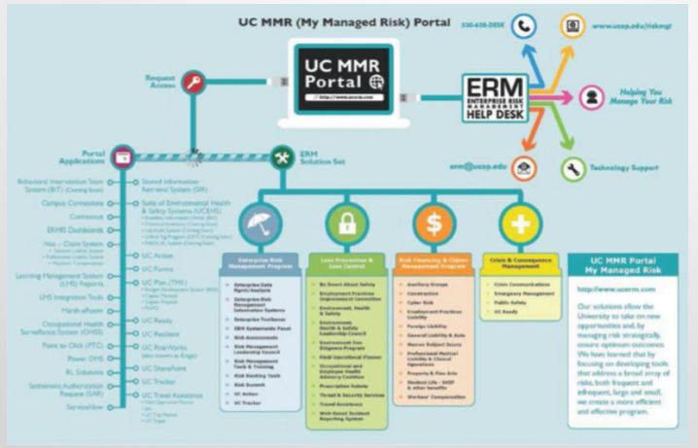
UC MMR (My Managed Risk) PortaL

Slide 8
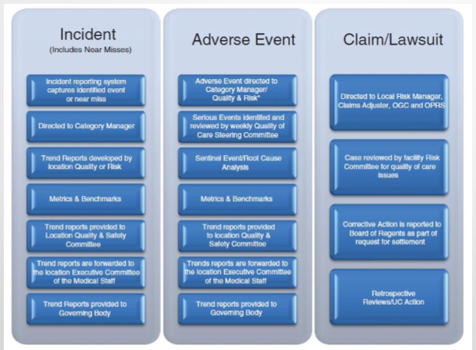
UC’s Approach to Evaluating Incidents, Events, and ClaimS

Slide 9
PREMIUM RATE PROGRAM
Program to reduce frequency and severity of loss
  Professional Liability Prescription Program (PLPP)
Encourage risk reduction initiatives
  Aimed at reducing cost of risk
Rewards units for implementing effective initiatives
  Annual rebates for initiatives that work
  Driving concept - Everyone is a risk manager
ERM and the Center for Health Quality and Innovation
  Joint venture to award up to $8 million
  Reduce risk of clinical harm to UC surgery patient

Slide 10
PHIVE
Personal health information (PHI)
UC asked Bickmore to develop a software tool
  Estimates the value of PHI
  PHI value estimator (PHIve)
PHIve steps
  Process determines the impact of PHI breach
Repercussions
  Reputational
  Financial
  Legal and regulatory
  Operational
  Clinical

Slide 11
SUMMARY
Risk is a part of all organizations
ERM assists organizations in managing all risk
UC deliberately advanced ERM to reduce overall risk
UC Office of Risk management updates risk plans in an ongoing effort
Technology is a cornerstone of UC’s ERM

