Slide 1
ITS835 enterprise risk management Chapter 3
ERM at Mars, Incorporated: ERM for Strategy and Operations

Slide 2
Introduction
Mars’ ERM history
Phase 1 –Crash and Burn
Phase 2 -Success
Global rollout
Reporting
Operating workshops
Technology
Aggregation
Template evolution
Conclusion

Slide 3
Mars’ erm history
Mars, Incorporated
Privately held -> migration to non-family management
Decentralized management
Leadership had legacy commitment to risk management
ERM was viewed as an evolution
COSO versus bespoke approach
COSO –Committee of Sponsoring Organizations structure
Bespoke approach won
Phase 1
Failed due to being impractical and overly complex
Phase 2
Simpler and targeted

Slide 4
Planning workshops
Desire to align senior management goals with ERM
Started with simple template
Operating plan initiative sheet
Objective
Score
Risk column
Risk treatment column
Management team met to define and rank
Risks
Risk treatments
Changed label from “mitigations”

Slide 5
Global rollout
Used lessons learned from pilot
Each unit has specific nuances
Interviewing GM and CFO together saved subsequent interview time
Workshops helped to identify
Gaps in risk management readiness
High-risk initiatives
Ongoing activities with unexpected high risk

Slide 6
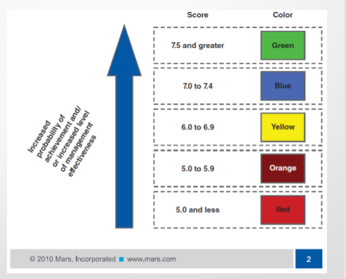
reporting
Color-coding adds
Urgency
Clarity
Groups are defined
Clusters
Score represents
Confidence of meeting goals

Slide 7
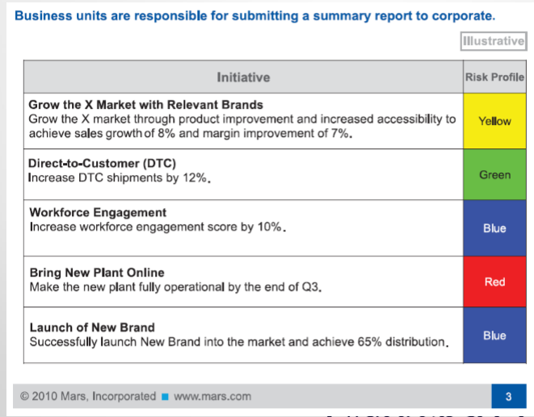
Reporting [cont’d]

Slide 8
Reporting [cont’d]

Slide 9
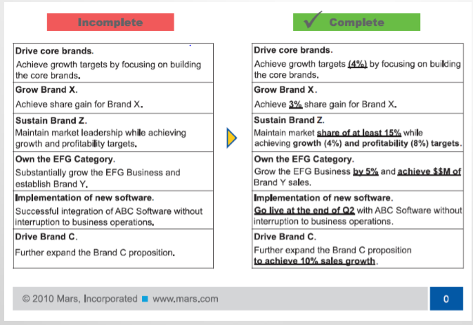
Reporting [cont’d]

Slide 10
Operating workshops
Several ongoing changes
Technology
Early-on, process was technology agnostic
Word -> Excel
Excel -> purpose-built software
ERM supports aggregation
More complete view of organizational impact of risk
Continual template evolution
Added risk treatment owners and due dates

Slide 11
summary
Mars received an award for their ERM
Corporate Executive Boards’ “Force of Ideas Award” for ERM
Key factors for ERM success
Alignment with Mars’ principles
Focus on meeting objectives
Operational
Strategic
Flexible
Realistic

