Slide 1
ITS 835 enterprise risk management Chapter 30, 31, & 34
miscellaneous Case Studies on ERM and RIsk

Slide 2
overview
Three case studies
Alleged Corruption at Chessfield
Bon Boulangerie
Building an ERM Program at General Motors
Different scenarios and organizations
Useful in examining broader implications
Look for similarities

Slide 3
Alleged Corruption at Chessfield
Chessfield
Fictional private American company in sports and entertainment
HQ in NYC
“Good ol’ boys” board
Informal governance
Whistle-blower
CEO compensation very high (4x comparable peers)
Potential environment for excessive risk taking
Chessfield CEO requested independent governance review
Review included
Document review –minimal documentation
Interviews – substantial discontent and lack of confidence in leadership
CEO compensation
Limited documentation to support decision
Basis seemed to be long relationship with decision makers
Industry standard metrics missing
Risk management
Few risk management protocols or controls
Most processes were manual (i.e. no IT)

Slide 4
Chessfield [cont’d]
Review resulted in 45 recommendations
43 from reviewer
2 added by regulator •
All but 2 recommendations were accepted, which were
3 longest serving board member resign
A female be selected for directorship and compensation committee
Identify broad implications of this case

Slide 5
Bon Boulangerie
Bakery in Oakville, Ontario
When purchased, single site retail and café
Ray Pane added wholesale operation
Plan to expand wholesale business
From 20km to 120km coverage
Include grocery stores
Add product line
Goal: triple profits in 3 years
What are the operational risks?

Slide 6
Building an erm program at general motors
Background
GM approach to ERM
Game theory
Looking forward

Slide 7
Erm at general motors
ERM program began in 2010
ERM to help achieve competitive advantage
New CEO
GM bankruptcy in 2009
CRO appointed
Financial and Risk Policy Committee formed
Risk officers identified and aligned to all CEO direct reports
GM embraced aggressive ER

Slide 8
Gm approach to erm
ERM built on GM’s vision
Design, build, and sell the world’s best vehicles
Identify and manage key risks
Bottom-up approach
Focus on “what can go right”
Lessons learned
Gave responsibility of assessing risk probability and impact to senior executives
Replaced ranked risk list with tiered list
Implemented a 5 point scale to measure
Inherent risk
Current risk
Residual risk

Slide 9
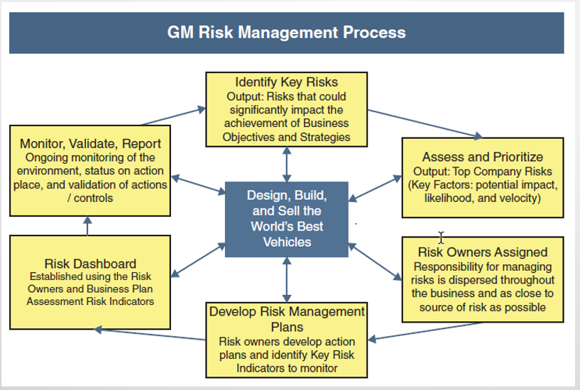
Gm risk management process

Slide 10
Inherent & Residual Risk scales

Slide 11
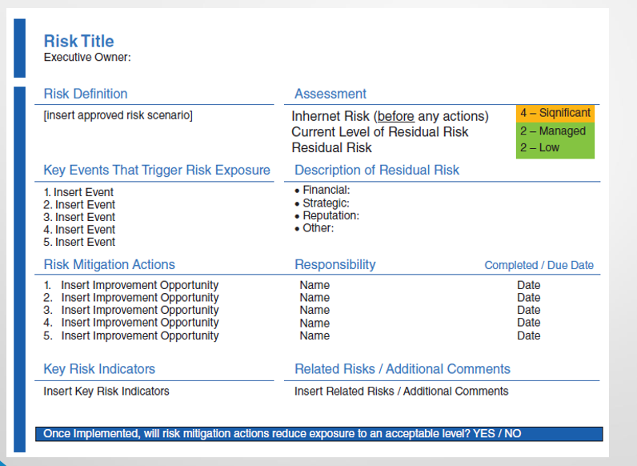
Risk template example

Slide 12
Game theory

Slide 13
Looking forward
Top risk attention in place
Ready to add focus on day-to-day operational risks
Developing program for operational control self assessment (CSA)
Approach is a policy-based CSA
Starts with simple yes-no questions to line managers
Benefits of a policy-based program
Policy can be leveraged to ensure results
Helps to educate teams on larger scope objectives
Ensures that policies are current and effective

