Slide 1
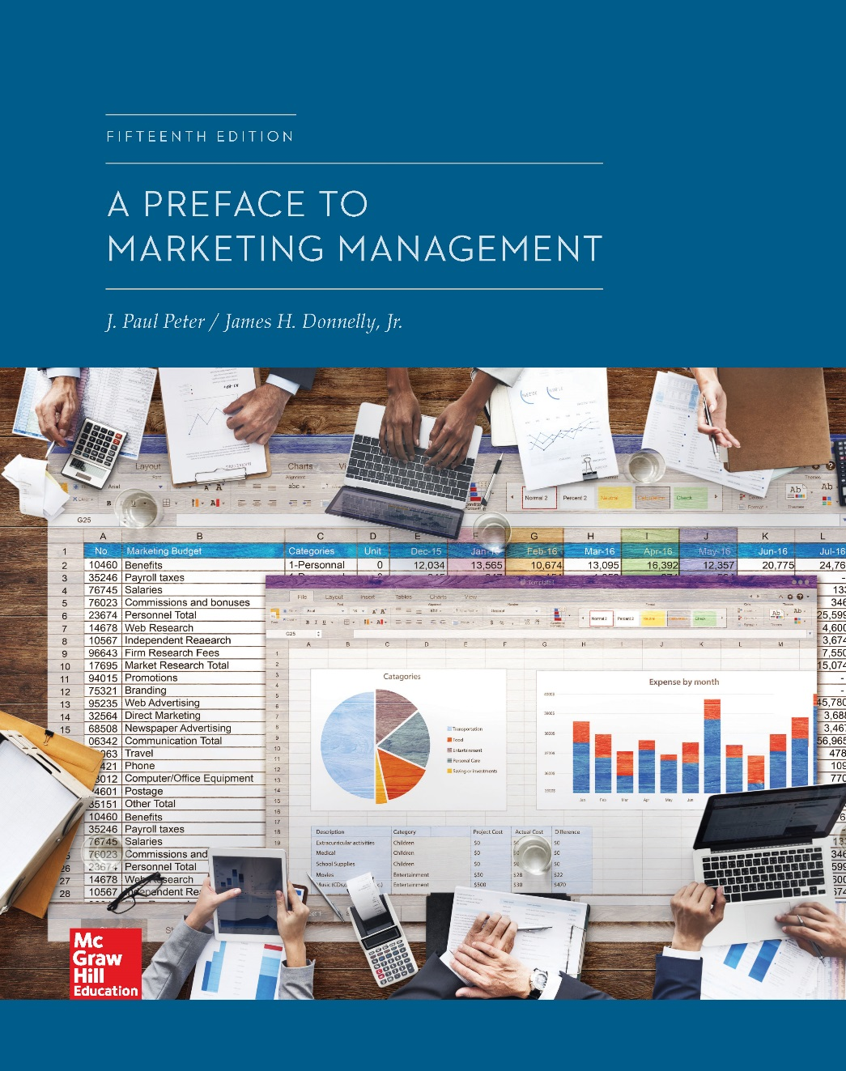
Chapter 11
Pricing Strategy
© McGraw-Hill Education. All rights reserved. Authorized only for instructor use in the classroom. No reproduction or further distribution permitted without the prior written consent of McGraw-Hill Education.

Slide 2
Chapter Outline
Demand influences on pricing decisions
Supply influences on pricing decisions
Environmental influences on pricing decisions
A general pricing model

Slide 3
Demand Influences on Pricing Decisions
Concern the nature of the target market and expected reaction of consumers to a given price or change in price
Primary considerations
Demographic factors
Psychological factors
Price elasticity

Slide 4
Demographic Factors
Number of potential buyers
Location of potential buyers
Position of potential buyers
Expected consumption rates of potential buyers
Economic strength of potential buyers
Jump to Demographic Factors, Appendix

Slide 5
Types of Psychological Pricing Strategies
Prestige pricing
Involves charging a high price to create a signal that the product is exceptionally fine
Odd pricing
Setting prices at one or a few cents or dollars below a round number in order to create the perception that the price is low
Bundle pricing
Involves selling several products together at a single price in order to suggest a good value
Jump to Types of Psychological Pricing Strategies, Appendix

Slide 6
Price Elasticity
Measure of consumers’ price sensitivity, which is estimated by dividing relative changes in the quantity sold by relative changes in price
Calculated by dividing percent change in quantity demand by percent change in price

Slide 7
Basic Methods of Measuring Price Elasticity
Historical data or from price slash quantity data across different sales districts
Sampling a group of consumers from the target market and polling them concerning various price slash quantity relationships

Slide 8
Supply Influences on Pricing Decisions
Pricing objectives
Should be derived from overall marketing objectives, which in turn should be derived from corporate objectives
Common pricing objectives according to research
Achieving a target return on investment
Stabilizing price and margin
Achieving a target market share
Meeting or preventing competition

Slide 9
Cost Considerations in Pricing, 1
Price of a product must cover costs of production, promotion, distribution and a profit
Variations in cost-oriented pricing
Markup pricing: Involves adding a percentage to the invoice price in order to determine the final selling price
Cost-plus pricing: Totaling of the costs of producing a product or completing a project and then adding on a percentage or fixed profit amount
Rate-of-return pricing: Involves adding a desired rate of return on investment to total costs

Slide 10
Cost Considerations in Pricing, 2
Advantages of cost-oriented pricing
Simplicity
Yields a good pricing decision
Criticism of cost-oriented pricing
Little or no consideration to demand factors
Fails to reflect competition adequately

Slide 11
Product Considerations, 1
Perishability: Discounting the products as they approach being no longer fit for sale
Products are perishable if the demand for them is confined to a specific time period
Distinctiveness: Marketers can charge higher prices if they can successfully distinguish their products from those of their competitors
Branding and brand equity are used to make products distinctive

Slide 12
Product Considerations, 2
Life cycle
Skimming policy: Seller charges a relatively high price on a new product initially and then lowers the price at a later date to make sales to more price-sensitive buyers
Penetration policy: Seller charges a relatively low price on a new product initially in order to grow a market, gain market share, and discourage competition from entering the market

Slide 13
Environmental Influences on Pricing Decisions, 1
Internet
Has made prices much easier for consumers and organizational buyers to compare
Has forced marketers to be much more transparent in their pricing strategies
Competition
Factors that help determine firm’s selling price compared to competitors
Number of competitors
Market shares, growth, and profitability of competitors

Slide 14
Environmental Influences on Pricing Decisions, 2
Strengths and weaknesses of competitors
Likely entry of new firms into the industry
Degree of vertical integration of competitors
Number of products sold by competitors
Cost structure of competitors
Historical reaction of competitors to price changes
Going-rate pricing: Pricing a product at the average charged in the industry
Sealed-bid pricing: Bidding process in which each seller submits a sealed bid and attempts to price below competition in order to get the contract

Slide 15
Environmental Influences on Pricing Decisions: Government Regulations, 1
Price fixing
Competitors in a market collude to set the final price of a product
Illegal under the Sherman Antitrust Act and the Federal Trade Commission Act
Deceptive pricing
Involves price deals that mislead the consumer
Illegal under Section 5 of the Federal Trade Commission Act
Jump to Environmental Influences on Pricing Decisions: Government Regulations, 1, Appendix

Slide 16
Environmental Influences on Pricing Decisions: Government Regulations, 2
Price discrimination
Charging different prices to different buyers for goods of like grade and quality
Illegal under the Robinson-Patman Act if it lessens or is deemed injurious to competition
Predatory pricing
Involves charging a very low price for a product with the intent of driving competitors out of business
Illegal under the Sherman Act and Federal Trade Commission Act
Jump to Environmental Influences on Pricing Decisions: Government Regulations, 2, Appendix

Slide 17
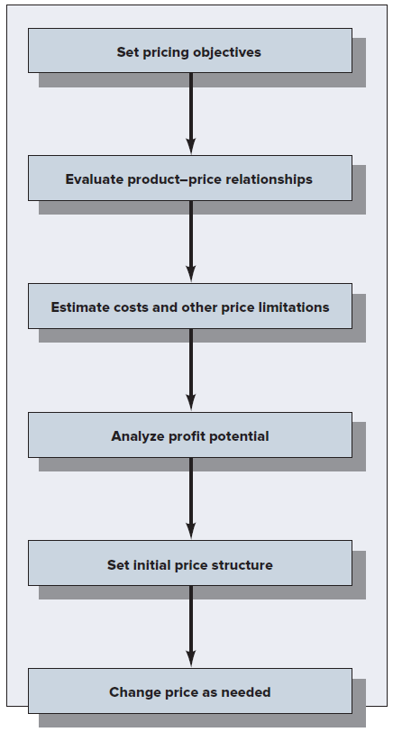
Figure 11.1: A General Pricing Model
Jump to Figure 11.1: A General Pricing Model, Appendix

Slide 18
Set Pricing Objectives
Clear statement of pricing objectives is given
Pricing objectives guide the pricing strategy and should be designed to support the overall marketing strategy
Efforts to set prices must be coordinated with other functional areas

Slide 19
Evaluating Product and Price Relationships, 1
Considerations for marketers
What value the product has for customers
How price will influence product positioning
Product could be priced:
Relatively high for a product class because it offers value in the form of high quality, special features, or prestige
At about average for the product class because it offers value in the form of good quality for a reasonable price
Relatively low for a product class because it offers value in the form of acceptable quality at a low price

Slide 20
Evaluating Product and Price Relationships, 2
Value pricing: Setting prices so that targeted customers will perceive products to offer greater value than competitive offerings
Price elasticity: Measure of consumers’ price sensitivity that is estimated by dividing relative changes in the quantity sold by relative changes in price

Slide 21
Estimating Costs and Other Price Limitations
Costs to produce and market products provide a lower bound for pricing decision and a baseline from which to compute profit potential
Other price limitations
Government regulations
Prices charged by competitors for similar and substitute products
Competitive reactions that could influence the price of a new product or a price change in an existing one

Slide 22
Analyzing Profit Potential
Quantity discounts
Discounts for purchasing a large number of units
Promotional allowances
Price reduction offered to channel members in exchange for performing various promotional activities
Slotting allowances
Payments to retailers to get them to stock items on their shelves, a common tactic for getting new products into stores
Jump to Analyze Profit Potential, Appendix

Slide 23
Setting Initial Price Structure
Done after all of the supply, demand, and environmental factors have been considered by marketers
Price structure takes into account:
Price to various channel members
Recommended price to final consumers or organizational buyer

Slide 24
Changing Price as Needed
Reasons for changing initial price structure
Channel members may bargain for greater margins
Competitors may lower their prices
Costs may increase with inflation
In the short term, discounts and allowances have to be larger or more frequent than planned
In the long term, price structures tend to increase for most products

Slide 25
APPENDICES

Slide 26
Demographic Factors, Appendix
There are 5 small rectangular boxes partially overlapping 5 large rectangular boxes. Each pair of small and large boxes is placed one below the other. The small boxes contain labels. The large boxes are empty. In the first pair of boxes, the small box is labeled number of potential buyers. In the second pair of boxes, the small box is labeled location of potential buyers. In the third pair of boxes, the small box is labeled position of potential buyers. In the fourth pair of boxes, the small box is labeled expected consumption rates of potential buyers. In the fifth pair of boxes, the small box is labeled economic strength of potential buyers.
Jump back to Demographic Factors

Slide 27
Types of Psychological Pricing Strategies, Appendix
There are 3 small rectangular boxes partially overlapping 3 large rectangular boxes. Each pair of small and large boxes is placed one below the other. The content in the large box explains the term provided in the small box. In the first pair of boxes, the small box is labeled prestige pricing. The content in the large box reads involves charging a high price to create a signal that the product is exceptionally fine. In the second pair of boxes, the small box is labeled odd pricing. The content in the large box reads setting prices at one or a few cents or dollars below a round number in order to create the perception that the price is low. In the third pair of boxes, the small box is labeled bundle pricing. The content in the large box reads involves selling several products together at a single price in order to suggest a good value.
Jump back to Types of Psychological Pricing Strategies

Slide 28
Government Regulations, 1, Appendix
There are 2 small rectangular boxes partially overlapping 2 large rectangular boxes. Each pair of small and large boxes is placed one below the other. The content in the large box contains sub-points, which explain the term provided in the small box. In the first pair of boxes, the small box is labeled price fixing. The content in the large box has two sub-points. The first sub-point reads competitors in a market collude to set the final price of a product. The second sub-point reads illegal under the Sherman Antitrust Act and the Federal Trade Commission Act. In the second pair of boxes, the small box is labeled deceptive pricing. The content in the large box has two sub-points. The first sub-point reads involves price deals that mislead the consumer. The second sub-point reads Illegal under Section 5 of the Federal Trade Commission Act.
Jump back to Government Regulations, 1

Slide 29
Government Regulations, 2, Appendix
There are 2 small rectangular boxes partially overlapping 2 large rectangular boxes. Each pair of small and large boxes is placed one below the other. The content in the large box explains the term provided in the small box. In the first pair of boxes, the small box is labeled price discrimination. The large box has two points. The first point reads charges different prices to different buyers for goods of like grade and quality. The second point reads illegal under the Robinson-Patman Act if it lessens or is deemed injurious to competition. In the second pair of boxes, the small box is labeled predatory pricing. The large box has two points. The first point reads involves charging a very low price for a product with the intent of driving competitors out of business. The second point reads illegal under the Sherman Act and Federal Trade Commission Act.
Jump back to Government Regulations, 2

Slide 30
Figure 11.1: A General Pricing Model, Appendix
There are six rectangular boxes placed one below the other. To denote a process, downward pointing arrows are placed at the bottom of each of the boxes, except for the last one. The content in the first box reads set pricing objectives. The content in the second box reads evaluate product and price relationships. The content in the third box reads estimate costs and other price limitations. The content in the fourth box reads analyze profit potential. The content in the fifth box reads set initial price structure. The content in the fifth box reads change price as needed.
Jump back to Figure 11.1: A General Pricing Model

Slide 31
Analyze Profit Potential, Appendix
There are 3 small rectangular boxes partially overlapping 3 large rectangular boxes. Each pair of small and large boxes is placed one below the other. The content in the large box explains the term provided in the small box. In the first pair of boxes, the small box is labeled quantity discounts. The content in the large box reads discounts for purchasing a large number of units. In the second pair of boxes, the small box is labeled promotional allowances. The content in the large box reads price reduction offered to channel members in exchange for performing various promotional activities. In the third pair of boxes, the small box is labeled slotting allowances. The content in the large box reads payments to retailers to get them to stock items on their shelves, a common tactic for getting new products into stores.
Jump back to Analyze Profit Potential

