Slide 1
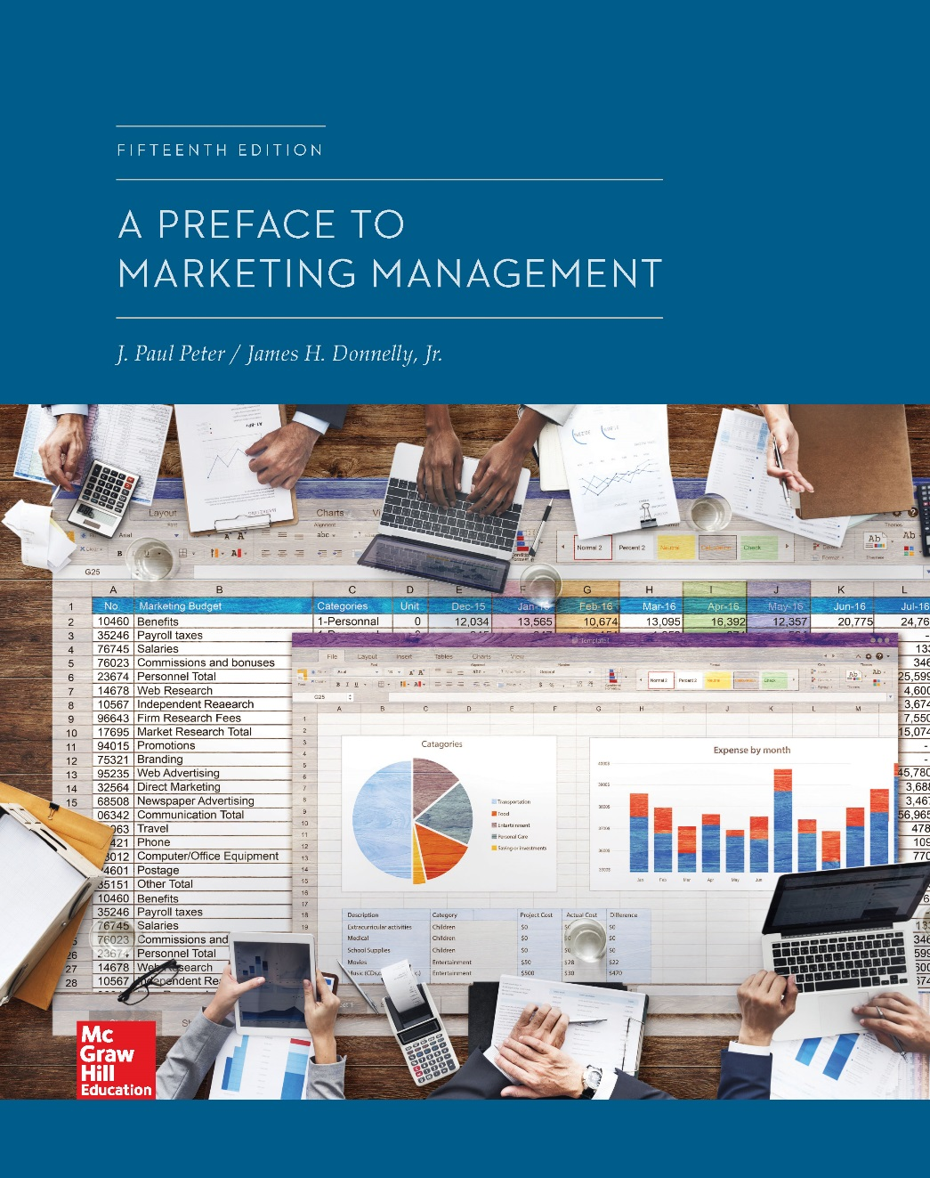
Chapter 10
Distribution Strategy
© McGraw-Hill Education. All rights reserved. Authorized only for instructor use in the classroom. No reproduction or further distribution permitted without the prior written consent of McGraw-Hill Education.

Slide 2
Chapter Outline
The need for marketing intermediaries
Classification of marketing intermediaries and functions
Channels of distribution
Selecting channels of distribution
Managing a channel of distribution
Wholesaling
Store and nonstore retailing

Slide 3
Channel of Distribution and Marketing Intermediaries
Channel of distribution: Combination of institutions through which a seller markets products to organizational buyers or ultimate consumers
Marketing intermediaries are used by producers because they perform functions cheaply and efficiently
Role of intermediaries is to bring supply and demand together in an efficient and orderly fashion

Slide 4
Classification of Marketing Intermediaries
Middlemen
Merchant middlemen
Agent
Wholesaler
Retailer
Broker
Manufacturers’ agent
Distributor
Jobber
Facilitating agent

Slide 5
Functions Performed in Channels of Distribution, 1
Transactional function
Buying
Selling
Risk taking
Logistical function
Assorting
Storing
Sorting
Transporting

Slide 6
Functions Performed in Channels of Distribution, 2
Facilitating function
Financing
Grading
Marketing information and research

Slide 7
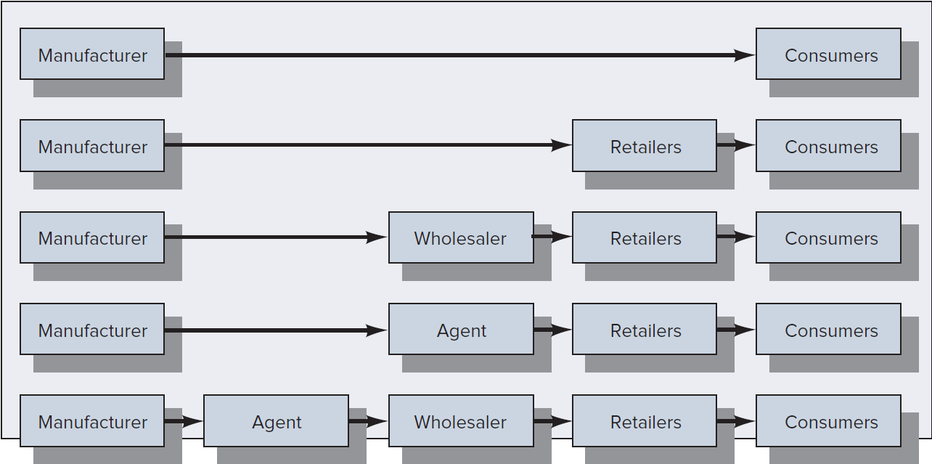
Figure 10.3: Conventional Channels of Distribution of Consumer Goods
Jump to Figure 10.3: Conventional Channels of Distribution of Consumer Goods, Appendix

Slide 8
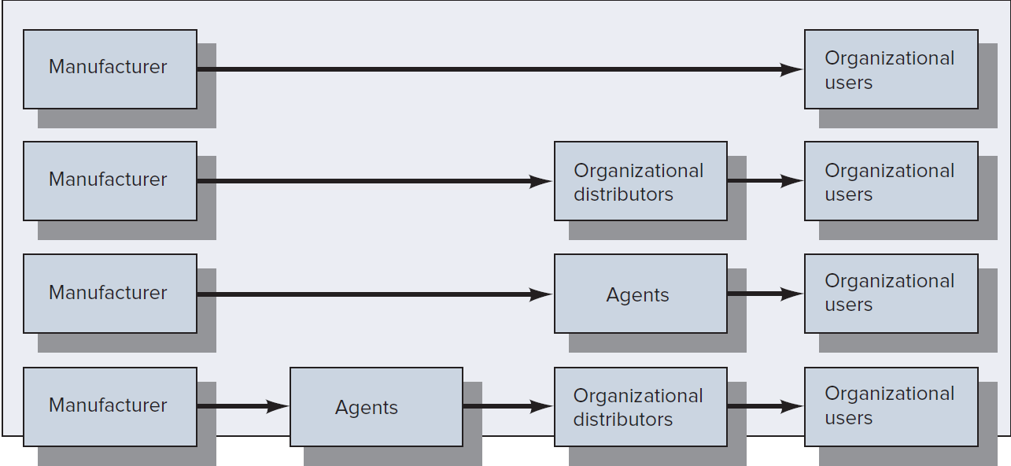
Figure 10.4: Conventional Channels of Distribution for Organizational Goods
Jump to Figure 10.4: Conventional Channels of Distribution for Organizational Goods, Appendix

Slide 9
Selecting Channels of Distribution, 1
General considerations
Customer characteristics
Product characteristics
Intermediary characteristics
Competitor characteristics
Company characteristics
Environmental characteristics

Slide 10
Selecting Channels of Distribution, 2
Specific considerations
Distribution coverage required
Degree of control desired
Total distribution cost
Channel flexibility

Slide 11
Distribution Coverage Required
Intensive distribution: Manufacturer attempts to gain exposure through as many wholesalers and retailers as possible
Selective distribution: Manufacturer limits the use of intermediaries to the ones believed to be the best available in a geographic area
Exclusive distribution: Manufacturer limits distribution, and intermediaries are provided exclusive rights within a particular territory

Slide 12
Degree of Control Desired
Seller must make decisions concerning the degree of control desired over the marketing of the firm’s products
Degree of control achieved by the seller is proportionate to the directness of the channel
When more indirect channels are used, the manufacturer must surrender some control over the marketing of the firm’s product

Slide 13
Total Distribution Cost and Channel Flexibility, 1
Channel of distribution should be viewed as a total system composed of interdependent subsystems
Objective of the system manager should be to optimize total system performance
Major distribution costs to be minimized are:
Transportation
Order processing
Cost of lost business

Slide 14
Total Distribution Cost and Channel Flexibility, 2
Inventory carrying costs
Storage-space charges, cost of capital invested, taxes, insurance, obsolescence, and deterioration
Packaging
Materials handling
Channel flexibility: Ability of the manufacturer to adapt to changing conditions

Slide 15
Managing a Channel of Distribution
Relationship marketing
Marketing with the conscious aim to develop and manage long-term and slash or trusting relationships with customers, distributors, suppliers, or other parties in the marketing environment
Long-term relationships throughout the channel lead to higher-quality products with lower costs and can account for the increased use of vertical marketing systems
Vertical marketing systems: Channels in which members are more dependent on one another and develop long-term working relationships to improve efficiency and effectiveness

Slide 16
Types of Vertical Marketing Systems, 1
Administered systems: Have higher degree of interorganizational planning and management than in a conventional channel
Contractual systems: Involve independent production and distribution companies entering into formal contracts to perform designated marketing functions
Types
Retail cooperative organization
Wholesaler-sponsored voluntary chain
Various franchising programs

Slide 17
Types of Vertical Marketing Systems, 2
Corporate systems: Single ownership of two or more levels of a channel
Forward integration: Manufacturer’s purchase of wholesalers or retailers who distribute its products
Backward integration: Wholesalers or retailers purchase channel members above them

Slide 18
Wholesaling
Wholesalers are merchants engaged in buying, taking title to, storing and physically handling goods, and reselling the goods to retailers or to industrial or business risers
Also called distributors in some industries
Create value for suppliers, retailers, and users of goods by performing distribution functions efficiently and effectively
Try to attract producers to use their services
Need to attract retailers and organizational customers to buy from them

Slide 19
Store Retailing, 1
Retailers vary in the:
Types of merchandise they carry
Breadth and depth of their product assortments
Amount of service they provide

Slide 20
Store Retailing, 2
Types of retailers
Mass merchandisers: Carry broad product assortments and compete on two bases
Specialty stores: Handle deep assortments in a limited number of product categories
Limited-line stores
Single-line stores
Category killers
Convenience stores: Retailers whose primary advantages are location convenience, close-in parking, and easy entry and exit

Slide 21
Methods of Nonstore Retailing
Catalogs and direct mail
Vending machines
Television home shopping
Direct sales or telemarketing
Online retailing
Mobile retailing
Multichannel marketing: Offering products and services in stores, in catalogs, and online

Slide 22
Online Retailing: Advantages for Marketers, 1
Reduces the need for stores, paper catalogs, and salespeople
Allows good visual presentation and full description of product features and benefits
Allows vast assortments of products to be offered efficiently
Allows strategic elements, such as product offerings, prices, and promotion appeals, to be changed quickly
Allows products to be offered globally in an efficient manner

Slide 23
Online Retailing: Advantages for Marketers, 2
Allows products to be offered 24 hours a day, 365 days a year
Fosters the development of one-on-one, interactive relationships with customers
Provides an efficient means for developing a customer database and doing online marketing research

Slide 24
Online Retailing: Disadvantages for Marketers, 1
Strong price competition online often squeezes profit margins
Low entry barriers lead some e-marketers to overemphasize order-taking and not develop sufficient infrastructure for order fulfillment
Customers must go to the website rather than having marketers seek them out via salespeople and advertising
Limits the market to customers who are willing and able to purchase electronically

Slide 25
Online Retailing: Disadvantages for Marketers, 2
Not as good for selling touch-and-feel products as opposed to look-and-buy products unless there is strong brand, store, or site equity or the products are homogeneous
Often less effective and efficient in business-to-consumer markets than in business-to-business markets

Slide 26
APPENDICES

Slide 27
Figure 10.3: Conventional Channels of Distribution of Consumer Goods, Appendix
The first channel presents two rectangular boxes. It begins with a rectangular box labeled manufacturer. An arrow from this box points to a rectangular box labeled consumers. The second channel presents three rectangular boxes. It begins with a rectangular box labeled manufacturer. An arrow from this box points to a second rectangular box labeled retailers. Another arrow from the second box leads to a third box labeled consumers. The third channel presents four rectangular boxes. It begins with a rectangular box labeled manufacturer. An arrow from this box points to a second rectangular box labeled wholesaler. An arrow from the second box points to the third box labeled retailers. An arrow from the third box points to the fourth box labeled consumers. The fourth channel presents four rectangular boxes. It begins with a box labeled manufacturer. An arrow from the first box points to a second rectangular box labeled agent. An arrow from the second box points to the third box labeled retailers. An arrow from the third box points to the fourth box labeled consumers. The fifth channel presents five rectangular boxes. It begins with a box labeled manufacturer. An arrow from this box points to the second box labeled agent. An arrow from the second box points to the third box labeled wholesaler. An arrow from the third box points to the fourth box labeled retailers. An arrow from the fourth box points to the fifth box labeled consumers.
Jump back to Figure 10.3: Conventional Channels of Distribution of Consumer Goods

Slide 28
Figure 10.4: Conventional Channels of Distribution for Organizational Goods, Appendix
The first channel contains two rectangular boxes. It begins with a rectangular box labeled manufacturer. An arrow from this box points to a rectangular box labeled organizational users. The second channel contains three rectangular boxes. It begins with a rectangular box labeled manufacturer. An arrow from this box points to the second rectangular box labeled organizational distributors. An arrow from the second box points to the third box labeled organizational users. The third channel contains three rectangular boxes. It begins with a rectangular box labeled manufacturer. An arrow from this box points to the second rectangular box labeled agents. An arrow from the second rectangular box points to the third rectangular box labeled organizational users. The fourth channel contains four rectangular boxes. It begins with a box labeled manufacturer. An arrow from this box points to the second box labeled agent. An arrow points from the second box to the third box labeled organizational distributors. An arrow from the third box points to the fourth box labeled organizational users.
Jump back to: Figure 10.4: Conventional Channels of Distribution for Organizational Goods

