Slide 1
Managing and Using Information Systems: A Strategic Approach – Sixth Edition
Keri Pearlson, Carol Saunders, and Dennis Galletta
© Copyright 2016 John Wiley & Sons, Inc.

Slide 2
Chapter 6 Architecture and Infrastructure

Slide 3
Mohawk Paper
What did Mohawk paper see as an opportunity?
What did they do?
What was the result?
Notes:
Opportunity: Cloud, SOA, XML technology allowing them to make service the primary focus, collaborate with network of partners, incorporate flexibility into the process. Can shift quickly from outsourced to insourced for projects.
Results: 5 times the number of products sold to customers compared to before. Tripled earnings. More customers than before: now 100, previously 10-15 distributors. Automated transactions: saving $1 to $2 million

Slide 4
From Vision to Implementation
Architecture translates strategy into infrastructure
Home architect develops a blueprint of a proposed house—based on customer
Business architect develops a blueprint of a company’s proposed systems—based on strategy
This “blueprint” is used for translating business strategy into a plan for IS.
The IT infrastructure is everything that supports the flow and processing of information (hardware, software, data, and networks).

Slide 5
From abstract to concrete – building vs. IT

Slide 6
The Manager’s Role
Must understand what to expect from IT architecture and infrastructure.
Must clearly communicate business vision.
May need to modify the plans if IT cannot realistically support them.
Manager MUST be involved in the decision making process.

Slide 7
From Strategy to Architecture
Manager starts out with a strategy.
Strategy is used to develop more specific goals
Business requirements must be determined for each goal so the architect knows what IS must accomplish.

Slide 8
Example
Strategy: Be a customer-oriented company
Goal: 30-day money back guarantee
Business Requirement: ability to track purchases
Business Requirement: ability to track problems
Goal: Answer email questions within 6 hours
Business Requirement: Ability to handle the volume

Slide 9
From Business Requirements to Architecture

Slide 10
The Example Continues
Business Requirement: Ability to track purchases
Architectural Requirement:
Database that can handle all details of more than a 30-day history

Slide 11
From Architecture to Infrastructure
Adds more detail to the architectural plan.
actual hardware, software, data, and networking
Components need coherent combination

Slide 12
From Architecture to Infrastructure

Slide 13
The Example Continues
Architectural Requirement: Database that can handle all details of more than a 30-day history
Functional Specification: be able to hold 150,000 customer records, 30 fields; be able to insert 200 records per hour
Hardware specification: 3 gigaherz Core 2 Duo Server
Hardware specification: half terabyte RAID level 3 hard drive array
Software specification: Apache operating system
Software specification: My SQL database
Data protocol: IP (internet protocol)

Slide 14
A Framework for the Translation
Considerations for moving from strategy to architecture to infrastructure:
Hardware – physical components
Software – programs
Network – software and hardware
Data – utmost concern: data quantity & format
What-who-where is a useful framework

Slide 15
Information systems analysis framework.
Component | What | Who | Where
Hardware | What hardware does the organization have? | Who manages it? Who uses it? Who owns it? | Where is it located? Where is it used?
Software | What software does the organization have? | Who manages it? Who uses it? Who owns it? | Where is it located? Where is it used?
Network | What networking does the organization have? | Who manages it? Who uses it? Who owns it? | Where is it located? Where is it used?
Data | What data does the organization have? | Who manages it? Who uses it? Who owns it? | Where is it located? Where is it used?

Slide 16
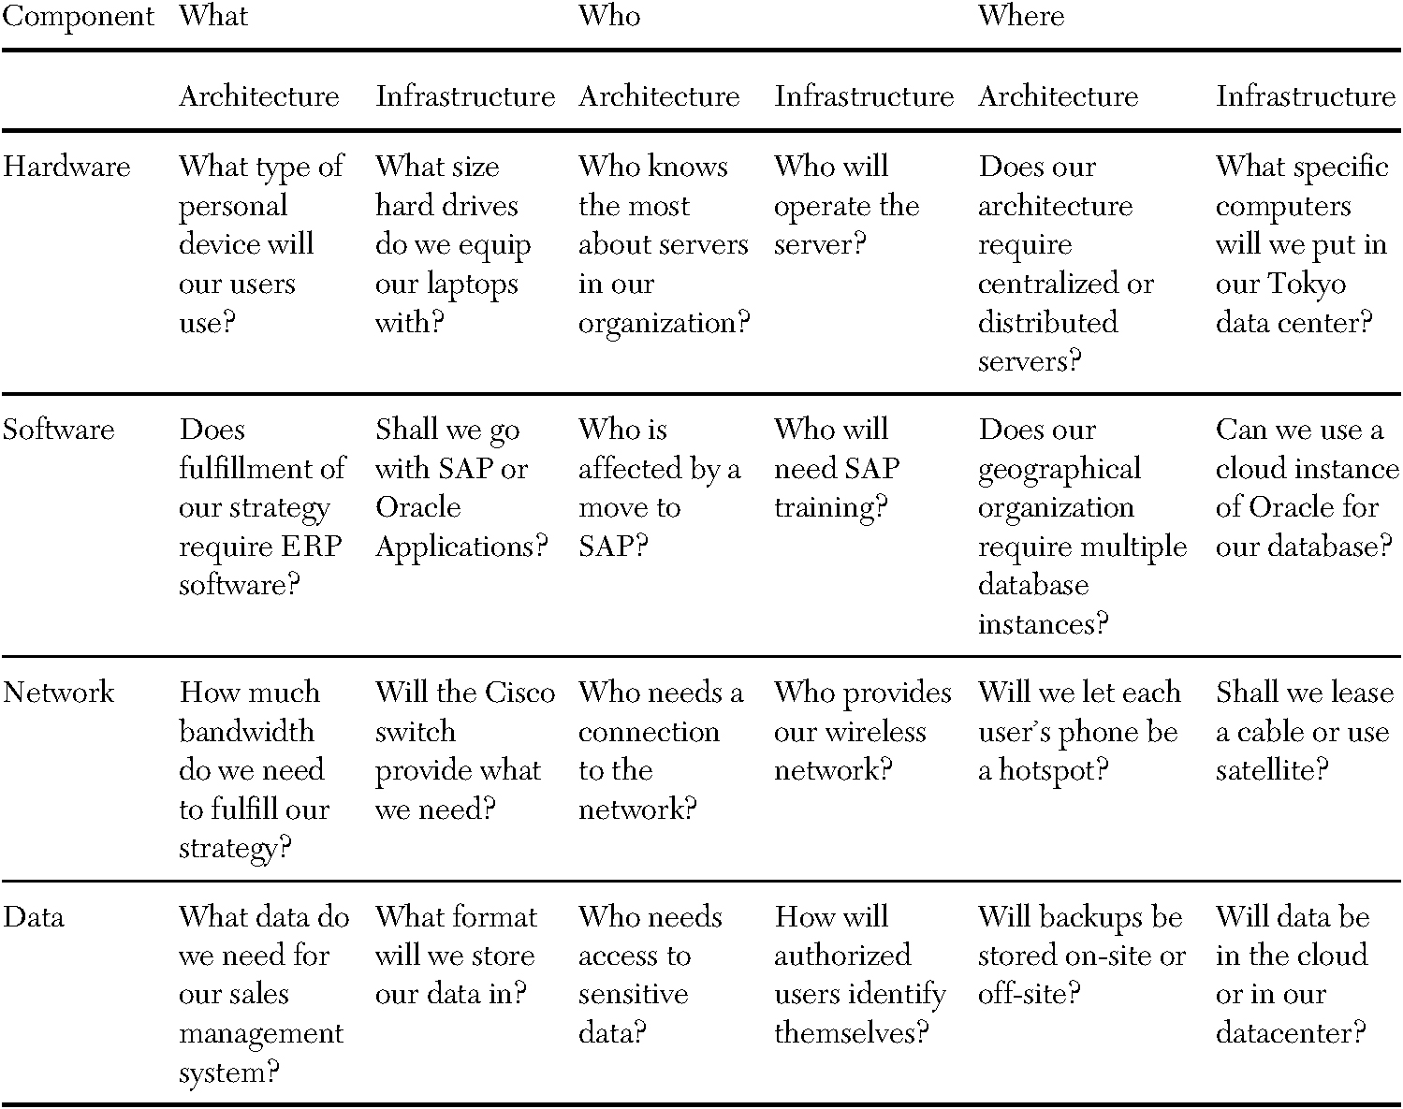
Figure 6.3 Infrastructure and architecture analysis framework with sample questions.

Slide 17
Common IT Architecture Configurations
Centralized architecture – All purchases, support, and management from data center
Decentralized architecture – uses multiple servers perhaps in different locations
Service-Oriented architecture – uses small chunks of functionality to build applications quickly.
Example: e-commerce shopping cart
Software-Defined architecture – instantly reconfigures under load or surplus

Slide 18
Software-Defined Architecture
Birdbath example: Thanks to the Oprah Winfrey show, sales went from 10 per month to 80,000.
Increased sales seen as an attack with static system
Adaptive system warns other parts of sales fluctuations, preventing lost sales
Famous Coffee Shop example:
WiFi shares lines with production systems; problems in one can be shunted to another
Also, coffee bean automatic reordering; spot market purchasing
High potential for decreasing costs

Slide 19
New Technologies
Peer to peer architecture: Allows networked computers to share resources without a central server
Wireless (mobile) infrastructure: allows communication without laying wires
Web-based architecture: places information on web servers connected to the Internet
Cloud-based architecture: places both data and processing methods on servers on the Internet, accessible anywhere
Capacity-on-demand: enables firms to make available more processing capacity or storage when needed

Slide 20
Architectural Principles
Fundamental beliefs about how the architecture should function

Slide 21
Enterprise Architecture (EA)
The “blueprint” for all IS and interrelationships in the firm
Four key elements:
Core business processes
Shared data
Linking and automation technologies
Customer groups
One example is TOGAF (The Open Group Architecture Foundation)
Methodology and set of resources for developing an EA
Specifications are public
Business and IT leaders develop EA together

Slide 22
Virtualization and Cloud Computing
Cloud computing refers to:
Resources that are available “on the Internet”
No software for the organization to develop or install (only web browser)
No data for the organization to store (it stays somewhere in the Internet “cloud”)
The provider keeps and safeguards programs and data
This is “infrastructure as a service” (IaaS)
Also available is SaaS (Software as a service)
And there is also PaaS (Platform as a service)
Utility Computing: Pay only for what you use (like power, lights)
Source: Computerworld Aug 4, 2008

Slide 23
Examples of Systems Provided in the “Cloud?”
Just some examples
Word processing; spreadsheeting; email (Google Docs: $50 per user annually)
Buying/selling Financial services (Salesforce.com)
Email (Gmail, Hotmail)
Social networking (Facebook)
Business networking (LinkedIn)
Music (iTunes)
Storage (Amazon’s Simple Storage Service—S3)
A server (Amazon’s Elastic Compute Cloud—EC2)
Source: Computerworld Aug 4, 2008 and CRN website

Slide 24
Assessing Strategic Timeframe
Varies from industry to industry
Level of commitment to fixed resources
Maturity of the industry
Cyclicality
Barriers to entry
Also varies from firm to firm
Management’s reliance on IT
Rate of advances affecting the IT management counts on

Slide 25
Assessing Adaptability
Guidelines for planning adaptable IT architecture and infrastructure
Plan for applications and systems that are independent and loosely coupled
Set clear boundaries between infrastructure components
When designing a network architecture, provide access to all users when it makes sense to do so

Slide 26
Assessing Scalability
Scalability refers to how well a component can adapt to increased or decreased demand
Needs are determined by:
Projections of growth
How architecture must support growth
What happens if growth is much higher than projected
What happens if there is no growth

Slide 27
Other Assessments
Standardization – Common, shared standards are easy to plug in
Maintainability – Can the infrastructure be maintained?
Security – Decentralized architecture is more difficult to secure

Slide 28
Assessing Financial Issues
Quantify expected return on investment
Can be difficult to quantify
Steps
Quantify costs
Determine life cycles of components
Quantify benefits
Quantify risks
Consider ongoing dollar costs and benefits

Slide 29
Managing and Using Information Systems: A Strategic Approach – Sixth Edition
Keri Pearlson, Carol Saunders, and Dennis Galletta
© Copyright 2016 John Wiley & Sons, Inc.

