Slide 1
Attitudes, Beliefs, and Consistency
7

Slide 2
Learning Objectives
Define attitudes and why people have them
Describe how attitudes are formed
Summarize how major consistency theories and the duplex mind relate to attitudes
Explain the relationship between attitudes and behavior
Debate the role of attitudes in coping with trauma
Notes:
This is an overview of the topics of the chapter.

Slide 3
Introduction
Facebook allows people to express their attitudes and beliefs
Many digital tools are substitutes for normal social interaction
Facebook users tend to be more extraverted and narcissistic, but less conscientious and socially lonely, in comparison to nonusers
Notes:
Supplemental Lecture: See Roy Baumeister’s own PowerPoint© lecture on Attitudes.
Discussion Idea: How does expressing attitudes online differ from expressing them in person? What are some consequences for participating in a site like Facebook? What are some benefits?

Slide 4
What Are Attitudes and Why Do People Have Them?
Attitudes versus beliefs
Attitudes: global evaluations toward some object or issue
Beliefs: information about something; facts or opinions
Notes:
Discussion Idea: What functions do attitudes serve? What functions do beliefs serve?

Slide 5
Dual Attitudes
Different evaluations of the same attitude object held by the same person
Perhaps one is deliberate, the other automatic
Automatic attitudes
Very fast evaluative, “gut-level” responses that people don’t think a great deal about
Deliberate attitudes
Reflective responses that people think more carefully about
Notes:
Technology Tip: Students can take a sample IAT test – but caution them that the results may be a bit disconcerting. Alternatively, you may wish to access this site in class to illustrate the structure of the test. (https://implicit.harvard.edu/implicit/)
Discussion Idea: How do automatic and deliberate attitudes relate to the duplex mind? Are we aware of all our attitudes?
Discussion Idea: What studies have used the Implicit Association Test (IAT) to measure automatic attitudes? Is this a good measure of automatic attitudes? What issues arise from trying to measure automatic attitudes?

Slide 6
Why People Have Attitudes
Mainly used to sort things into “good” and “bad” categories
Like or dislike
Helpful in decision making
Increases ease, speed, and quality
Notes:
Teaching Tip: Students interested in the phenomenon of immediate evaluations can be directed to Malcolm Gladwell’s book Blink, in which he describes several examples of rapid initial evaluations. (http://gladwell.com/blink/blink-q-and-a-with-malcolm/)
Discussion Idea: How do attitudes help us deal with a complex world?
Discussion Idea: How do immediate, quick, and automatic attitudes help us deal with the world? How do slower, deliberate attitudes help?
Discussion Idea: How are attitudes useful in making choices?

Slide 7
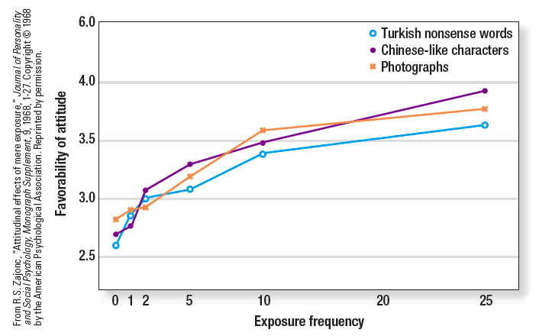
How Attitudes Are Formed
Mere exposure effect
Tendency to come to like things simply because they are encountered repeatedly
Notes:
Figure 7.1: Relation between frequency of mere exposure to Turkish words, Chinese-like characters, and photographs of men and attitudes toward these stimuli (Zabjonc, 1968).
Technology Tip: Changing Minds has a good summary of mere-exposure effect. (http://changingminds.org/explanations/theories/mere_exposure.htm)
Discussion Idea: How does the mere-exposure effect change attitudes? In what situations will it not change attitudes? How does the mere-exposure effect work on Facebook users?
Discussion Idea: How could an embodied attitudes experiment end up shaping someone’s attitude about an issues, such as raising tuition?

Slide 8
How Attitudes Are Formed (cont’d.)
Embodied attitudes
Bodily movements shape people’s attitudes
Classical conditioning
Learning in which, through repeated pairings, a neutral stimulus comes to evoke a conditioned response
Notes:
Teaching Tip: To emphasize the way that classical conditioning can shape attitudes, ask students to recall the last time they were nauseous and vomiting. Then ask them to reflect on their attitudes regarding what they consumed just before getting sick.
Discussion Idea: How can classical conditioning influence people to develop a positive (or negative) attitude towards a conditioned stimulus? How can classical conditioning explain then prejudiced attitudes about groups because of negative information in the media? How do advertisers take advantage of classical conditioning to sell products?

Slide 9
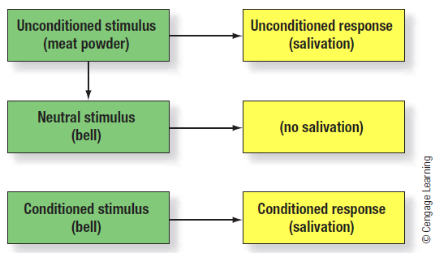
Classical Conditioning
Notes:
Figure 7.2: Ivan Pavlov proposed classical conditioning theory.

Slide 10
How Attitudes Are Formed (cont’d.)
Operant conditioning
People are more likely to repeat behaviors that have been rewarded
Less likely to repeat behaviors that have been punished
Social learning
People are more likely to imitate behaviors if they have seen others rewarded for them
Less likely to imitate behaviors if they have seen others punished for them
Notes:
Discussion Idea: How can operant conditioning shape our attitudes? What effect does the “like” button on Facebook have on our attitudes? What effect might a “dislike” button have?
Discussion Idea: How can social learning shape our attitudes? What effect does seeing violence rewarded have on children’s attitudes towards violence?

Slide 11
Polarization
Attitude polarization
People’s attitudes become more extreme as they reflect on them
May generate new ideas or insights not considered when initial attitudes were formed
People with strong attitudes on certain issues may evaluate relevant evidence in a bias manner
Notes:
Technology Tip: A host of television and print ads are available at the site “Best Ads on TV” (http://www.bestadsontv.com/)
Discussion Idea: Why do our attitudes become more polarized as we reflect on them? What is the effect of having a strong initial attitude on polarization? In what ways do we view evidence with a biased perspective? How does the way we receive evidence (from an “ingroup” member versus “outgroup” member) change our attitude towards evidence?

Slide 12
Consistency
Commonalities in theories about consistency
Specify conditions required for consistency and inconsistency
Assume inconsistency is unpleasant
Specify conditions required to restore consistency

Slide 13
Cognitive Dissonance and Attitude Change
Cognitive dissonance theory
Inconsistencies produce psychological discomfort
Leads people to rationalize their behavior or change their attitudes
People want to maintain consistency
Notes:
Technology Tip: The full text of Festinger and Carlson’s classic article is available at “Psych Classics” (http://psychclassics.yorku.ca/Festinger/index.htm).
Discussion Idea: What causes cognitive dissonance?
Discussion Idea: How do people address cognitive dissonance in their lives? In what ways does rationalization work to relieve cognitive dissonance?
Discussion Idea: What causes more cognitive dissonance: being paid a lot to say something you don’t believe, or being paid very little?

Slide 14
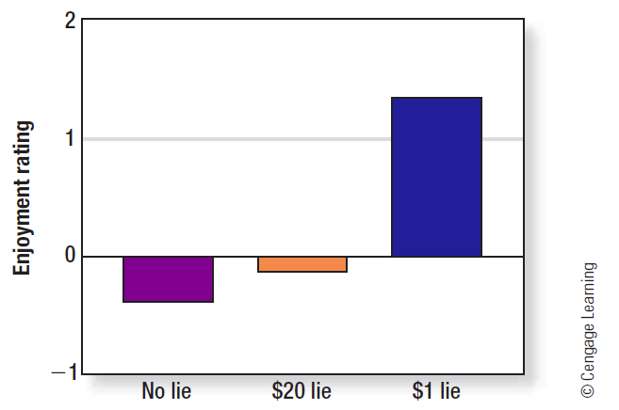
A Study on Cognitive Dissonance
Notes:
Figure 7.3: Participants in the Festinger and Carlson (1959) study who had been paid $1 to lie about how enjoyable the experiment was rated it as more enjoyable than did those in the other two groups, which were not significantly different from each other. Source: Festinger and Carlsmith (1959).

Slide 15
Justifying Effort and Choices
Effort justification
When people suffer, work hard, or make sacrifices, they will try to convince themselves that it is worthwhile
Justifying choices
Post-decision dissonance: cognitive dissonance experienced after making a difficult choice
Reduced by increasing attractiveness of chosen alternative and decreasing attractiveness of rejected
Notes:
Technology Tip: An accessible discussion of cognitive dissonance and real-life applications (including cult examples) are available at the “Skeptics Dictionary” (http://skepdic.com/cognitivedissonance.html)
Discussion Idea: How do people justify effort to relieve cognitive dissonance? Does hazing really create a more tight-knit group?
Discussion Idea: How does choice affect dissonance?
Discussion Idea: What role does self-presentation play in cognitive dissonance?

Slide 16
Food for Thought
Would you eat a bug or a worm?
Subjects unwilling to eat a worm changed their opinion after being told they would have to eat the worm, and were given time to think about it
People are willing to suffer, if they are expecting to suffer—but only if they have changed their attitudes

Slide 17
Advances in Dissonance Theory
Dissonance is marked by both arousal and unpleasant arousal
It feels bad
People expect each other to be consistent
Reject inconsistency
Self-presentation plays an important role
Convincing others convinces yourself
Dissonance theory and the media
Filter bubbles: forced selective exposure

Slide 18
Is the Drive for Consistency Rooted in Nature or Nurture?
The drive toward consistency most likely involves both parts of the duplex mind
Automatic system learns to detect inconsistencies and send out alarm signals (distress, arousal)
Deliberate system finds some resolution to the inconsistency by thinking about how to rationalize or rethink things
Notes:
Discussion Idea: How does biology influence our need for consistency? How does culture influence it?
Discussion Idea: How does consistency relate to the theory that humans are built to argue?
Discussion Idea: How does the duplex mind work towards consistency?

Slide 19
Attacking Attitudes
Gordon Allport
Attitude is the most important concept in psychology
Alan Wicker
Attitudes are a trivial, peripheral phenomenon
A–B problem: problem of inconsistency between attitudes (A) and behaviors (B)
Notes:
Discussion Idea: What explanations are given for studies showing that people’s attitudes do not predict behavior?
Discussion Idea: Does the weakness of the link between attitudes and behavior imply that social psychologists should study other aspects of humans?

Slide 20
Defending Attitudes
General attitudes and specific behaviors
Attitudes predict specific behavior, but must measure very specific attitudes
Behavior aggregation
Combining attitudes across many different behaviors on different occasions
Broad attitudes in context
Broad attitudes can influence specific behaviors when interpreted here-and-now
Notes:
Technology Tip: A rather bizarre example of the failure of attitudes to predict behavior comes from the sketch comedy group Olde English. They first ask individuals how much money it would take for them to strangle a puppy. They then approach the individuals with a puppy and a blank check, but all refuse to comply. Preview this film before deciding whether to show it in your class. (http://www.oldeenglish.org/podcast/Dead-Puppies).
Discussion Idea: How does the general nature of attitudes and the specific nature of behavior affect the ability for attitudes to predict behavior?
Discussion Idea: How does aggregating behavior give a better view of the link between attitudes and behavior?
Discussion Idea: How does the accessibility of an attitude influence behavior?

Slide 21
Defending Attitudes (cont’d.)
Attitude accessibility
How easily the attitude comes to mind
Behavioral intentions
Subjective norms: perceptions about whether significant others think they should perform the behavior
Perceived behavioral control: person’s beliefs about whether they can perform the behavior
Notes:
Discussion Idea: How do behavioral intentions affect attitude and behavior?

Slide 22
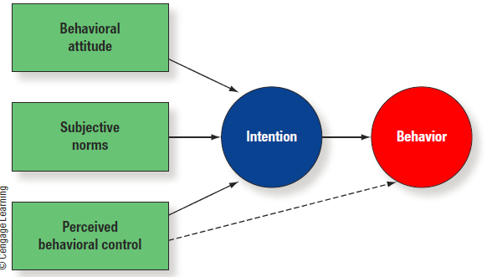
Defending Attitudes (cont’d.)
Notes:
Figure 7.4: Theory of planned behavior.

Slide 23
Beliefs and Believing
Belief versus doubting
Belief is automatic
Doubt is controlled
Belief perseverance
Once beliefs form, they are resistant to change, even if the information on which they are based is discredited
Notes:
Discussion Idea: How does the duplex mind influence belief and doubt?
Discussion Idea: What happens to belief when you are distracted? How do cults take advantage of this?
Discussion Idea: How salient are beliefs? How could belief perseverance limit what one remembers in a class?
Discussion Idea: How can belief perseverance be counteracted? Under what circumstances could beliefs be changed?

Slide 24
Belief and Coping
Beliefs help people understand the world around them
Coping: how people attempt to deal with traumas and go back to functioning effectively in life
Cognitive coping: idea that beliefs play a central role in helping people cope with and recover from misfortunes
Notes:
Discussion Idea: How does self-blame help people cope?
Discussion Idea: How does a sense of control help people cope with trauma?
Discussion Idea: How do people restore beliefs after trauma? How does downward comparison help? How does belief in a higher purpose help?

Slide 25
Belief and Coping (cont’d.)
Assumptive worlds: people live in social worlds with certain beliefs about reality
The world is benevolent
The world is fair and just
I am a good person
Notes:
Discussion Idea: How can belief help people cope with tragedy? How can belief hinder coping?
Discussion Idea: How are people’s assumptive beliefs challenged when they are victims of a crime?

Slide 26
Religious Belief
Religious beliefs can help people cope with stress
People who rely on religion are less likely to fall back on ineffective coping strategies (e.g., drinking)
Appealing to a superordinate (high, all-encompassing) principle or power is an effective way to reduce dissonance
Notes:
Teaching Tip: Additional resources and discussion are available in Festinger’s book When Prophecy Fails. (http://www.amazon.com/When-Prophecy-Fails-Social-Psychological/dp/0061311324/sr=1-1/qid=1164491229/ref=pd_bbs_sr_1/104-0317742-5903166?ie=UTF8&s=books)
Discussion Idea: What are some of the benefits of religious beliefs? What are some of the drawbacks?
Discussion Idea: How can religious beliefs help people cope?
Discussion Idea: How can religion reduce dissonance?

Slide 27
Irrational Belief
People believe lots of seemingly crazy things
No rational basis
Paranormal beliefs
People who hold irrational beliefs
More anxious
Cope less well with terminal illnesses
More likely to become depressed over time
Have lower levels of self-esteem
Notes:
Discussion Idea: What are some of the negative issues of people who hold irrational beliefs?
Discussion Idea: How do gamblers sustain false belief that they will win, even when they lose most of the time?

Slide 28
Summary
Attitudes and beliefs reflect how we view the world
Attitudes are formed in two ways (automatically and deliberately) and are fairly stable once formed
Beliefs are the facts and information that we accept as true; they can help us cope or hurt us if they are irrational

