Slide 1
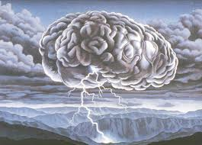
Analytic Tools

Slide 2
The best intelligence collection in the world is a failure without good analysis.

Slide 3
Three Basic Analytical Factors
Three Ingredients Of Analysis
Hypothesis
An idea about what is happening, did happen, or could happen
Assumption (we use knowledge from past experience/trends that we see)
Evidence

Slide 4
These 3 factors are not linear, but build on each other.
We view evidence in terms of assumptions & hypotheses.
Hypotheses rest on already-existing evidence.
New contrary evidence can change hypotheses.
Assumptions & hypotheses can be tough to change.

Slide 5
Five analytical techniques that can help:
Brainstorming
Devil’s Advocate
Red Teams
Link Diagrams
Analysis of Competing Hypotheses

Slide 6
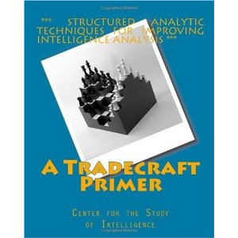
Source for Analysis
A Tradecraft Primer: Structured Analytic Techniques for Improving Intelligence Analysis
https://www.cia.gov/library/center-for-the-study-of-intelligence/csi-publications/books-and-monographs/Tradecraft%20Primer-apr09.pdf

Slide 7
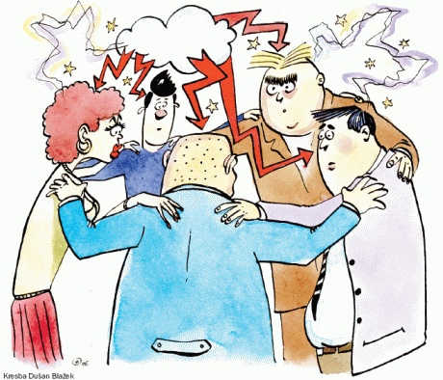
Brainstorming
The more ideas the better
Build one idea on another
Crazy ideas are okay
Do not critique ideas while brainstorming

Slide 8
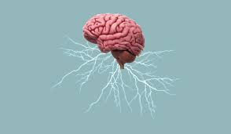
Some ways to make it work:
Keep group of manageable size.
Try to avoid major rank disparities.
Diversity is good.
Keep time parameters.
Have a good record keeper.

Slide 9
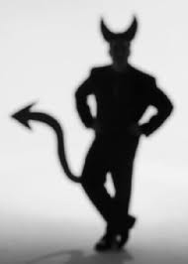
Devil’s Advocate
A person who takes an opposite position and who questions the accepted assumptions.
Tries to prove opposite conclusions.

Slide 10
Tools for Devil’s Advocates:
The different slants must be more than just “I disagree.”
Role is to present alternatives, not to win the debate.
Not too junior, not too senior.
Must have good background on subject.

Slide 11
Red Team Analysis
Try to think like the opposition.
Requires deep knowledge of opponents.
At best, can be a full-time assignment.
Members need to be creative, imaginative, and open.

Slide 12
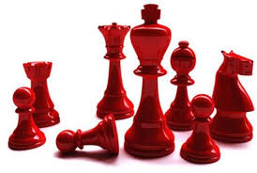
Red Teams
More involved in role playing than devil’s advocates.
Particularly good for threat & vulnerability assessments.

Slide 13
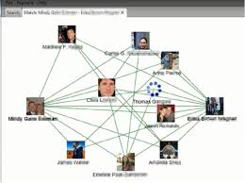
Link & Network Analysis
Provide graphical representations of relationships.
Very useful for criminal & terrorist group analysis.
As with any tool, an aid to analysis, not the final result.

Slide 14
Association Matrix
- Shows association between individual persons only
= Known association
= Suspected association

Slide 15
Association Matrix
Carlos is associated with Bill and George.
Bill is associated with Carlos and George
Carlos
George is associated with Carlos and
Bill - and may be associated with
Ahmed
Bill
George
Heinrich
Heinrich is associated with Sam
Ahmed
Ahmed may be associated with George
Sam
Sam is associated with Heinrich. Sam is dead.

Slide 16
ACTIVITIES MATRIX
SHOWS WHO IS ASSOCIATED
WITH WHAT

Slide 17
ACTIVITIES MATRIX
Who is associated with.....?
Tom
Dick
Harry
Bonnie
Clyde
Terr. Gp.
4th ID bomb
TWA Flt 876
2794 Main St.
New York City
Blue Mercedes
Libyan training
Supplied SEMTEX

Slide 18
LINK DIAGRAMS
Reflect information from both
matrices
Are easy to read and interpret
Help you to ask the right question
Are effective briefing tools

Slide 19
Link Diagram
Show in an easy to read format:
Personal and non-personal links
Participants in activities
Internal and external relationships
Internal and external structures
Lines of command, control, and
communication

Slide 20
Link Diagram Graphics
People (single individuals)
JONES
BROWN
GREEN
Alias or AKA
Non-personal entities (places, activities, organizations)
PINK PANTHERS

Slide 21
Link Diagram Graphics
=
CARTER
CARTER
=
JONES
JONES
Strong or confirmed
personal association

Slide 22
Link Diagram Graphics 2
- Carter is associated with
Green, Jones & Brown
- Jones and Brown are
GREEN
JONES
associated
- Green and Jones are
associated
BROWN
CARTER
- Green and Brown are
NOT associated

Slide 23
Steps In Building a Link Diagram
Organize all available data
Complete both matrices
Transfer information from matrix
format to link diagram format

Slide 24
Form of link diagram
Alpha
Bravo
Charley
Delta
Echo

Slide 25
Network diagram
DELTA
ALPHA
BRAVO
ECHO
CHARLEY

Slide 26
Target & association matrix
Alpha
Bravo
Charley
Delta
Echo
TUCSON
TOMBSTONE
SUPPORT GP
SIERRA VISTA
SWISS BANK
ASSASSINATION

Slide 27
END RESULT
SWISS BANK
DELTA
SUPPORT GP
ALPHA
BRAVO
ECHO
TUCSON
TOMBSTONE
ASSASSINATION
SIERRA VISTA
CHARLEY

Slide 28
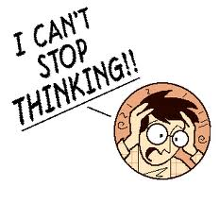
Analysis of Competing Hypotheses

Slide 29
What does ACH do?
Reduces biases
Spurs new ideas
Stimulates systematically considering evidence (frame work to objectively consider all the evidence)- it’s structured tool that help you consider all the evidence)
Can help detect denial and deception
Emphasizes diagnostic evidence (evidence that support some hypotheses but not other) make you realize which evidence support some hypotheses but other.
Often overlooked in intuitive analysis (not using structured tools)
Assists in developing collection
Provides a record

Slide 30
Analysis of Competing Hypotheses 2
Generate hypotheses
List significant evidence & arguments
Test (Compare) evidence against each hypothesis
Refine (Update) matrix
Evaluate each hypothesis/draw tentative conclusions
Sensitivity assessment (Taking a look at most contradictory evidence /seeing how reliable the evidence is/Re-sorting)
Report conclusions
Forecast future developments

Slide 31
Step 1: Developing Hypotheses
Brainstorming works best
Hypotheses must be:
Mutually exclusive (None of these hypotheses are the same or can be true at the same time)
Collectively exhaustive (consider all the possibilities)
Relevant
Testable
Simple

Slide 32
Key Assumption Check 1
Key Assumption Check Method
1. Identify all the key assumptions that an analyst or group holds about a situation, group, or topic. Record on whiteboard or on a simple template.

Slide 33
Key Assumption Check 2
2. Examine each assumption by asking:
o Why is this assumption correct?
o How confident am I that this assumption is still valid?
o What could invalidate this assumption?
o Could it have been true in the past but false now?
o If the assumption turns out to be invalid, how might it affect my analytic
judgment?

Slide 34
Key Assumption Check 3
3. Assign each assumption to one of the following categories:
o Basically supported or “solid.”
o Supported but with some caveats.
o Unsupported or questionable.

Slide 35
Step 2: Evidence
Gather and list significant evidence
Includes all “INTs”: (Intelligence disciplines) Signals, Human, Open Source, etc.
Identify any assumptions
Think about what is missing

Slide 36
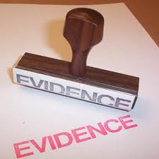
Evaluating Evidence
Evaluate evidence based on
Relevance of information
Credibility of information
Reliability of information (sources
If not relevant, not evidence
If working on multiple hypotheses for one intelligence problem, may be relevant to some and not to others
Can be directly or indirectly relevant

Slide 37
Evaluating Evidence 2
Motive (Reason) To Lie?
Possibility Of Deception?
Obvious Errors In Reporting?
Is Information Corroborated? (do multiple sources say the same thing)
Did Collectors/Users Introduce Bias? (the initial interpretation of data, did they put their own judgements, or bias)

Slide 38
Evaluating Evidence 3
Evaluate evidence based on
Relevance of information
Credibility of information
Reliability of information (sources/ collection methods/whether the source have access to the information)

Slide 39
Step 3: Evidence + Hypotheses
Consider how each item of evidence relates to each hypothesis
Determine how consistent each item of evidence is with each hypothesis

Slide 40
Balancing Evidence
Identify items that have the greatest impact
Are the biggest inconsistencies from a single source or single INT (Intelligence disciplines) ?
Are there changes over time?
Is there any definitive evidence?
What is the credibility, reliability and relevance of the sources?
What are the consequences if the critical items (evidence) are wrong?

Slide 41
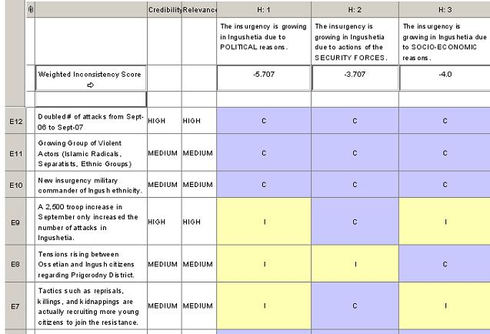
Step 4: Refine Matrix

Slide 42
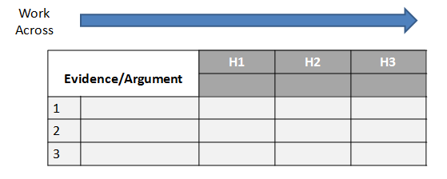
Easy Working Example

Slide 43
Steps 5-8: Conclusions & Forecasts

Slide 44
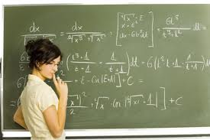
Issues with ACH
be
Can be time-consuming
Can require exacting language in developing hypotheses (very precise language/clear the way you state your hypotheses)
Can lead to over-confidence in numbers (too much reliance on the numbers generated by the matrix)
ACH is an aid to judgment

Slide 45
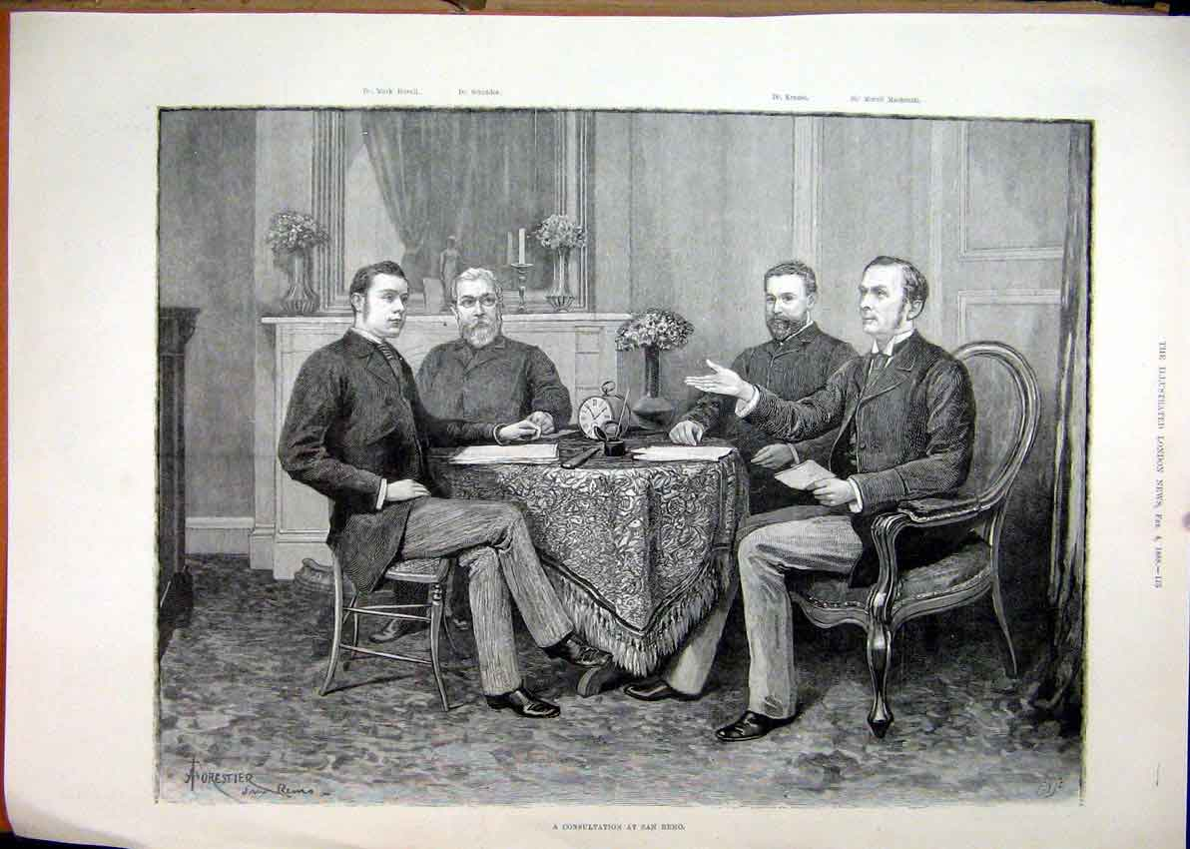
Questions & Discussion

