Slide 1
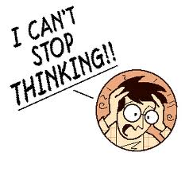
Analysis of Competing Hypotheses

Slide 2
What does ACH do?
Reduces biases
Spurs new ideas
Stimulates systematically considering evidence (frame work to objectively consider all the evidence)- it’s structured tool that help you consider all the evidence)
Can help detect denial and deception
Emphasizes diagnostic evidence (evidence that support some hypotheses but not other) make you realize which evidence support some hypotheses but other.
Often overlooked in intuitive analysis (not using structured tools)
Assists in developing collection
Provides a record

Slide 3
Analysis of Competing Hypotheses 2
Generate hypotheses
List significant evidence & arguments
Test (Compare) evidence against each hypothesis
Refine (Update) matrix
Evaluate each hypothesis/draw tentative conclusions
Sensitivity assessment (Taking a look at most contradictory evidence /seeing how reliable the evidence is/Re-sorting)
Report conclusions
Forecast future developments

Slide 4
Step 1: Developing Hypotheses
Brainstorming works best
Hypotheses must be:
Mutually exclusive (None of these hypotheses are the same or can be true at the same time)
Collectively exhaustive (consider all the possibilities)
Relevant
Testable
Simple

Slide 5
Step 2: Evidence
Gather and list significant evidence
Includes all “INTs”: (Intelligence disciplines) Signals, Human, Open Source, etc.
Identify any assumptions
Think about what is missing

Slide 6
Evaluating Evidence
Evaluate evidence based on
Relevance of information
Credibility of information
Reliability of information (sources
If not relevant, not evidence
If working on multiple hypotheses for one intelligence problem, may be relevant to some and not to others
Can be directly or indirectly relevant

Slide 7
Evaluating Evidence 2
Motive (Reason) To Lie?
Possibility Of Deception?
Obvious Errors In Reporting?
Is Information Corroborated? (do multiple sources say the same thing)
Did Collectors/Users Introduce Bias? (the initial interpretation of data, did they put their own judgements, or bias)

Slide 8
Evaluating Evidence 3
Evaluate evidence based on
Relevance of information
Credibility of information
Reliability of information (sources/ collection methods/whether the source have access to the information)

Slide 9
Step 3: Evidence + Hypotheses
Consider how each item of evidence relates to each hypothesis
Determine how consistent each item of evidence is with each hypothesis

Slide 10
Balancing Evidence
Identify items that have the greatest impact
Are the biggest inconsistencies from a single source or single INT (Intelligence disciplines) ?
Are there changes over time?
Is there any definitive evidence?
What is the credibility, reliability and relevance of the sources?
What are the consequences if the critical items (evidence) are wrong?

Slide 11
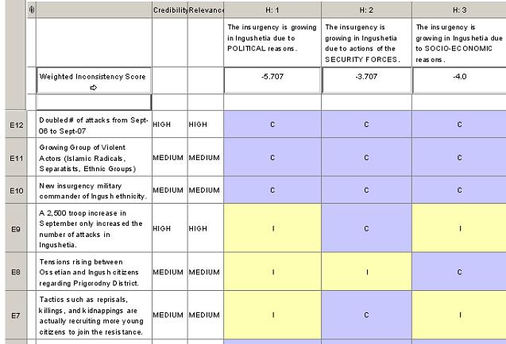
Step 4: Refine Matrix

Slide 12
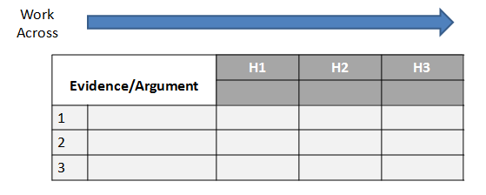
Easy Working Example

Slide 13
Steps 5-8: Conclusions & Forecasts

Slide 14
Issues with ACH
be
Can be time-consuming
Can require exacting language in developing hypotheses (very precise language/clear the way you state your hypotheses)
Can lead to over-confidence in numbers (too much reliance on the numbers generated by the matrix)
ACH is an aid to judgment

Slide 15
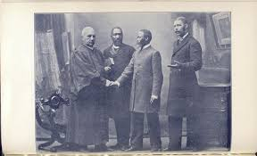
Questions & Discussion

