Slide 1
Week 11 Class Lecture
Lived spirituality and conscientizacion

Slide 2
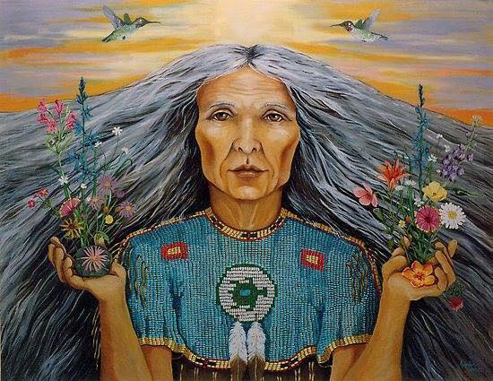

Slide 3
Critical Reading Questions Massacre of the Dreamers (Chapters 7, 9, and 10)
1. What are the main points of each chapter? And how do Chapter 7 and 9 help build her theoretical framework for Xicanisma?
2. What important issues does Castillo raise in each chapter ? And what specific examples does she use?
3. What solutions does she give in each chapter?
4. In her last chapter, she concludes her ideas/theories on Xicanisma....What themes/issues/topics does she outline? And how do they connect to her theoretical framework?
5. Add any other questions, comments or critiques.

Slide 4
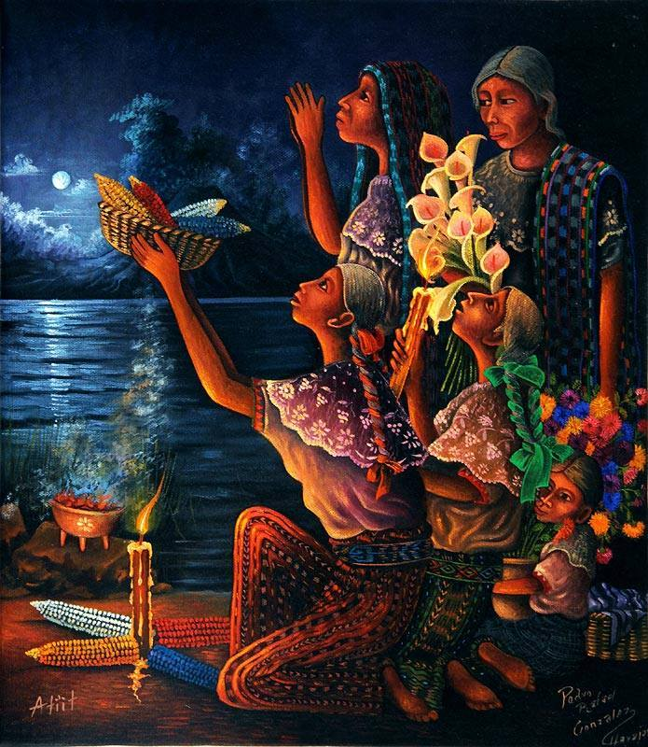
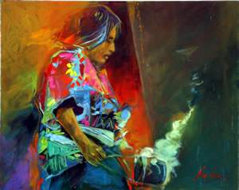

Slide 5
Curanderas and Curanderos
Curanderos practice what is called curanderismo, or a holistic form of healing, which combines prayer, herbal remedies, rituals, psychic healing, spiritualism, and massage.
According to the American Cancer Society, curanderismo is said to be the result of the Spanish colonization, when different Catholic rituals were combined with native folk medicine. In the United States, curanderismo is most commonly found in the Southwestern region.
The word ‘curanderismo’ comes from the Spanish word curar, which means to heal, and this form of medicine is popular in different Hispanic cultures because it deals with issues Western medicine does not acknowledge, such as a link between illness and evil spirits.
This mystical aspect of curanderismo keeps it prevalent among Hispanics; however, some individuals visit curanderos because they simply do not trust Western doctors or prefer not to take prescription medicines.
https://newstaco.com/2013/09/26/what-are-curanderos-in-hispanic-cultures/

Slide 6
Curanderos, or practitioners of curanderismo, believe good health is maintained by a delicate balance of hot and cold within the body. Because of this belief, much emphasis is placed on what a person eats, what their physical activities are, and what medications they are taking.
Depending on whether or not an illness is ‘hot’ or ‘cold,” a curandero will make adjustments to daily habits to help re-establish that temperature balance within the body.
“A curandero (or curandera for a female) is a traditional folk healer or shaman in Hispanic America, who is dedicated to curing physical or spiritual illnesses, explained Elena Avila, MSN, RN, Curandera.
Curanderos are sought after for everything from physical and psychological issues to marital discord treatment, as many Hispanics believe these issues are a result of a ‘loss of spirit,’ bad luck, or curse.

Slide 7
“The role of a curandero or curandera can also incorporate the roles of psychiatrist along with that of doctor and healer. Many curanderos use Catholic elements, such as holy water and saint pictures. The use of Catholic prayers and other borrowings and lendings are often found alongside native religious elements.”—Elena Avila

Slide 8
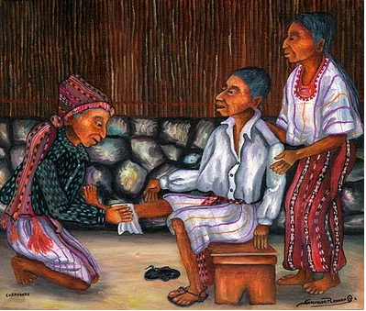
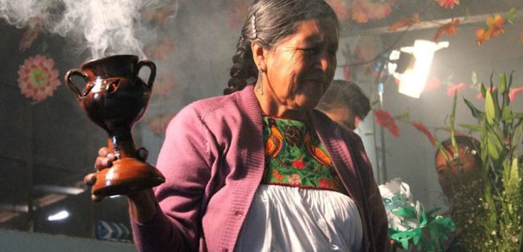

Slide 9
Sometimes a curandero is asked to help ward off the effects of a brujo, which the Texas State Historical Association indicates is a witch (male or female) who uses supernatural powers for evil, often selling services to those who wish to inflict pain and suffering on others.
Depending on the ailment, aid from a specialized curandero may be sought, and these individuals are referred to as:
Yerberos: Individuals who specialize in the use of medicinal plants and herbs; considered the equivalent of a pharmacist in Western medicine.
Parteras: Midwives who are the primary source of guidance for pregnant women and who oversee births.
Sobadores: Individuals trained to promote healing through massage techniques. Sobadores are also known to use bone manipulation much in the way a Western chiropractor would.

Slide 10
GLORIA ANZALDÚA
THE HEALING POWER OF WORDS AND CULTURE
THIRD WORLD FEMINISM FROM THE BORDERLANDS

Slide 11
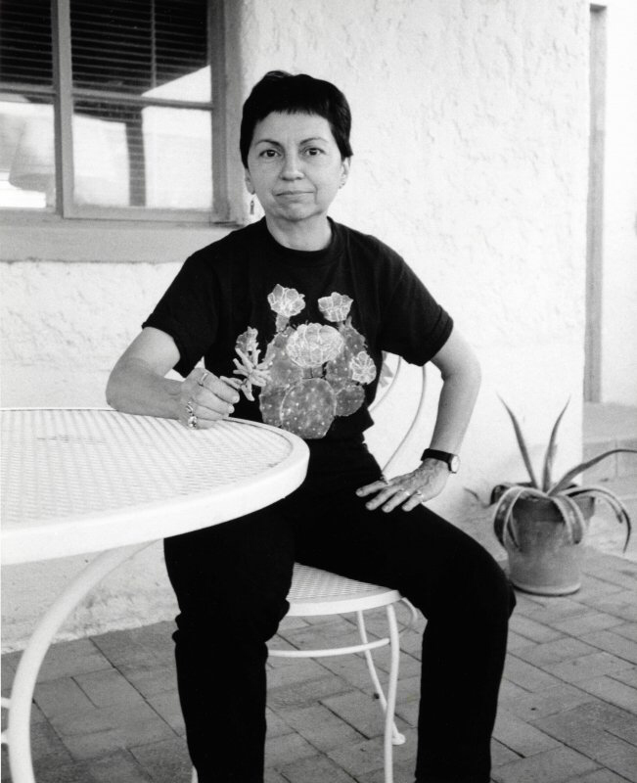
Gloria Anzaldúa
a self-described “Chicana dyke-feminist, tejana patlache poet, writer, and cultural theorist."
born to sharecropper/field-worker parents on September 26th, 1942 in South Texas Rio Grande Valley.
B.A. in English, Art, and Secondary Education from Pan American University. She then earned an M.A. in English and Education from the University of Texas.
Awards for her work, such as the Lambda Lesbian Small Book Press Award for Haciendo Cara, an NEA Fiction Award, the Before Columbus Foundation American Book Award for This Bridge Called My Back, and the Sappho Award of Distinction.
Anzaldua died of diabetes complications on May 15, 2004.

Slide 12
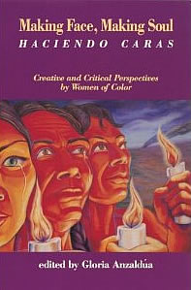
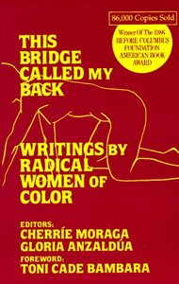
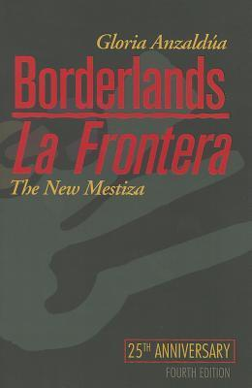
Third World Feminism
The Bridge Called my Back
Anzaldúa’s writing moved entre mundos/Borderlands between among diverse worlds
Incorporates spiritual, theoretical, emotional, ethical, moral and intellectual work.
Queer Theory

Slide 13
Soon after Gloria Anzaldúa’s Borderlands/ La Frontera: The New Mestiza was published (1987), the notion of ‘borderlands’ began to gain currency as key feminist theoretical concept with import across disciplines in the U.S. and beyond.
It has indeed been recognized as the most important concept that the field of Latina/o Studies has contributed to cultural studies in the United States, Europe, and Latin America.
‘Borderlands’ is also a fundamental term in the conceptualization of marginalized identities and of agency in today’s transnational feminism.
While re-thinking Aztlán -the legitimate homeland of the “Chicano/a nation” -, she conceptualized a space of belonging defined by the border itself, a painful physical space “where the Third World grates against the first and bleeds” (25). This liminal, hostile region constitutes for her “a third country” (33), understood as both a geopolitical and a psychic space.

Slide 14
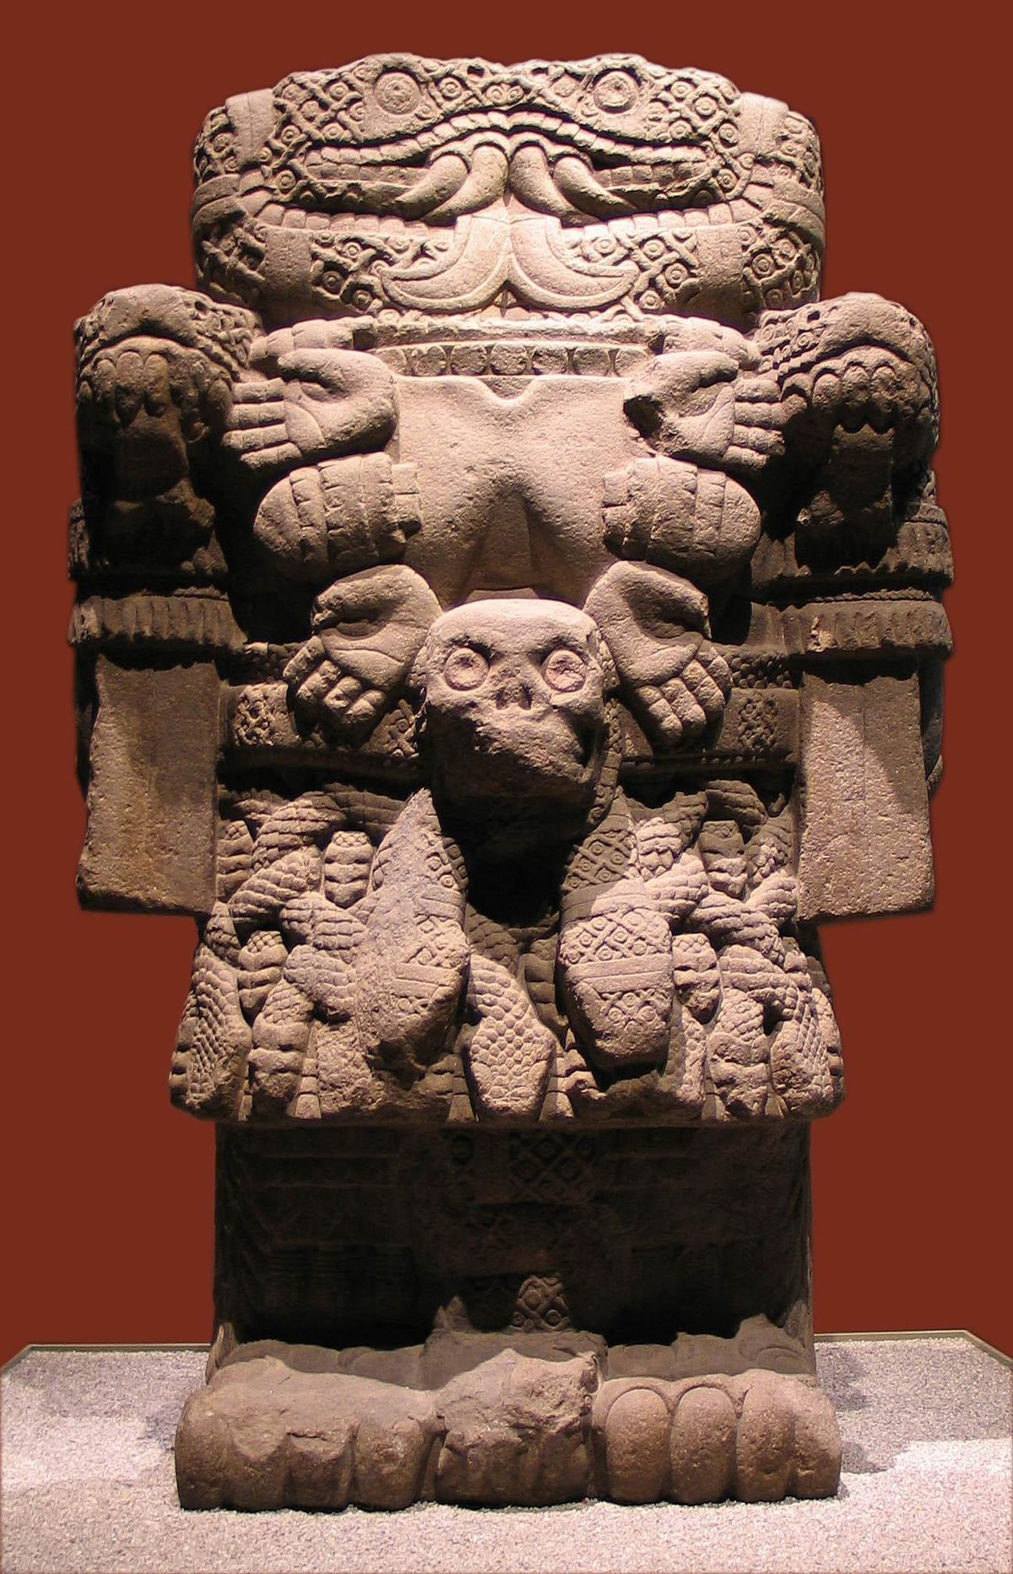
Gloria Anzaldua also was among the first Chicana writers to recover and rewrite Mexican histories and Mexica goddess figures from a feminist, decolonial perspective, Gloria Anzaldúa is what I call a “daughter of Coatlicue.”
Coatlicue is the Mexica earth mother goddess of creation and destruction. In patriarchal Mexica mythhistory, Coatlicue’s daughter is named Coyolxauhqui, the Mexica warrior goddess dismembered by her brother Huitzilopochtli, the God of War, and banished to the sky as the moon.

Slide 15
Spanish chroniclers, for example, described Coatlicue as an “old hag” and a satanic “idol.” Engagement with Coatlicue’s physically dismembered daughter, therefore, marks the desire to suture the wounds inflicted by patriarchy and eurocentrism.
Given the additional context of Spanish colonialism that from its inception negatively constructed Mexica culture, Coatlicue, Coyolxauhqui, and other indigenous sacred figures were also demonized and fragmented.
“My whole struggle in writing,” says Anzaldúa, “has been to put us back together again. To connect up the body with the soul and the mind with the spirit”

Slide 16
The Coatlicue State is a term formed by the author Gloria Anzaldúa as a type of “internal whirlwind” which “gives and takes away life”, “invoking art," and that it is “alive, infused with spirit” (Anzaldúa 68, 88-89).
Coatlicue is an Aztec goddess that represents conflicting identities of life giver and death bringer, compassionate yet all powerful. Anzaldúa uses this image in order to articulate a type of identity conflict experienced by herself, Latinas, and women in general.
She describes that the Coatlicue State “simultaneously represents duality in life…and a third perspective- something more than mere duality or a synthesis of duality” (Anzaldúa 68).
To be in the Coatlicue State is to be on the verge of experiencing something life-altering. Individuals who reside in lands where their family's culture is not that of the dominate culture, often experience an identity crisis between the various cultures of their life.

Slide 17
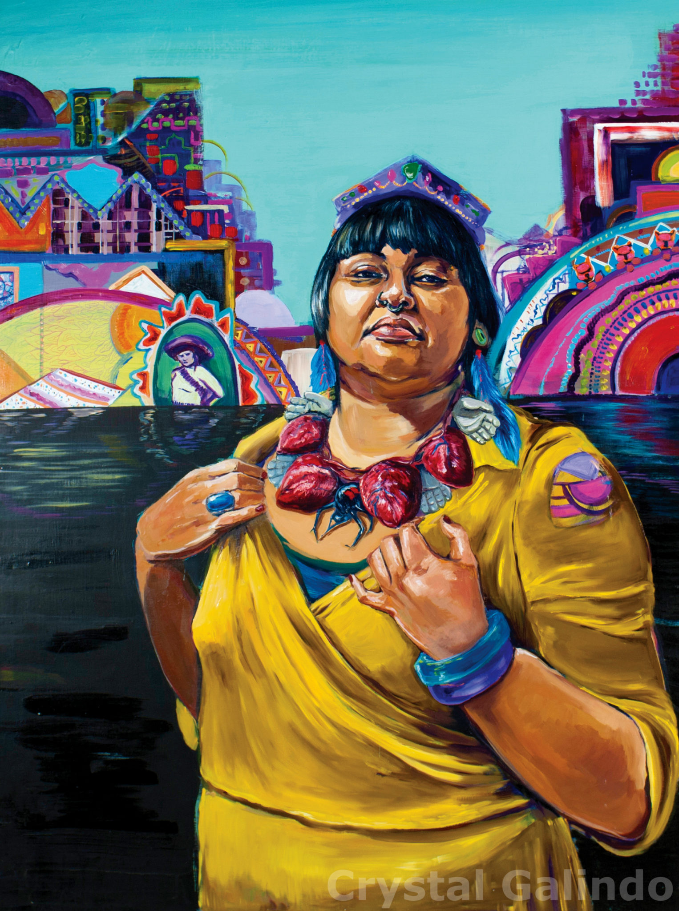
Coatlicue State interpreted today
Crystal Galindo, Artist
More info on the artist:
https://remezcla.com/features/culture/crystal-galindo-painter-chicanas/

Slide 18
Xicana/Latina Spiritualities- Highlights from Dr. Lara Medina

Slide 19
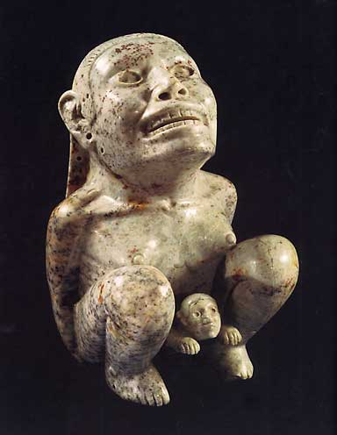
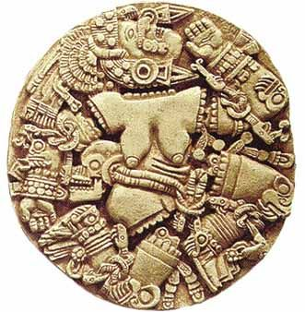
Coyolxauhqui—Aztec Moon Goddess
Tlazolteotl – Aztec Goddess of Fertility and Midwives

Slide 20
Spirituality
Spirituality is the essence and quality of one’s relationship to self, others, the forces of nature, and the sacred source of life.
Spirituality informs one’s world view, identity, value system and epistemology.
The goal of spirituality is to empower one’s life within community.

Slide 21
Nepantla Spirituality
Nepantla: a Nahua term meaning to be in the middle, the center.
As racially mixed women, Xicanas/Latinas are born in nepantla.
Nepantleras: “supreme border crossers… act as intermediaries between cultures and their various versions of reality.”
Nepantla is a physical, psychological, emotional and spiritual space that includes rather than excludes.
A spiritual orientation to life that facilitates the co-existence of diverse religious and spiritual beliefs and practices which nourish our spiritual activism.

Slide 22
“Markers of Xicana Spirituality”
Feminist/Earth centered consciousness
Interdependence/interconnectedness
Individual in relationship to a community
Reciprocity/Exchange
Justice
Inclusivity
Deep respect for elders and ancestral lineages
The arts communicate our deepest values “that awaken higher states of consciousness.”

Slide 23
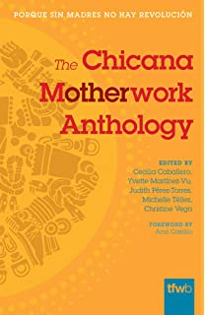
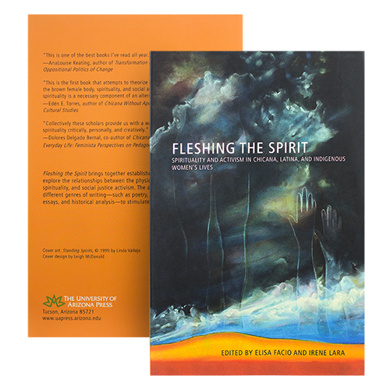
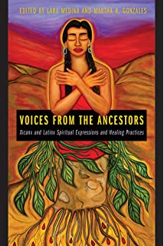
Further Reading Recommendations:

