Slide 1
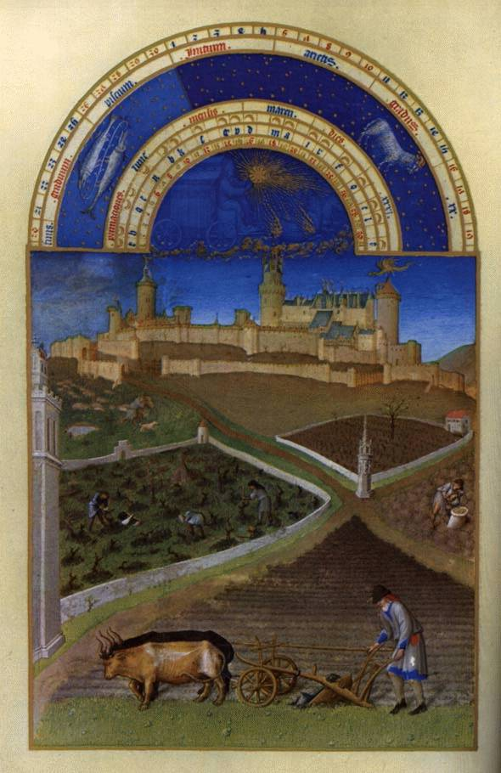
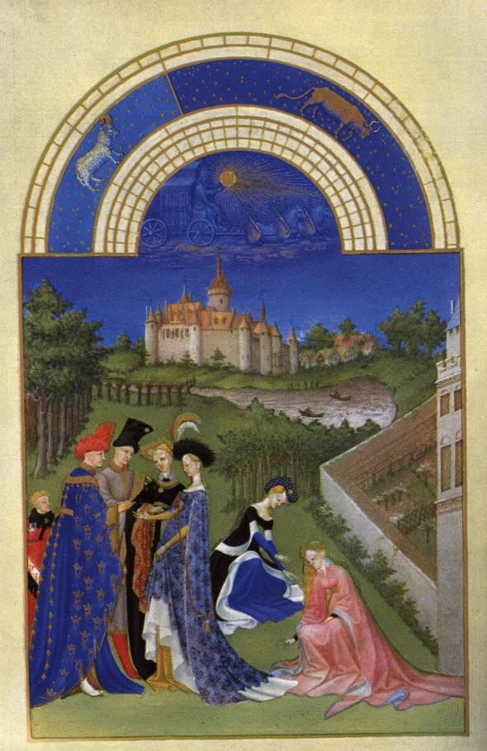
March
April
The Limbourg Brothers inspired from the naïve concept of Medieval Time together with the beginning of the interest in exploration of the nature that typical to the Renaissance era. The result is the International Style: a very clear, sharp vision of a dream-like world. There are indications of understanding some principles of perspective, but still not like the knowledge of the Italian artists, especially of Florence.
The Book of Hours produced for the Duke of Berry, the brother of King Charles V. The duke was a collector of manuscripts, jewels, and rare artifacts. He owned more than 300 manuscripts. The miniatures (8 ½” x 5 ½“) present two themes of life on earth: The pleasure life of the aristocrats and the working life of the farmers. All of the scenes represent the changing of the seasons. The story in this book based on the belief in the Golden Age on earth or the myth of the Lost Paradise. It was a new approach where secular themes and religious ones were presented in art and life.
Limbourg Brothers, from the Book of Hours of the duke of Berry, 1413-1416, Burgundy, France

Slide 2
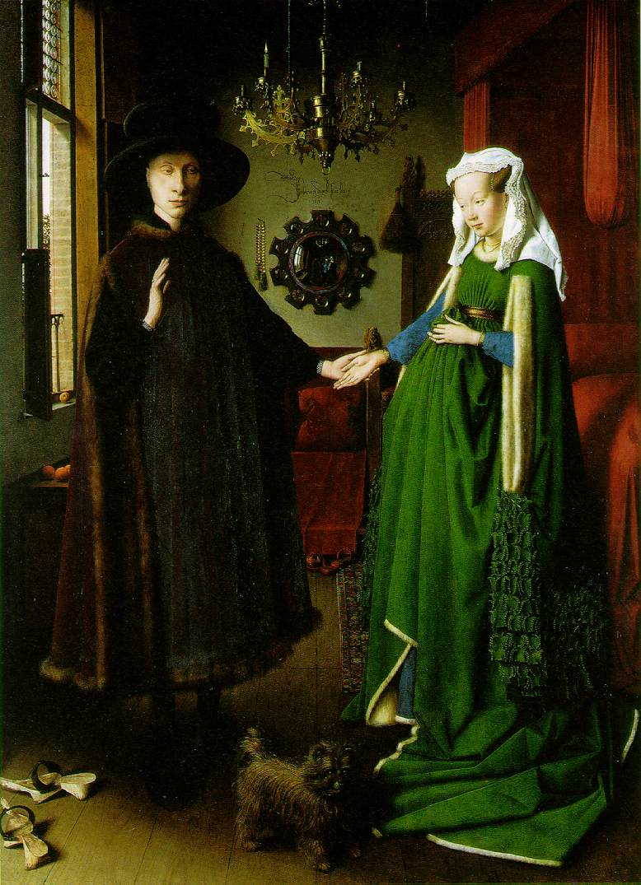
Jan Van Eyck (1390-1441), Giovanni Arnolfini and his Bride, 1434

Slide 3
Basic Information
Artist: Jan Van Eyck
Title: Giovani Arnolfini and his wife
Time: 15th century
Media: Oil on wood panel
Style: Flemish Renaissance
Who are the figures in the painting?
Giovani Arnolfini and his wife during their wedding. Giovani was a financial agent of the Medici family in the Netherland.
Formal aspects
Composition: The man stands by the window and the wife in the inside of the room
The mirror is in the center of the composition
Light and shadow: The dark room is illuminated from one source – the window
Colors: Green and black outfit against red fabric

Slide 4
Message
Single burning candle = presence of Christ
Bed with Canopy = Social status
Oranges = Fertility
Traditional green dress of a bride = natural fertility
Shoes removed as a respect to God (Moses)
Dog = Faithfulness

Slide 5
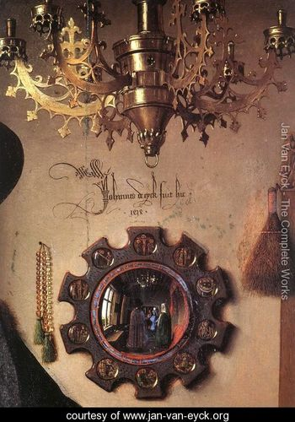
Message
The artist as a witness: “Jan van Eyck was there”
The artist and another figure are reflected in the mirror
Brush = Domestic care
Episodes from the Passion of the Christ on the frame of the mirror

Slide 6
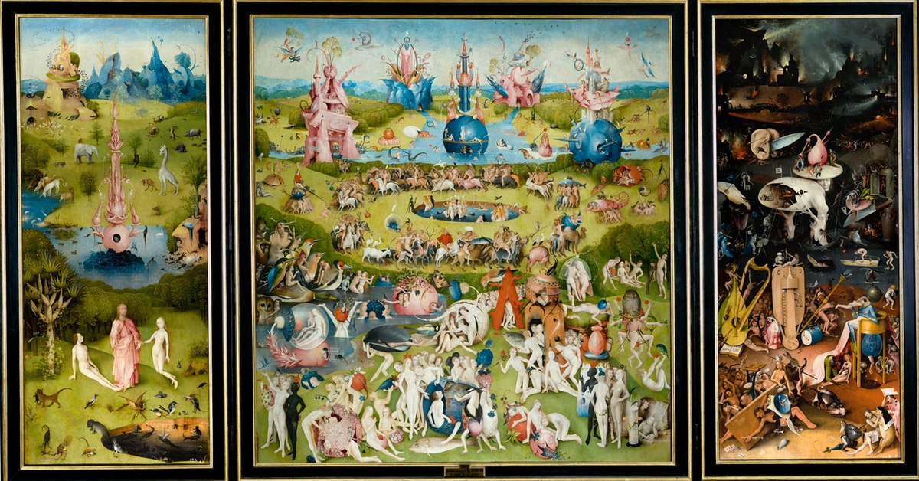
The Renaissance in the north was different than that of Italy. It was influence from the special atmosphere and climate of north Europe: Mysterious, dark, foggy and cold. The Flemish artist Bosch developed an imaginary world combined with the fearful approach of the middle ages. The colorful palette that he presents preceded the Venetian artists. There are different theories explaining the themes of Bosch: Extreme religious artist that inspired by Savonarola ( A monk who criticized the return of Paganism ), or satiric artist that made mockery of the medieval concept of fear and hell.
Hieronymus Bosch (1450-1516), The Garden of Earthly Delights, c. 1480-1515

