Slide 1
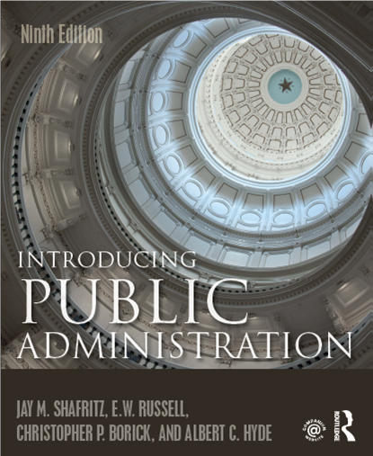
CHAPTER 14
Program Audit and Evaluation

Slide 2
The Audit
The audit is any independent examination or objective assessment of an organization.
In all cases and audit connotes comparison with some standard.
In public administration, the audit refers to two very common activities:
It examines a financial report to determine whether it accurately represents expenditures, deductions, and other legal requirements.
It is the final phase of a government budgetary process. It reviews the operations of an agency to see whether it has spent its funds in accordance with the laws in an efficient manner.

Slide 3
What Auditors Do
Organizations have auditors whose basic task is to certify that financial accounts are correct.
New applications of auditing have evolved beyond this traditional meaning. Thus it is possible to have:
Types of Audits
Comprehensive
Management
Efficiency
Performance

Slide 4
Auditing and Accounting
Auditing has become a major branch of the accounting profession.
Auditing remains the process of classifying, measuring, and interpreting financial transactions to provide management with information upon which to base economic decisions.
Auditing continues to evolve with multiple applications that now include independent assessments of such things as environmental, social, and infrastructural issues.

Slide 5
Auditing in the Federal Sector
Auditing the federal in the federal is the responsibility of the General Accounting Office. Established in 1921, the GAO serves as a support agency to audit federal government expenditures and assist the Congress in its legislative oversight responsibilities. A comprehensive audit program under the GAO should include the following 3 types of audits.
Financial & Compliance that determines whether funds are properly spent & in compliance with the law
Economy & Efficiency, that determines whether resources have been used appropriately
Program results, that determines whether the desired results have been achieved

Slide 6
Auditing Evolving & Auditor Independence
Criteria have been developed to ensure that the auditor stands independent of the organizations they are auditing.
These criteria for auditors include a location in the bureaucracy outside of management, a high reporting line for the audit results.
In 1978 The Inspector General Act created 12 IGs to do internal audits and reviews of agency operations and processes. Currently there are over 70 IG offices in the federal government.
In 2004 – The GAO changed its name to Government Accountability Office.

Slide 7
Program Evaluation and Policy Analysis
Program Evaluation and Policy Analysis are often confused. They are not the same:
Policy Analysis, asks the question…
What will likely be the effects of a policy once it occurs?

Slide 8
The Politics of Policy Analysis
Policy analysis can be defined simply an estimate of what would happen if some governmental procedure were changed.
For the most part, policy analysis is a discretionary commodity.
Some political executives like a lot of it.
The theoretical model of policy analysis uses review and evaluation of factual information provided by totally objective, apolitical, expert professionals to provide a firmer basis for political actions.

Slide 9
The Politics of Policy Analysis
After a decision is made, the time comes to close ranks, cease internal debate, and provide a united front on the wisdom of the decision, with the policy analysts prudently keeping their opinions to themselves.
There are two judges for the suitability of a politician’s decisions: the press and the public

Slide 10
Characteristics of a Policy Analyst
Technical skills – quantitative techniques not used in most analyses but should be understood by analyst.
Multidisciplinary – knowledge from many different disciplines.
Creativity – Analysts must be able to frame issues quickly into fundamental questions, explore related information from all conceivable sources, and provide at least some useful insights in very little time.

Slide 11
Characteristics of a Policy Analyst
Clarity – The model must get the point across clearly and quickly.
Poise – Policy analysis is part of an adversarial process. Instant analysis and intense debate is the rule.
Expertise – Analysts should understand the issue under consideration. Competence affects credibility.
Political savvy – Policy analysis must be politically sensitive.

Slide 12
Program Evaluation & Policy Analysis
Program Evaluations refer to….
The standards against which a program can be evaluated:
Compliance
Efficiency
Effectiveness
Relevance

Slide 13
Program Evaluation & Policy Analysis
Program evaluation is the use of social research methods to systematically investigate the effectiveness of social intervention programs.
The need for program evaluation is undiminished and may even be expected to grow.
Contemporary concern over the allocation of scarce resources makes it more essential than ever to evaluate the effectiveness of social interventions.

Slide 14
Evaluating Public Programs
Program evaluation is a way of bringing to public decision-makers the available knowledge about a problem, about the relative effectiveness of past and current strategies for addressing or reducing that problem, and about the observed effectiveness of programs.

Slide 15
Evaluating Public Programs
Evaluation must be tailored to the political and organizational context of the program to be evaluated.
The assessment should look into:
The need for the program
The design of the program
The program implementation and service delivery
The program impact or outcomes
Program efficiency
Accurate description of program performance and assessment against relevant standards or criteria.

Slide 16
Meeting the Need for Evaluation
Three basic questions
Can the results of the evaluation influence decisions about the program?
Can the evaluation be done in time to be useful?
Is the program significant enough to merit evaluation?

Slide 17
Administrative Purposes for Evaluation
Policy formulation – to assess or justify the need for a new program and to design it optimally on the basis of past experience.
Information on the problem addressed by the program: how big is it? What is its frequency and direction? How is it changing?
Information on the results of past programs that dealt with the problem: were those programs feasible? Were they successful? What difficulties did they encounter?
Information allowing the selection of one program over another: what are the comparative costs and benefits? What kinds of growth records were experienced?

Slide 18
Administrative Purposes for Evaluation
Policy execution – to ensure that a program is implemented in the most cost-effective and technically competent way.
Information on program implementation: how operational is the program? How similar is it across sites? Does it conform to the policies and expectations formulated? How much does it cost? How do stakeholders feel about it? Are there delivery problems or error, fraud, and abuse?
Information on program management: what degree of control exists over expenditures? What are the qualifications and credentials of the personnel? What is the allocation of resources? How is program information used in decision making?

Slide 19
Administrative Purposes for Evaluation
Accountability in public decision making – to determine the effectiveness of an operating program and the need for its continuation, modification, or termination.
Information on program outcomes or effects: what happened as a result of program implementation?
Information on the degree to which the program made or is making a difference: what change in the problem or threat has occurred that can be directly attributed to the program?
Information on the unexpected (and expected) effects of the program.

Slide 20
Evaluation Metrics?
It all comes down to measureable results (performance) and gathering evidence to show outcomes and impacts.
4 Key questions:
Is the organization doing the right things (activities and resource allocation)
Is the organization doing things right? (outputs by activities)
Have the outputs made a difference? (outcomes vs outputs–internal environment)
Have the outcomes had impact? (external environment)

Slide 21
Budget and Performance Integration “Breathing life into the promise of GPRA”
Define measurable results.
Monitor progress in achieving results.
Make management and resource decisions based on such progress.
Strategic goals should reflect the broad, long-term outcomes the agency aspires to achieve by implementing its mission. Strategic goals communicate the agency efforts to address national problems, needs, challenges, and opportunities on behalf of the American people
Strategic objectives reflect the outcome or management impact the agency is trying to achieve and generally include the agency’s role.
They express more specifically the results or direction the agency will work to achieve in order to make progress on its mission

Slide 22
OMB Guidance 230.1 What is an agency Strategic Plan?
The GPRA Modernization Act (2010) aligns strategic planning with the beginning of each new term of an Administration, requiring every federal agency to produce a new Strategic Plan by the first Monday in February following the year in which the term of the president commences.
The Strategic Plan, therefore, presents the long-term objectives an agency hopes to accomplish at the beginning of each new term of an Administration by describing:
general and long-term goals the agency aims to achieve
what actions the agency will take to realize those goals
how the agency will deal with challenges and risks that may hinder achieving results.

Slide 23
Evaluations
Evaluations take place within the discipline or paradigm in which they are conducted.
These paradigms can vary widely.
The standards, however, must reflect the fundamental questions that must be answered of any program.

Slide 24
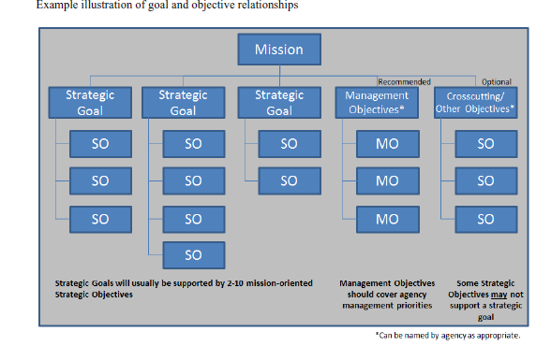
Strategic Goals & Objectives – GPRA Style

