Slide 1
Healthcare Inequality

Slide 2
What is Healthcare Inequality
(i) a clear statement of the Topic and affected parties, (ii) a clear statement of the Issue(s)
raised by the Topic, (iii) a clear statement of the applicable LAW governing the Issue(s) your
Group chose to present (with proper citations to judicial cases, statutes, administrative agency
regulations or codes, municipal ordinances. Treaties, etc), and, (iv) a clear statement of the
current status of the Issue(s) raised and/or a prediction about the future legal outcome(s). If
there is no or very little regulatory laws, what does the Group identify as requiring regulation
and why (e.g., to protect what interests or from what harm)? What proposed legislation or
regulation should be in place to protect interests?

Slide 3
Discrimination through Healthcare Inequality
Black Americans face greater health risks (nutrition, higher infant death rate, lower life span, poverty)
Despite having greater health risks, African Americans are cheated by the healthcare system.
Minorities are cheated by the healthcare system because of “economic discrimination, insufficient hospitals, racial discrimination in treatment and services, and culturally incompetent care.” (American Bar Association)
Undocumented immigrants also face higher health risks and are not compensated by the healthcare system.
Undocumented immigrants deal with “social determinants of health”, affected by poverty, nutrition, stress from risk of deportation, housing insecurity, etc.
Affordable Care act excluded health insurance from undocumented immigrants, putting countless people at risk.
As of 2017, 28 million people did not have health insurance in the United States. Of these people, “3.9 million of them were children younger than 18 years of age.” (ScienceDirect)

Slide 4
Women and Healthcare
H.Res 16
Introduced into the House of Reps. on Jan. 3, 2019. This would make it easier for women of all ages to access high quality and comprehensive medical care
Sebelius v. Hobby Lobby Stores, Inc.

Slide 5
Inaccessibility to Vaccinations
Many children do not have access to vaccines or are vaccinated later than recommended due to lack of healthcare.
Many American children, mostly minorities, do not get their recommended vaccinations due to issues stemming from poverty and lack of health insurance.
“The measles vaccination rate in D.C. for kindergartners is only 81%. We really look for at the very least 90% — hopefully more like 95% — to prevent outbreaks,” (NPR) This causes a huge risk for outbreaks of these diseases, putting children’s lives at risk.
There is a direct correlation between poverty and vaccination rates in the United States.
Program called Vaccines for Children, provides free vaccines to children without health insurance who would otherwise have no access to them.

Slide 6
Political Aspects of Healthcare Debate
Negative:
Trump continuously making moves to repeal the Affordable Care Act, creating uncertainty for many who are covered by Obamacare.
Affordable Care Act expanded Medicaid all over the country, protected people with pre-existing conditions from being turned down, and allowed children to stay on their parents’ health insurance until age 26.
Positive:
Democratic candidate Bernie Sanders advocates for raising the minimum wage to $15 per hour.
This new wage would put America’s lower class above the poverty line, resulting in healthier people, lessening disparity between wealthy and lower class/ impoverished minorities, etc.

Slide 7
The Gender Pay Gap
“Women continue to be paid less than men in the United States despite decades-long efforts to close the gap. Moreover, the gap — women currently earn 82 cents for every dollar earned by a man — persists across many industries, from Hollywood studios to nursing.”
“The U.S. House has passed the Paycheck Fairness Act, which would, among other things, require companies to demonstrate that salary differences are based on education or years of experience rather than gender bias.”

Slide 8
Texas v United States (2019)
“The United States healthcare system touches millions of lives in a daily and deeply personal way. Health-insurance policy is therefore a politically charged affair—inflaming emotions and testing civility. But Article III courts, the Supreme Court has confirmed, are not tasked with, nor are they suited to, policymaking.¹ Instead, courts resolve discrete cases and controversies” - US District Court Judge Reed O’Connor
Tax Cuts and Jobs Act

Slide 9
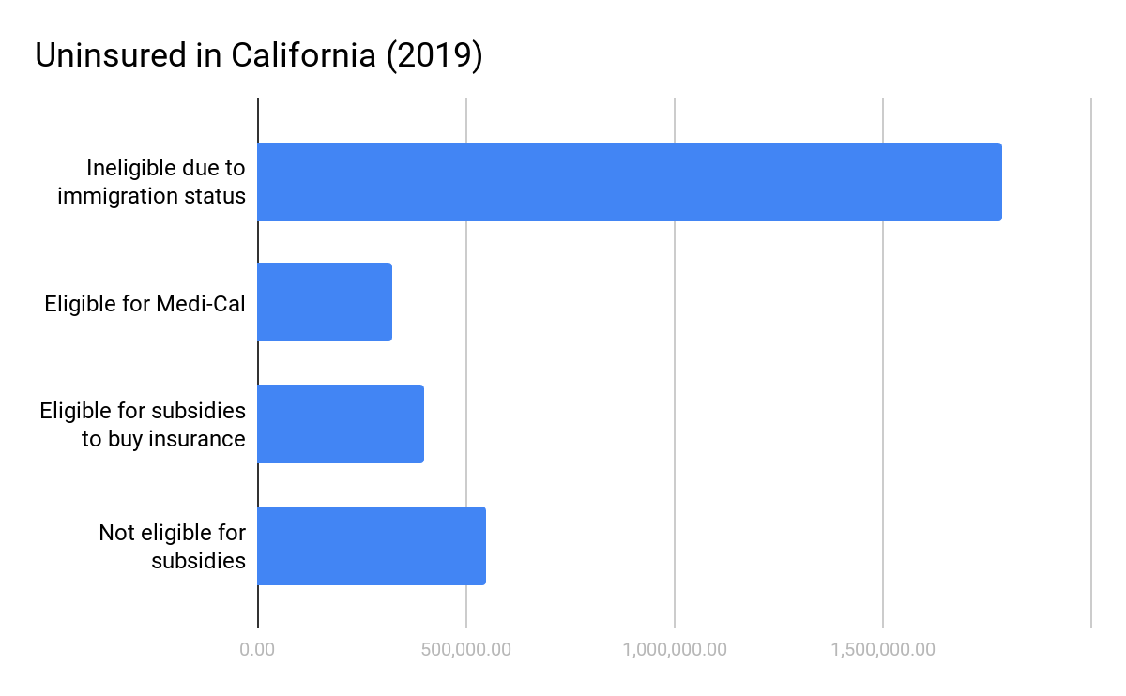
California v Trump (2017)
Judge - “The United States suffers from immense inequality of wealth and opportunity”
Access to healthcare for low-income individuals should come before saving money
Courts should apply laws to help decrease the inequality
It is their job to make sure people with lower income have access to healthcare

Slide 10
Healthcare Inequality in the World

Slide 11
Solutions

