Slide 1
Community Report
Your Name
County, State

Slide 2
Introduction
Notes:
Introduce your county. Include a map.

Slide 3
Two (2) Positive health indicators
Health Indicators (HI) | Your) County, (State) Indicator % | Your state % | “Top” US performer %
Diabetic monitoring (NOTE: these are only examples from Turner Co, Ga, choose the best ones for your county) | 88% | 85% | 90%
Mammography screening | 69% | 62% | 71%
Diabetic monitoring is defined as Percentage of diabetic Medicare enrollees ages 65-75 that receive HbA1c monitoring.
Mammography screening is defined as: Percentage of diabetic Medicare enrollees ages 65-75 that receive HbA1c monitoring.
(Countyhealth rankings.org)
Notes:
Select Two (2) positive health indicators (i.e. county has less smoking, or, fewer premature deaths than state and national average. ) If your county has not positive health indicates, state this.

Slide 4
Concerning Health Outcome Quality of Life
Health Indicators (HI) | Your) County, (State) Indicator % | Your state % | “Top” US performer %
**Sexually transmitted diseases | 594.5 | 514.8 | 134.1
**Low birth weight | 15% | 9% | 6%
**(NOTE: these are only examples from Turner Co., Ga, choose the two most concerning
ones for your county)
Sexually transmitted diseases are defined as Number of newly diagnosed chlamydia cases per 100,000 population.
Low birth weight is defined as Percentage of live births with low birthweight (< 2500 grams).
(Countyhealthrankings.org)
…
Notes:
Slides 3 & 4
Select four (4) of your community’s most troubling health indicators that are worse that the state and US (i.e., see ppt table to use).

Slide 5
Concerning Health Outcome Social and Economic factors
Health Indicators (HI) | Your) County, (State) Indicator % | Your state % | “Top” US performer %
**High school graduation
**Median household income
**(NOTE: these are only examples, choose the two most concerning
ones for your county)
High school graduation is defined as………
Median household income is defined …….
Notes:
Slides 3 & 4
Select four (4) of your community’s most troubling health indicators that are worse that the state and US (i.e., see ppt table to use).
Provide a description (2-3 sentence, in-depth paragraph) of each (4) indicators (link on ‘blue’ indicators in County Health Rankings table that will take you to definitions and descriptions for each.)
Provide definitions of each (negative) health indicator (found on county healthranksing.org website).

Slide 6
Most urgent health indicator & MN PH Intervention in (County), (State)
Notes:
Analysis of Most Urgent Indicator: From these four(4) health indicators you selected as a problem for your community,
choose the one most urgent indicator that you will recommend to your community to address. Explain why, of the 4 problem health indicators you report, you believe this one is the most urgent.

Slide 7
Healthy People 2020
Notes:
Which Healthy People 2020 goal (one) does this problem health indicator address? Briefly define the goal. Link here for HP 2020 goals and objectives: http://www.healthypeople.gov/2020/topicsobjectives2020/default

Slide 8
Aggregate populations: (example: West Virginia)
Aggregate Population | West Virginia Obese % | HP 2020 Target goal for % Obese
Pre-schoolers (2-4 or 5 y/o) | 16.4 | 9.4%
High School / Adolescents | 17.9 | (find & fill HP% in)
Adults | 37.7 | (find & fill HP % in)
Notes:
Slide 7:
Obesity rates slide: Identify your state’s (a) adult, (b) adolescent, and (c) preschooler (2-5 y/o) obese percentages. Find HP 2020 target goal and fill in the column)
Note: this is example of slide 7.

Slide 9
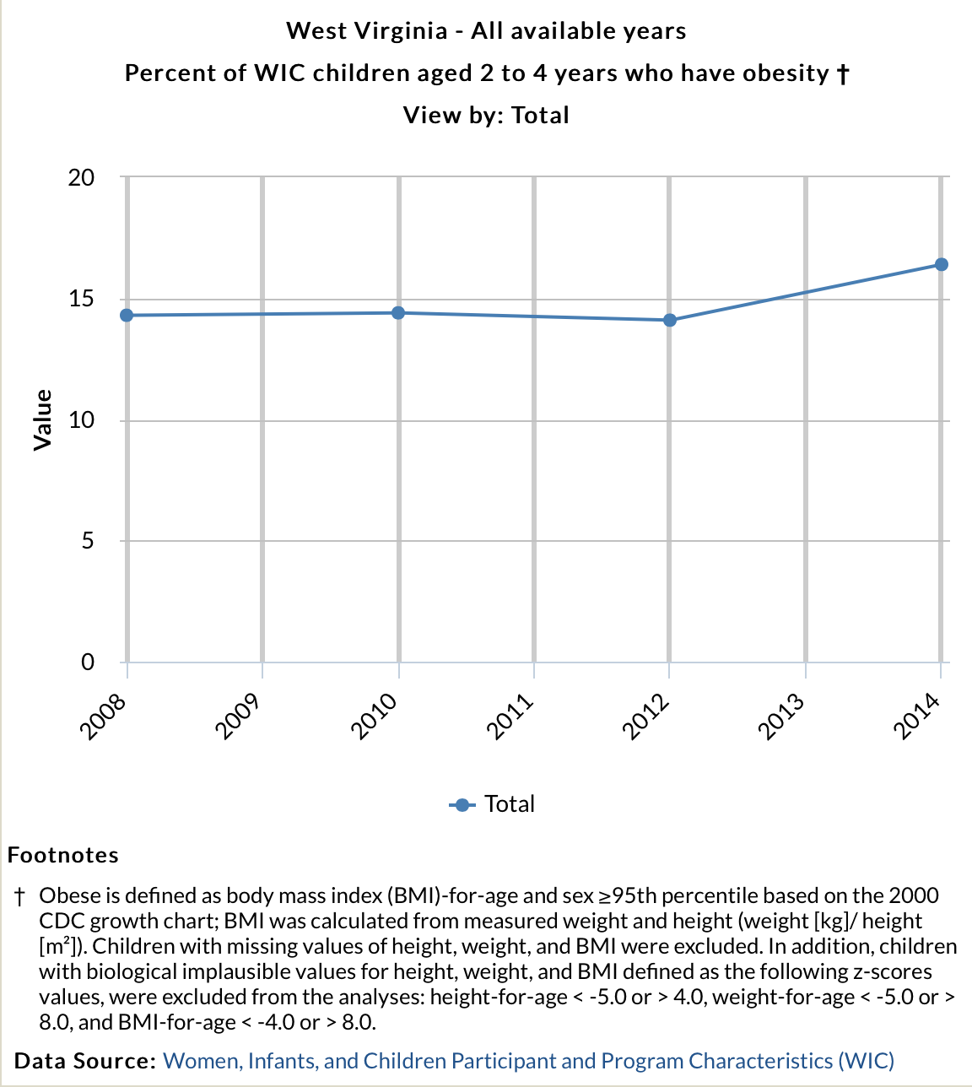
WV preschoolers' (2-4 y/o) obesity trend over time
Notes:
Note: this is example of slide 8

Slide 10
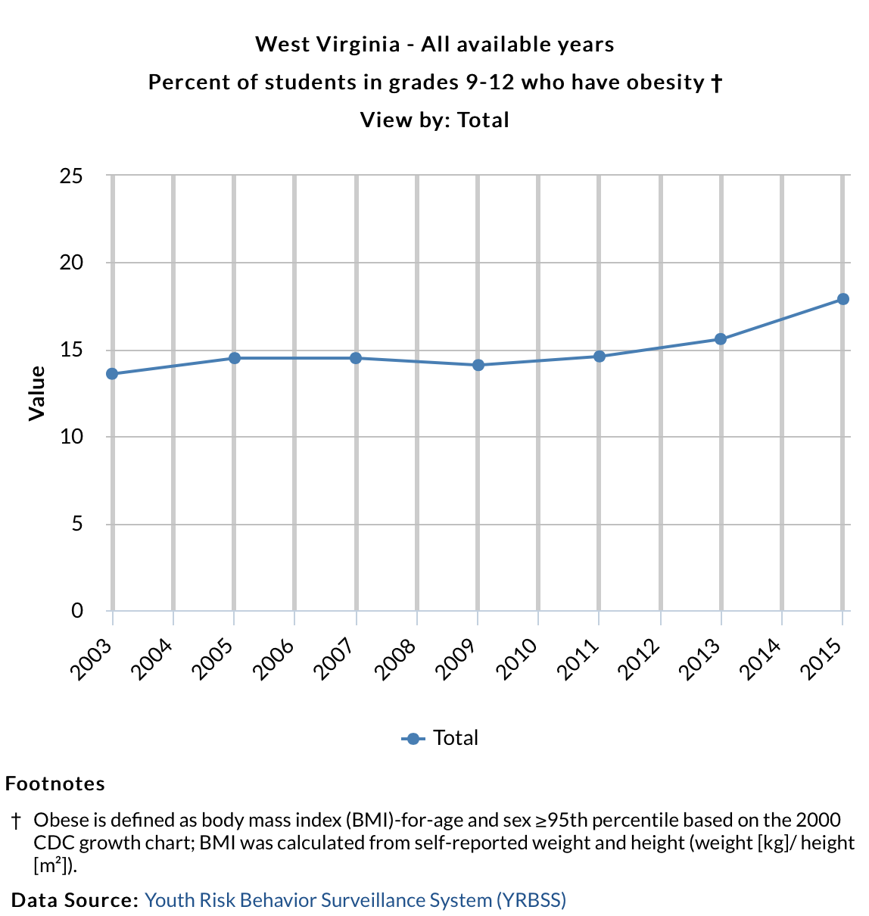
High-schoolers (Adolescents) obesity trend over time
Notes:
Note: this is example of slide 9

Slide 11
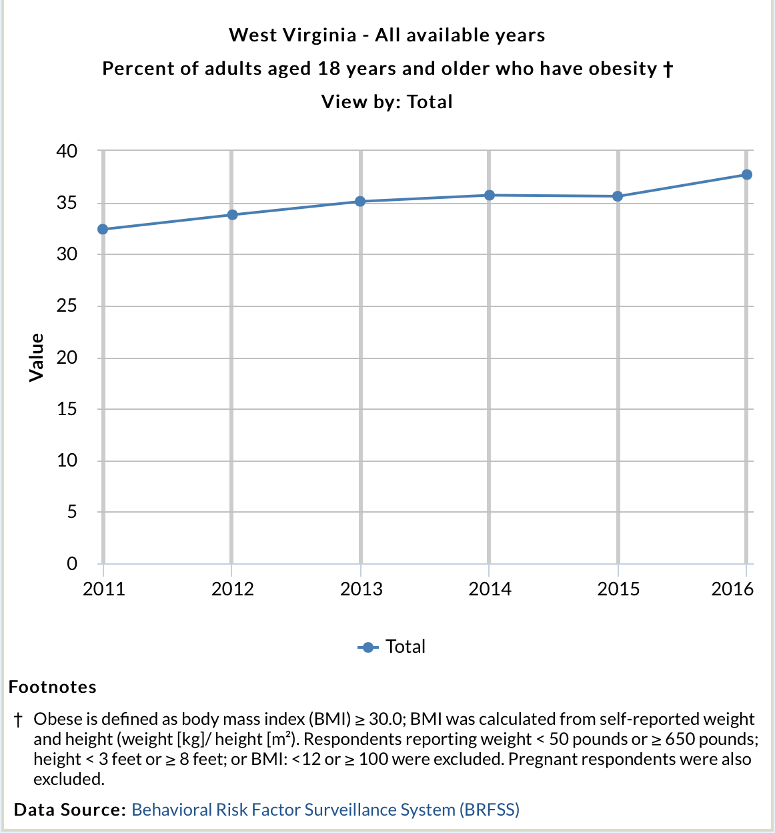
WV adult obesity trend over time
Notes:
Note: this is example of slide 10

Slide 12
Discussion of HP 2020 & at-risk data
Notes:
Discussion: synthesize the overweight/obesity data: How does your populations compare to Healthy People 2020 target goals?

Slide 13
Windshield & walkability survey
Introduce school, grade levels, number of children attending,
Include photo (no faces, for privacy)
Notes:
Choose a convenient school to conduct a windshield walkability survey. Introduce the school (grades, # children attending) and a picture (no faces for privacy reasons).

Slide 14
Did you have room to walk?
(i.e. take photos (no faces) of streets, sidewalks
Notes:
, complete the walkability survey and score it (see survey link here: __________***).
For headings, use the 5 questions for the slides. Take photos of each of the five (5) walkability categories that illustrates your ‘yes’ or ‘no’ response.

Slide 15
___Score & discussion
Notes:
Score and discussion slides: After each of the 5 category photos, describe the ‘Score & discussion’ slide thoroughly. i.e., describe the category scores/answers as seen in the picture.

Slide 16
Was it easy to cross the street?
(photos) no faces
Notes:
For headings, use the 5 questions for the slides. Take photos of each of the five (5) walkability categories that illustrates your ‘yes’ or ‘no’ response.

Slide 17
Score & discussion
Notes:
Score and discussion slides: After each of the 5 category photos, describe the ‘Score & discussion’ slide thoroughly. i.e., describe the category scores/answers as seen in the picture.

Slide 18
Did drivers behave well?
(photo)
Notes:
For headings, use the 5 questions for the slides. Take photos of each of the five (5) walkability categories that illustrates your ‘yes’ or ‘no’ response.

Slide 19
Score & discussion
Notes:
Score and discussion slides: After each of the 5 category photos, describe the ‘Score & discussion’ slide thoroughly. i.e., describe the category scores/answers as seen in the picture.

Slide 20
Was it easy to follow safety rules?
(photo)
Notes:
For headings, use the 5 questions for the slides. Take photos of each of the five (5) walkability categories that illustrates your ‘yes’ or ‘no’ response.

Slide 21
Score & discussion
Notes:
Score and discussion slides: After each of the 5 category photos, describe the ‘Score & discussion’ slide thoroughly. i.e., describe the category scores/answers as seen in the picture.

Slide 22
Was the walk pleasant?
(photo)
Notes:
For headings, use the 5 questions for the slides. Take photos of each of the five (5) walkability categories that illustrates your ‘yes’ or ‘no’ response.

Slide 23
Score & discussion
Notes:
Score and discussion slides: After each of the 5 category photos, describe the ‘Score & discussion’ slide thoroughly. i.e., describe the category scores/answers as seen in the picture.

Slide 24
How does your neighborhood stack up? ____final score
(Discuss how safely can students walk to and from school.)
Notes:
: Final walkability score & conclusion: Add up your category ratings (see survey) and describe how your school ‘stacked up.’ As a Public Health nurse, what is your conclusion about children’s safety if walking around the school’s environment? How strongly would you recommend this walking environment as a good physical activity opportunity when going to and leaving from school?

Slide 25
MN PH Intervention
(Write your SMART objective/plan)
Notes:
Think of a MN PH Intervention you recommend as the next step to promote walking opportunities for the students. Name the specific intervention, what you plan to do, who is the target audience, and what level the intervention is.

Slide 26
References
Notes:
slide List all references used for this ppt project Use APA format order (authors, date, title, etc.). The hanging indentations do not set in some PPT editions. No penalty if margins do not set in APA hanging indentations.

