Slide 1
Chapter 3
Forecasting

Slide 2
Chapter 3: Learning Objectives
You should be able to:
LO 3.1 List features common to all forecasts
LO 3.2 Explain why forecasts are generally wrong
LO 3.3 List elements of a good forecast
LO 3.4 Outline the steps in the forecasting process
LO 3.5 Summarize forecast errors
Copyright ©2018 McGraw-Hill Higher Education. All rights reserved. No reproduction or distribution without the prior written consent of McGraw-Hill Education

Slide 3
Forecast
Forecast – a statement about the future value of a variable of interest
We make forecasts about such things as weather, demand, and resource availability
Forecasts are important to making informed decisions
Copyright ©2018 McGraw-Hill Higher Education. All rights reserved. No reproduction or distribution without the prior written consent of McGraw-Hill Education

Slide 4
Two Important Aspects of Forecasts
Expected level of demand
The level of demand may be a function of some structural variation such as trend or seasonal variation
Accuracy
Related to the potential size of forecast error
Copyright ©2018 McGraw-Hill Higher Education. All rights reserved. No reproduction or distribution without the prior written consent of McGraw-Hill Education

Slide 5
Forecast Uses
Plan the system
Generally involves long-range plans related to:
Types of products and services to offer
Facility and equipment levels
Facility location
Plan the use of the system
Generally involves short- and medium-range plans related to:
Inventory management
Workforce levels
Purchasing
Production
Budgeting
Scheduling
Copyright ©2018 McGraw-Hill Higher Education. All rights reserved. No reproduction or distribution without the prior written consent of McGraw-Hill Education

Slide 6
Features Common to All Forecasts
Techniques assume some underlying causal system that existed in the past will persist into the future
Forecasts are not perfect
Forecasts for groups of items are more accurate than those for individual items
Forecast accuracy decreases as the forecasting horizon increases
LO 3.1
Copyright ©2018 McGraw-Hill Higher Education. All rights reserved. No reproduction or distribution without the prior written consent of McGraw-Hill Education

Slide 7
Forecasts Are Not Perfect
Forecasts are not perfect:
Because random variation is always present, there will always be some residual error, even if all other factors have been accounted for.
LO 3.2
Copyright ©2018 McGraw-Hill Higher Education. All rights reserved. No reproduction or distribution without the prior written consent of McGraw-Hill Education

Slide 8
Elements of a Good Forecast
The forecast
Should be timely
Should be accurate
Should be reliable
Should be expressed in meaningful units
Should be in writing
Technique should be simple to understand and use
Should be cost-effective
LO 3.3
Copyright ©2018 McGraw-Hill Higher Education. All rights reserved. No reproduction or distribution without the prior written consent of McGraw-Hill Education

Slide 9
Steps in the Forecasting Process
Determine the purpose of the forecast
Establish a time horizon
Obtain, clean, and analyze appropriate data
Select a forecasting technique
Make the forecast
Monitor the forecast errors
LO 3.4
Copyright ©2018 McGraw-Hill Higher Education. All rights reserved. No reproduction or distribution without the prior written consent of McGraw-Hill Education

Slide 10
Forecast Accuracy and Control
Allowances should be made for forecast errors
It is important to provide an indication of the extent to which the forecast might deviate from the value of the variable that actually occurs
Forecast errors should be monitored
Error = Actual – Forecast
If errors fall beyond acceptable bounds, corrective action may be necessary
LO 3.5
Copyright ©2018 McGraw-Hill Higher Education. All rights reserved. No reproduction or distribution without the prior written consent of McGraw-Hill Education

Slide 11
Chapter 3
Forecasting

Slide 12
Chapter 3: Learning Objectives
You should be able to:
LO 3.6 Describe four qualitative forecasting techniques
LO 3.7 Use a naïve method to make a forecast
LO 3.8 Prepare a moving average forecast
LO 3.9 Prepare a weighted-average forecast
LO 3.10 Prepare an exponential smoothing forecast
LO 3.11 Prepare a linear trend forecast
LO 3.12 Prepare a trend-adjusted exponential smoothing forecast
LO 3.13 Compute and use seasonal relatives
LO 3.14 Compute and use regression and correlation coefficients
LO 3.15 Construct control charts and use them to monitor forecast errors
LO 3.16 Describe the key factors and trade-offs to consider when choosing a forecasting technique
Copyright ©2018 McGraw-Hill Higher Education. All rights reserved. No reproduction or distribution without the prior written consent of McGraw-Hill Education

Slide 13
Forecast Accuracy Metrics
MAD weights all errors evenly
MSE weights errors according to their squared values
MAPE weights errors according to relative error
LO 3.5
Copyright ©2018 McGraw-Hill Higher Education. All rights reserved. No reproduction or distribution without the prior written consent of McGraw-Hill Education

Slide 14
Forecast Error Calculation
Period | Actual (A) | Forecast (F) | (A-F) Error | |Error| | Error² | [|Error|/Actual]x100
1 | 107 | 110 | -3 | 3 | 9 | 2.80%
2 | 125 | 121 | 4 | 4 | 16 | 3.20%
3 | 115 | 112 | 3 | 3 | 9 | 2.61%
4 | 118 | 120 | -2 | 2 | 4 | 1.69%
5 | 108 | 109 | 1 | 1 | 1 | 0.93%
 |  |  | Sum | 13 | 39 | 11.23%
 |  |  |  | n = 5 | n-1 = 4 | n = 5
 |  |  |  | MAD | MSE | MAPE
 |  |  |  | = 2.6 | = 9.75 | = 2.25%
LO 3.5
Copyright ©2018 McGraw-Hill Higher Education. All rights reserved. No reproduction or distribution without the prior written consent of McGraw-Hill Education

Slide 15
Forecasting Approaches
Qualitative forecasting
Qualitative techniques permit the inclusion of soft information such as:
Human factors
Personal opinions
Hunches
These factors are difficult, or impossible, to quantify
Quantitative forecasting
These techniques rely on hard data
Quantitative techniques involve either the projection of historical data or the development of associative methods that attempt to use causal variables to make a forecast
LO 3.6
Copyright ©2018 McGraw-Hill Higher Education. All rights reserved. No reproduction or distribution without the prior written consent of McGraw-Hill Education

Slide 16
Qualitative Forecasts
Forecasts that use subjective inputs such as opinions from consumer surveys, sales staff, managers, executives, and experts
Executive opinions
A small group of upper-level managers may meet and collectively develop a forecast
Sales force opinions
Members of the sales or customer service staff can be good sources of information due to their direct contact with customers and may be aware of plans customers may be considering for the future
Consumer surveys
Since consumers ultimately determine demand, it makes sense to solicit input from them
Consumer surveys typically represent a sample of consumer opinions
Other approaches
Managers may solicit 0pinions from other managers or staff people or outside experts to help with developing a forecast.
The Delphi method is an iterative process intended to achieve a consensus
LO 3.6
Copyright ©2018 McGraw-Hill Higher Education. All rights reserved. No reproduction or distribution without the prior written consent of McGraw-Hill Education

Slide 17
Time-Series Forecasts
Forecasts that project patterns identified in recent time-series observations
Time-series – a time-ordered sequence of observations taken at regular time intervals
Assume that future values of the time-series can be estimated from past values of the time-series
Copyright ©2018 McGraw-Hill Higher Education. All rights reserved. No reproduction or distribution without the prior written consent of McGraw-Hill Education

Slide 18
Time-Series Behaviors
Trend
Seasonality
Cycles
Irregular variations
Random variation
Copyright ©2018 McGraw-Hill Higher Education. All rights reserved. No reproduction or distribution without the prior written consent of McGraw-Hill Education

Slide 19
Trends and Seasonality
Trend
A long-term upward or downward movement in data
Population shifts
Changing income
Seasonality
Short-term, fairly regular variations related to the calendar or time of day
Restaurants, service call centers, and theaters all experience seasonal demand
Copyright ©2018 McGraw-Hill Higher Education. All rights reserved. No reproduction or distribution without the prior written consent of McGraw-Hill Education

Slide 20
Cycles and Variations
Cycle
Wavelike variations lasting more than one year
These are often related to a variety of economic, political, or even agricultural conditions
Irregular variation
Due to unusual circumstances that do not reflect typical behavior
Labor strike
Weather event
Random Variation
Residual variation that remains after all other behaviors have been accounted for
Copyright ©2018 McGraw-Hill Higher Education. All rights reserved. No reproduction or distribution without the prior written consent of McGraw-Hill Education

Slide 21
Time-Series Forecasting - Naïve Forecast
Naïve forecast
Uses a single previous value of a time series as the basis for a forecast
The forecast for a time period is equal to the previous time period’s value
Can be used with
A stable time series
Seasonal variations
Trend
LO 3.7
Copyright ©2018 McGraw-Hill Higher Education. All rights reserved. No reproduction or distribution without the prior written consent of McGraw-Hill Education

Slide 22
Time-Series Forecasting - Averaging
These techniques work best when a series tends to vary about an average
Averaging techniques smooth variations in the data
They can handle step changes or gradual changes in the level of a series
Techniques
Moving average
Weighted moving average
Exponential smoothing
LO 3.8
Copyright ©2018 McGraw-Hill Higher Education. All rights reserved. No reproduction or distribution without the prior written consent of McGraw-Hill Education

Slide 23
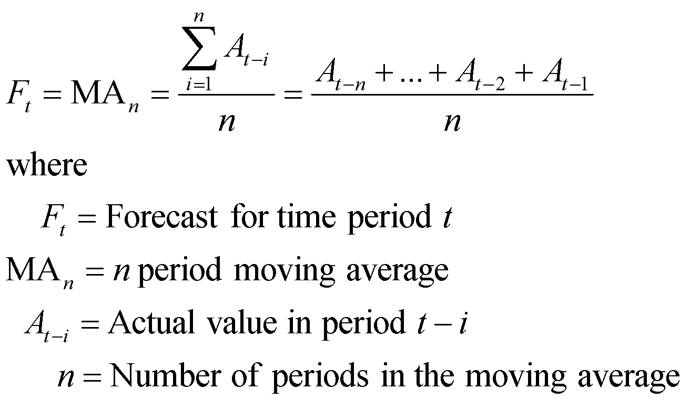
Moving Average
Technique that averages a number of the most recent actual values in generating a forecast
LO 3.8
Copyright ©2018 McGraw-Hill Higher Education. All rights reserved. No reproduction or distribution without the prior written consent of McGraw-Hill Education

Slide 24
Moving Average (cont.)
As new data become available, the forecast is updated by adding the newest value and dropping the oldest and then re-computing the average
The number of data points included in the average determines the model’s sensitivity
Fewer data points used—more responsive
More data points used—less responsive
LO 3.8
Copyright ©2018 McGraw-Hill Higher Education. All rights reserved. No reproduction or distribution without the prior written consent of McGraw-Hill Education

Slide 25
Weighted Moving Average
The most recent values in a time series are given more weight in computing a forecast
The choice of weights, w, is somewhat arbitrary and involves some trial and error
LO 3.9
Copyright ©2018 McGraw-Hill Higher Education. All rights reserved. No reproduction or distribution without the prior written consent of McGraw-Hill Education

Slide 26
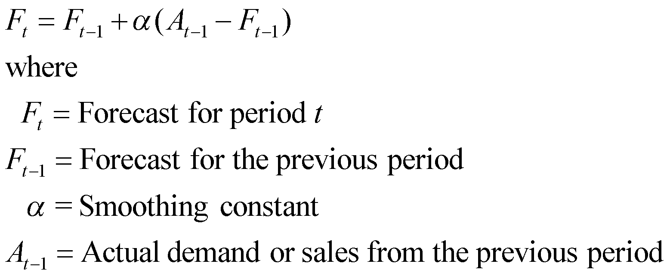
Exponential Smoothing
A weighted averaging method that is based on the previous forecast plus a percentage of the forecast error
LO 3.10
Copyright ©2018 McGraw-Hill Higher Education. All rights reserved. No reproduction or distribution without the prior written consent of McGraw-Hill Education

Slide 27
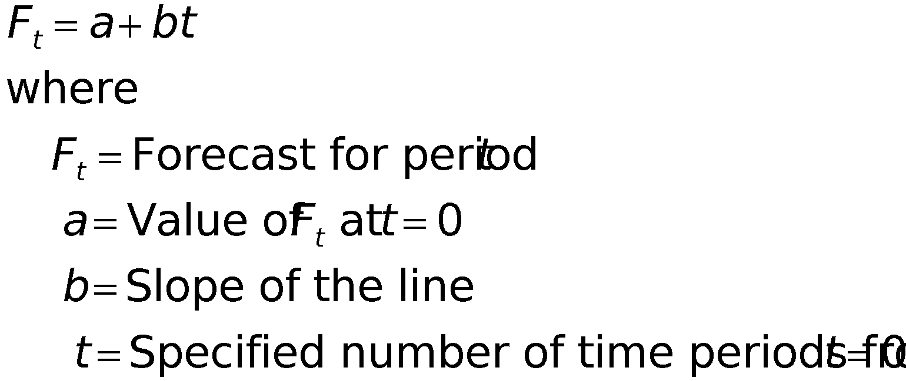
Linear Trend
A simple data plot can reveal the existence and nature of a trend
Linear trend equation
LO 3.11
Copyright ©2018 McGraw-Hill Higher Education. All rights reserved. No reproduction or distribution without the prior written consent of McGraw-Hill Education

Slide 28
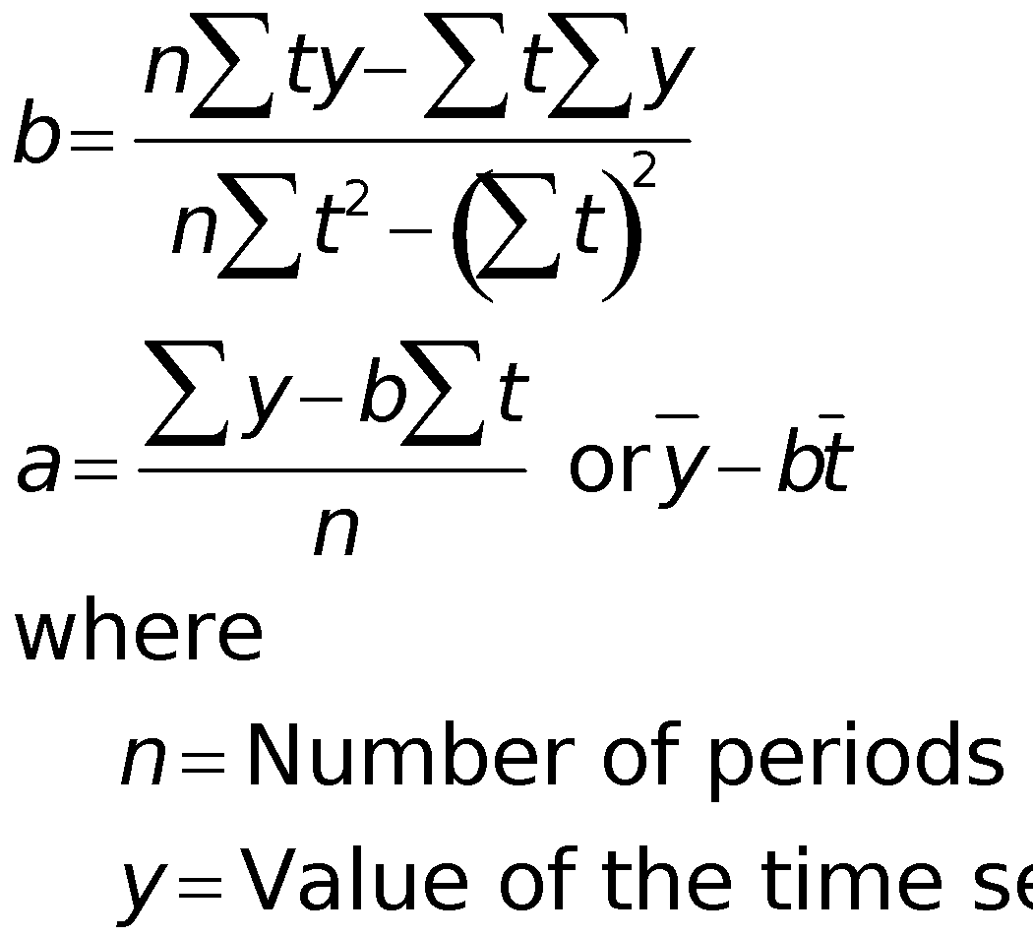
Estimating Slope and Intercept
Slope and intercept can be estimated from historical data
LO 3.11
Copyright ©2018 McGraw-Hill Higher Education. All rights reserved. No reproduction or distribution without the prior written consent of McGraw-Hill Education

Slide 29
Trend-Adjusted Exponential Smoothing
The trend adjusted forecast consists of two components
Smoothed error
Trend factor
LO 3.12
Copyright ©2018 McGraw-Hill Higher Education. All rights reserved. No reproduction or distribution without the prior written consent of McGraw-Hill Education

Slide 30
Trend-Adjusted Exponential Smoothing (cont.)
Alpha and beta are smoothing constants
Trend-adjusted exponential smoothing has the ability to respond to changes in trend
LO 3.12
Copyright ©2018 McGraw-Hill Higher Education. All rights reserved. No reproduction or distribution without the prior written consent of McGraw-Hill Education

Slide 31
Techniques for Seasonality
Seasonality – regularly repeating movements in series values that can be tied to recurring events
Expressed in terms of the amount that actual values deviate from the average value of a series
Models of seasonality
Additive
Seasonality is expressed as a quantity that gets added to or subtracted from the time-series average in order to incorporate seasonality
Multiplicative
Seasonality is expressed as a percentage of the average (or trend) amount which is then used to multiply the value of a series in order to incorporate seasonality
LO 3.13
Copyright ©2018 McGraw-Hill Higher Education. All rights reserved. No reproduction or distribution without the prior written consent of McGraw-Hill Education

Slide 32
Seasonal Relatives
Seasonal relatives
The seasonal percentage used in the multiplicative seasonally adjusted forecasting model
Using seasonal relatives
To deseasonalize data
Done in order to get a clearer picture of the nonseasonal (e.g., trend) components of the data series
Divide each data point by its seasonal relative
To incorporate seasonality in a forecast
Obtain trend estimates for desired periods using a trend equation
Add seasonality by multiplying these trend estimates by the corresponding seasonal relative
LO 3.13
Copyright ©2018 McGraw-Hill Higher Education. All rights reserved. No reproduction or distribution without the prior written consent of McGraw-Hill Education

Slide 33
Associative Forecasting Techniques
Associative techniques are based on the development of an equation that summarizes the effects of predictor variables
Predictor variables - variables that can be used to predict values of the variable of interest
Home values may be related to such factors as home and property size, location, number of bedrooms, and number of bathrooms
LO 3.14
Copyright ©2018 McGraw-Hill Higher Education. All rights reserved. No reproduction or distribution without the prior written consent of McGraw-Hill Education

Slide 34
Simple Linear Regression
Regression - a technique for fitting a line to a set of data points
Simple linear regression - the simplest form of regression that involves a linear relationship between two variables
The object of simple linear regression is to obtain an equation of a straight line that minimizes the sum of squared vertical deviations from the line (i.e., the least squares criterion)
LO 3.14
Copyright ©2018 McGraw-Hill Higher Education. All rights reserved. No reproduction or distribution without the prior written consent of McGraw-Hill Education

Slide 35
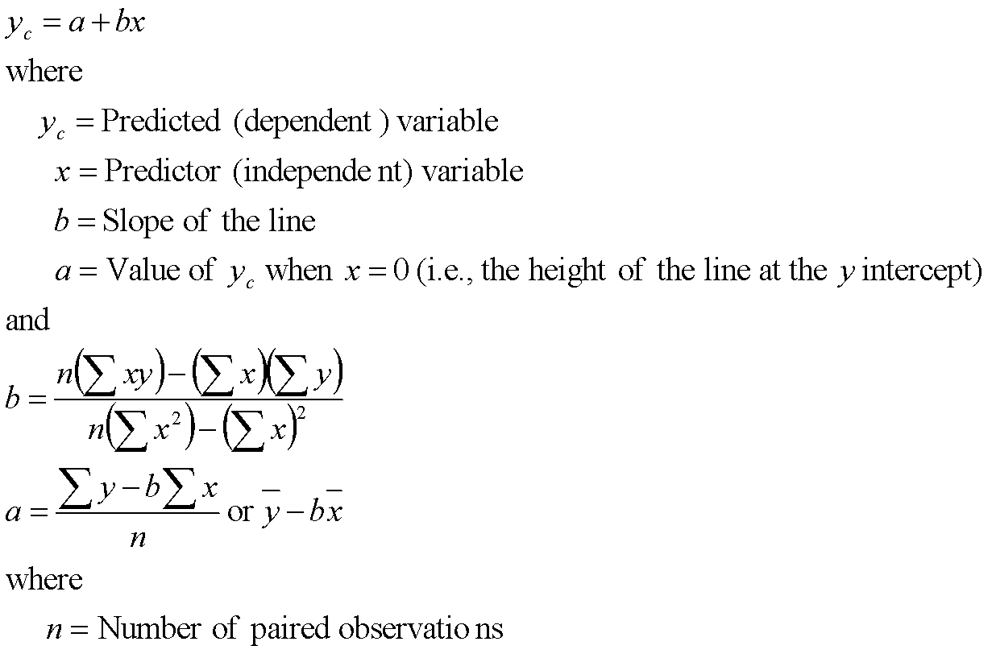
Least Squares Line
LO 3.14
Copyright ©2018 McGraw-Hill Higher Education. All rights reserved. No reproduction or distribution without the prior written consent of McGraw-Hill Education

Slide 36
Correlation Coefficient
Correlation, r
A measure of the strength and direction of relationship between two variables
Ranges between -1.00 and +1.00
r², square of the correlation coefficient
A measure of the percentage of variability in the values of y that is “explained” by the independent variable
Ranges between 0 and 1.00
LO 3.14
Copyright ©2018 McGraw-Hill Higher Education. All rights reserved. No reproduction or distribution without the prior written consent of McGraw-Hill Education

Slide 37
Simple Linear Regression Assumptions
Variations around the line are random
Deviations around the average value (the line) should be normally distributed
Predictions are made only within the range of observed values
LO 3.14
Copyright ©2018 McGraw-Hill Higher Education. All rights reserved. No reproduction or distribution without the prior written consent of McGraw-Hill Education

Slide 38
Issues to Consider:
Always plot the line to verify that a linear relationship is appropriate
The data may be time-dependent
If they are
use analysis of time series
use time as an independent variable in a multiple regression analysis
A small correlation may indicate that other variables are important
LO 3.14
Copyright ©2018 McGraw-Hill Higher Education. All rights reserved. No reproduction or distribution without the prior written consent of McGraw-Hill Education

Slide 39
Monitoring the Forecast
Tracking forecast errors and analyzing them can provide useful insight into whether forecasts are performing satisfactorily
Sources of forecast errors:
The model may be inadequate due to
omission of an important variable
a change or shift in the variable the model cannot handle
the appearance of a new variable
Irregular variations may have occurred
Random variation
Control charts are useful for identifying the presence of non-random error in forecasts
Tracking signals can be used to detect forecast bias
LO 3.15
Copyright ©2018 McGraw-Hill Higher Education. All rights reserved. No reproduction or distribution without the prior written consent of McGraw-Hill Education

Slide 40
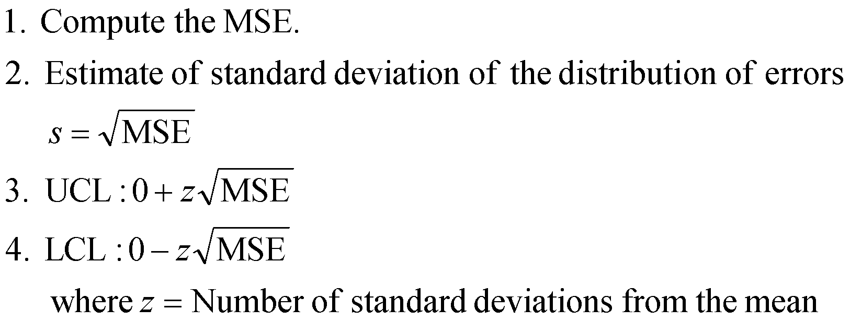
Control Chart Construction
LO 3.15
Copyright ©2018 McGraw-Hill Higher Education. All rights reserved. No reproduction or distribution without the prior written consent of McGraw-Hill Education

Slide 41
Choosing a Forecasting Technique
Factors to consider
Cost
Accuracy
Availability of historical data
Availability of forecasting software
Time needed to gather and analyze data and prepare a forecast
Forecast horizon
LO 3.16
Copyright ©2018 McGraw-Hill Higher Education. All rights reserved. No reproduction or distribution without the prior written consent of McGraw-Hill Education

Slide 42
Operations Strategy
The better forecasts are, the more able organizations will be to take advantage of future opportunities and reduce potential risks
A worthwhile strategy is to work to improve short-term forecasts
Accurate up-to-date information can have a significant effect on forecast accuracy:
Prices
Demand
Other important variables
Reduce the time horizon forecasts have to cover
Sharing forecasts or demand data through the supply chain can improve forecast quality
Copyright ©2018 McGraw-Hill Higher Education. All rights reserved. No reproduction or distribution without the prior written consent of McGraw-Hill Education

